Slide 1
Sweetsei®
Training Deck

Slide 2
Sweetsei®
Training Summary
1
Product Overview
2
Mode of Action
3
Application Information
4
Field Data

Slide 3
Product Overview

Slide 4

Sweetsei®
Biostimulant
Sweetsei is a biostimulant that improves fruit ripening and sizing. Designed with a unique combination of biochemical compounds that influences key plant pathways for ripening, sizing, and color, Sweetsei improves fruit maturation for larger, higher quality fruit and more profitable harvests.

Slide 5



Features & Benefits
Fruit Sizing
Sugar Accumulation
Coloration
Sweetsei positively influences fruit sizing for more marketable and larger fruit.
Sweetsei supports the accumulation and movement of sugars to the fruit for sweeter fruit.
Sweetsei influences pathways responsible for enhanced anthocyanins.

Slide 6
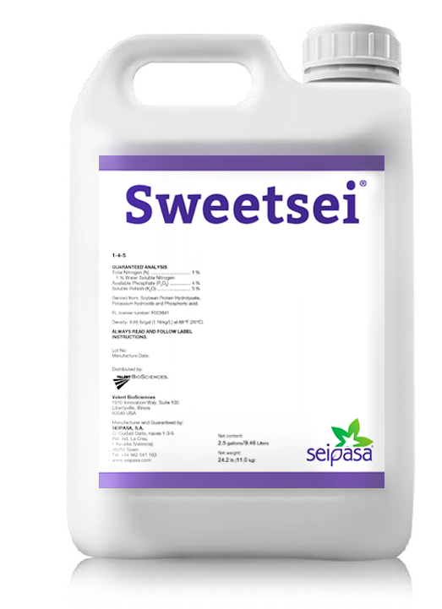
Guaranteed Analysis
Sweetsei
Guaranteed Analysis Total Nitrogen (N)…………………………………….... 1.0% 1% Water Soluble Nitrogen Available Phosphate (P₂O₅)...................................... 4.0% Soluble Potash (K₂O)................................................ 5.0%
Derived from: Soybean hydrolysate, potassium hydroxide, phosphoric acid

Slide 7
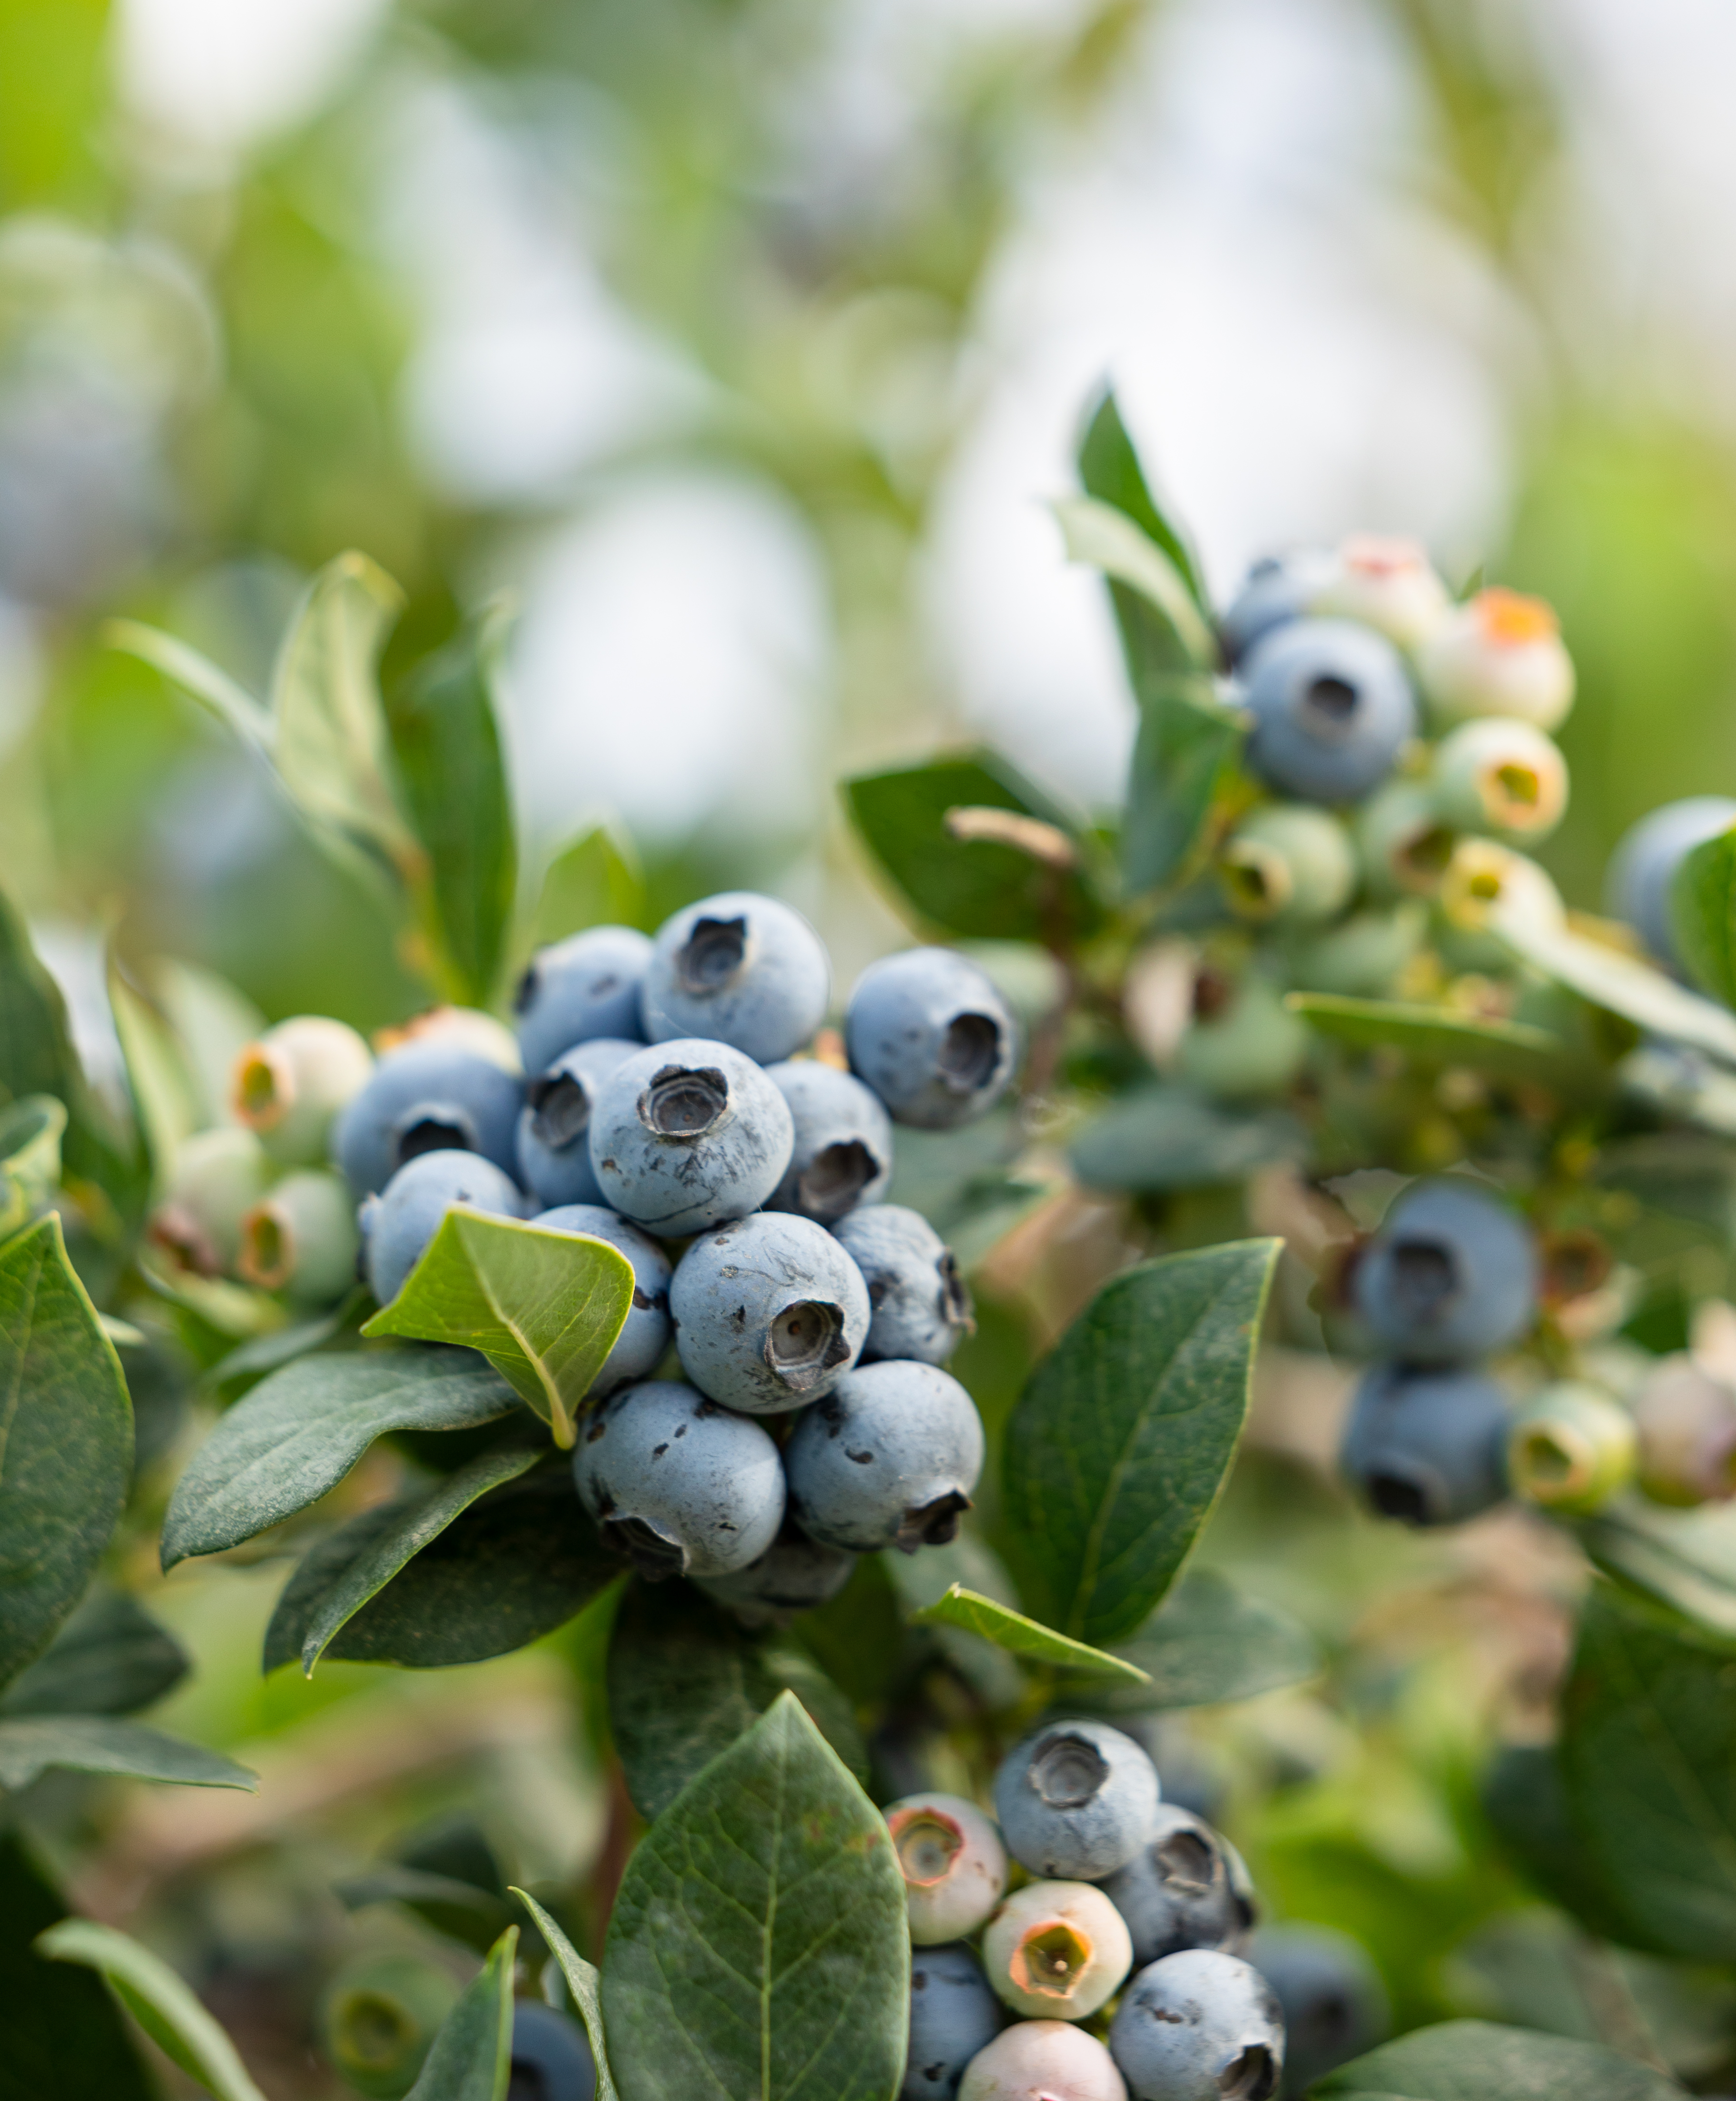
Sweetsei
Formulation | Soluble Liquid
Package Size | 2 x 2.5 Gal
Application | Foliar; Compatible with herbicides, fertilizers, fungicides, and insecticides
Target Crops | Berries, grapes, fruiting vegetables, citrus, cherries
Application Rates | 1-2 qt/ac
Uses | Conventional
Shelf Life | 2 Years

Slide 8
Mode of Action

Slide 9
Sweetsei Mode of Action
Plant Response to Sweetsei
Benefit | How
Methionine | Intermediary of the Yang and Ethylene cycles, which favor a greater synthesis of ethylene for ripening and/or de-greening in fruit crops.
Phenylalanine | Metabolic intermediary of the Shikimic Acid Pathway, responsible for the generation of flavonoids, anthocyanins and tannins, compounds responsible for color.
Polysaccharides | The contribution of this type of sugars favors an increase in Brix degrees in the fruits.
Potassium | Sugar mobilizer, promotes fruit sizing and affects the development of pigments responsible for fruit color, such as anthocyanins.

Slide 10
Sweetsei Mode of Action
Methionine
Methionine is a naturally occurring amino acid, involved in the production of protein.
Methionine is converted to S-adenosyl-methionine (SAM).
SAM is then converted to ACC by the enzyme ACC synthase.
In the plant cell, ACC oxidase converts ACC to ethylene.
Ethylene is a gaseous hormonal compound synthesized in most tissues of higher plants.
Ethylene has several beneficial effects on plants, including accelerating fruit ripening and promoting root growth.
Methionine
SAM synthase
Yang cycle
SAM
ACC
ACC synthase
MTA
ACC oxidase
Ethylene

Slide 11
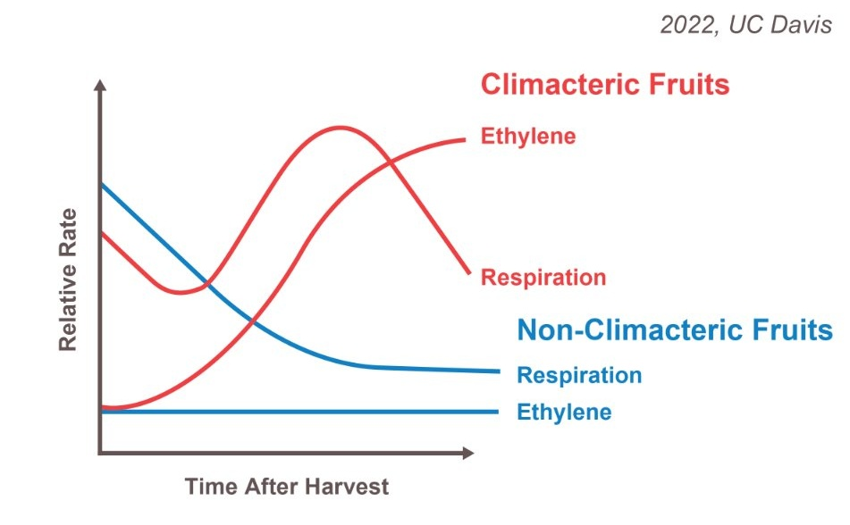
Sweetsei Mode of Action
Plant Hormones & Ripening
Abscisic Acid
Ethylene
Non-climacteric
Climacteric
Fruit ripening exists along a continuum of Abscisic Acid (ABA) and ethylene dependence.
While all fruit respond to both hormones, climacteric fruit rely primarily on ethylene, with ABA acting indirectly.
Non-climacteric fruit are more strongly regulated by ABA but still retain ethylene-dependent ripening traits.
Post Harvest
Climacteric fruit continue to ripen after harvest.
Non-Climacteric fruit may not ripen after harvest.

Slide 12
Sweetsei Mode of Action
Climacteric and Non-Climacteric Crops
Climacteric Fruit
Non-Climacteric Fruit
Ethylene in Climacteric Fruits
In climacteric fruits, ethylene is a primary regulator of ripening, triggering a surge in respiration and other ripening-related processes.
Ethylene in Non-Climacteric Fruits
Non-climacteric fruits do not exhibit a direct ripening response to ethylene. However, they can still respond to ethylene. For example, ethylene can induce certain ripening-related processes, including some aspects of fruit coloration.

Slide 13
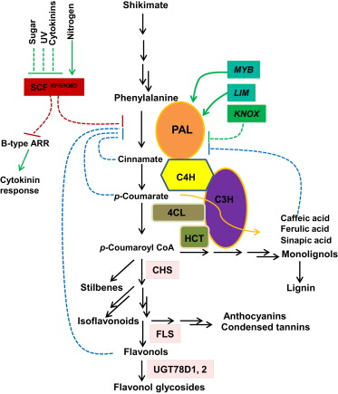
Sweetsei Mode of Action
Phenylalanine
Phenylalanine is a metabolic intermediate of the Shikimic Acid Pathway, a pathway responsible for the generation of anthocyanins and flavonoids.
Phenylalanine is a crucial aromatic amino acid in plants, serving as a building block for proteins and a precursor for a wide array of plant compounds.
Phenylalanine acts as a precursor for the following specialized metabolites:
  Flavonoids: A broad class of natural, plant-based compounds known for various health benefits.
  Anthocyanins: A sub-group of flavonoid pigments responsible for the red, purple, and blue colors in many plants, especially fruits and flowers.
    Anthocyanins are also considered a significant source of antioxidants.
2015, Xuebin Zhang, Chang-Jun Liu

Slide 14
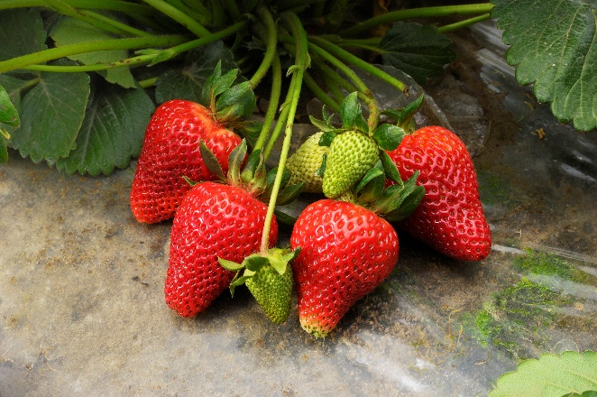
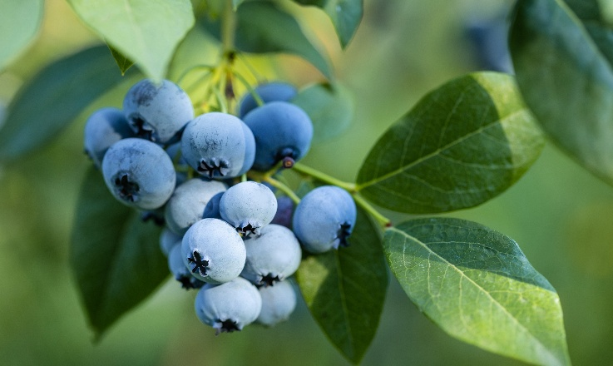
Sweetsei Mode of Action
Polysaccharides
In plants
Polysaccharides offer a range of benefits, including structural support, energy storage, and various biological activities.
Polysaccharides are also known as complex carbohydrates. They are made up of many monosaccharide, or simple sugar, molecules that have linked together through a process called dehydration synthesis.
In fruits & vegetables
Polysaccharides can significantly impact their flavor by influencing the release and perception of volatile flavor compounds.
Additionally,
Other beneficial effects of polysaccharides have been reported on fruits and vegetables; these include extending the shelf-life, maintaining firmness, and reducing weight/mass loss.

Slide 15
Sweetsei Mode of Action
Potassium
Potassium dictates how water and carbohydrates move through a plants vascular system. It is an important nutrient that facilitates robust efficient ripening and sizing.
Phloem Mobility
Sink Strength
Cell Expansion
Potassium ions load sugars into the phloem and drive the osmotic gradient needed to pump them through the plant.
Potassium aids upregulation of sugar transport genes, facilitating strong sink signaling in the fruit.
Potassium movement into the cells of the fruit increases turgor pressure, stretching cell walls.

Slide 16
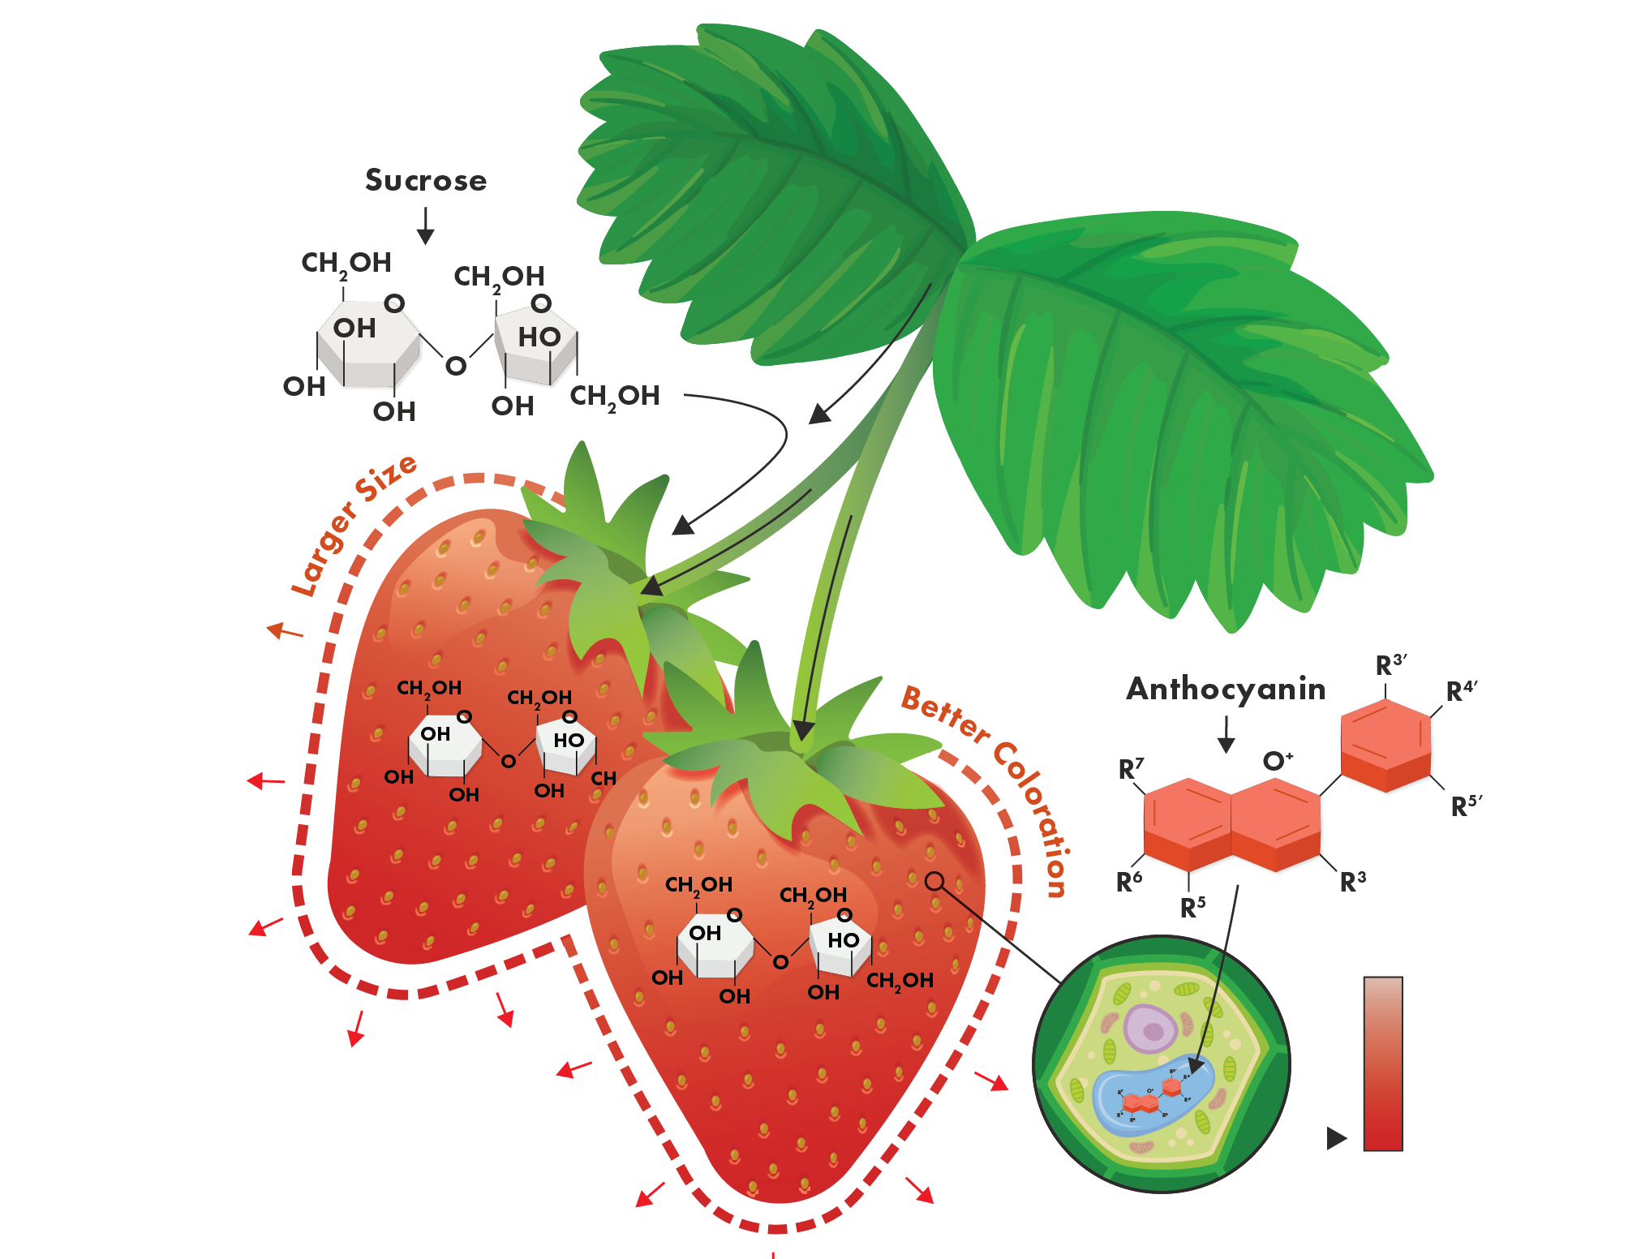
How it Works
Sweetsei supports the movement of sugar to the fruit for greater Brix.
Sweetsei influences plant pathways responsible for anthocyanin accumulation.
Sweetsei supports fruit expansion for larger fruit.

Slide 17
Application Information

Slide 18

General Application Guidelines
Can be utilized with many common fungicides, insecticides, and fertilizers
  A standard jar test is recommended before tank mixing
  Recommended mixing sequence: water, adjuvants, pesticides, Sweetsei, other fertilizers, balance of water while agitating
Avoid extremely high or low pH spray solutions
  Target a spray solution with a pH between 6.0-9.0
If Sweetsei is blended with other products, always mix prior to application
Maintain continuous agitation during application
Use as fine of a spray mist as possible
DO NOT spray in the heat of the day or when the plant is under moisture stress
DO NOT spray to the point of runoff
DO NOT irrigate 3-4 hours after application or apply if rainfall is expected within 3-4 hours

Slide 19
Application Rates & Timing
Crop Type | Use Rate/Acre | Application Timing
Strawberries | 1 qt/ac | Every 7 – 14 days from the beginning of color initiation, reapply as needed
Tomatoes | 2 qt/ac | At the beginning of color initiation
Blueberries | 1 qt/ac | Every 7 – 14 days from the beginning of color initiation, apply 1 – 2 times
Grapes | 2 qt/ac | Apply about 7 days after veraison
Cherries | 2 qt/ac | Apply during the transition from straw-yellow color stage to pink color stage

Slide 20

Registration Status:
Sweetsei
Registered
Not Registered
Registration status is subject to change and may vary by state.

Slide 21
Field Data

Slide 22

Sweetsei on Strawberries
Glades Crop Care | Jupiter, FL | 2024 – 2025
OVERVIEW
CROP | Strawberries
VARIETY | Sensation
DESIGN | Randomized Complete Block
CONCLUSION
Sweetsei was foliar applied in addition to a Grower Standard (GS), on two dates, beginning at the first fully formed fruit and again a week later. Applications were compared to the GS alone.
Strawberry harvest was assessed over four dates and results showed that the addition of Sweetsei increased early harvest yields by an average of 31.9% and increased average fruit size 6.3%.
 | TREATMENT | RATE/ACRE | TIMING
 | Sweetsei | 32 oz/ac | 12/5/2024 12/12/2024
LOCAL WEATHER SUMMARY
October - March
Temperature: 71.3°F
Precipitation:
Total Rainfall – 18.40”
Avg Monthly Rainfall – 3.10”

Slide 23

Sweetsei on Strawberries
Butler Ag Research | Nipomo, CA | 2025
OVERVIEW
CROP | Strawberries
VARIETY | Big Sur
DESIGN | Randomized Complete Block
CONCLUSION
Sweetsei was foliar applied twice, beginning at the first ripe fruit, in addition to the Grower Standard (GS) and compared to the GS alone.
The addition of Sweetsei increased the number of marketable fruit on average 3% over four harvests as compared to the GS. Additionally, Sweetsei improved fruit Brix over the GS.
 | TREATMENT | RATE/ACRE | TIMING
 | Sweetsei | 32 oz/ac | 5/1/2025 5/9/2025
LOCAL WEATHER SUMMARY
January - August
Temperature: 57.9°F
Precipitation:
Total Rainfall – 5.07”
Avg Monthly Rainfall – 0.63”

Slide 24

Sweetsei on Strawberries
Holden Research and Consulting | Camarillo, CA | 2025
OVERVIEW
CROP | Strawberries
VARIETY | Portola
DESIGN | Randomized Complete Block
CONCLUSION
Sweetsei was foliar applied twice, beginning at the first ripe fruit, in addition to the Grower Standard (GS) and compared to the GS alone.
Sweetsei applications, on average, increased fully red fruit 25% across five harvests when compared to the GS.
 | TREATMENT | RATE/ACRE | TIMING
 | Sweetsei | 32 oz/ac | 10/1/2025 10/7/2025
LOCAL WEATHER SUMMARY
October - March
Temperature: 58.5°F
Precipitation:
Total Rainfall – 1.03”
Avg Monthly Rainfall – 6.20”

Slide 25
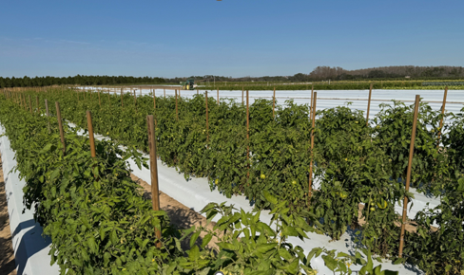
Sweetsei on Fresh Market Tomatoes
Florida Ag Research | Thonotosassa, FL | 2024
OVERVIEW
CROP | Tomatoes
VARIETY | STIM 2255
DESIGN | Randomized Complete Block
CONCLUSION
Sweetsei was drip applied in addition to a Grower Standard (GS) two times, beginning at 12/5/24. Application was compared to the GS alone.
7 days after application, plants treated with Sweetsei had 18.7% more red, marketable fruit compared to the GS.
 | TREATMENT | RATE/ACRE | TIMING
 | Sweetsei | 16 oz/ac | 12/5/2024 12/12/2024
LOCAL WEATHER SUMMARY
January - May
Temperature: 69.6°F
Precipitation:
Total Rainfall – 2.75”
Avg Monthly Rainfall – 13.77”

Slide 26
Sweetsei on Processing Tomatoes
Pacific Ag Research | Five Points, CA | 2025
OVERVIEW
CROP | Processing Tomatoes
VARIETY | SV9023
DESIGN | Randomized Complete Block
CONCLUSION
Sweetsei was soil applied in addition to a Grower Standard (GS), once when 10-20% of the fruit reached breakers to turning stage. Application was compared to the GS alone.
Tomato harvest was completed 8/4/2025 and results showed Sweetsei increased total red fruit 7 tons/ac and reduced breakers and greens.
 | TREATMENT | RATE/ACRE | TIMING
 | Sweetsei | 64 oz/ac | 7/10/2025
LOCAL WEATHER SUMMARY
April – September
Temperature: 74.7°F
Precipitation:
Total Rainfall – 0.12”
Avg Monthly Rainfall – 0.74”

Slide 27
Sweetsei on Processing Tomatoes
Grower Trial | Winters, CA | 2026
OVERVIEW
CROP | Processing Tomatoes
VARIETY | 9034
DESIGN | Split field
CONCLUSION
Sweetsei was soil applied in addition to a Grower Standard (GS), once when 10% of the fruit reached breakers to turning stage. Application was compared to the GS alone.
Tomato harvest was completed 7/15/2026 and results showed Sweetsei increased total red fruit 9.7 tons/ac and reduced greens.
GS + Sweetsei
 | TREATMENT | RATE/ACRE | TIMING
 | Sweetsei | 64 oz/ac | 6/17/2026
LOCAL WEATHER SUMMARY
April – September
Temperature: 72.0°F
Precipitation:
Total Rainfall – 1.50”
Avg Monthly Rainfall – 0.38”
Notes:
7200 plants/acre, 14 inch by 60 inch beds

Slide 28

Sweetsei on Blueberries
Holland Consulting & Research | Alma, GA | 2025
OVERVIEW
CROP | Blueberries
VARIETY | Legacy Southern Highbush
DESIGN | Randomized Complete Block
CONCLUSION
Sweetsei was foliar applied in addition to a Grower Standard (GS), at 15-20% blue fruit. Applications were compared to the GS alone.
15 Days after application of Sweetsei, there was 12% greater blue fruit on the treated plants compared to the GS.
Across three harvests (5/27/25, 6/3/25, 6/12/25), results showed Sweetsei increased total marketable fruit 1,260 lbs./ac over the GS.
 | TREATMENT | RATE/ACRE | TIMING
 | Sweetsei | 32 oz/ac | 5/23/2025
LOCAL WEATHER SUMMARY
May - July
Temperature: 79.9°F
Precipitation:
Total Rainfall – 15.48”
Avg Monthly Rainfall – 5.16”

Slide 29

Sweetsei on Blueberries
Northwest Contract Research | Quincy, WA | 2025
OVERVIEW
CROP | Blueberries
VARIETY | Eliott Northern Highbush
DESIGN | Randomized Complete Block
CONCLUSION
Sweetsei was foliar applied in addition to a Grower Standard (GS), at 15-20% blue fruit. Applications were compared to the GS alone.
15 Days after application of Sweetsei, there was 4% greater blue fruit on the treated plants compared to the GS.
At harvest on 8/7/2025, results showed that the addition of Sweetsei increased total marketable fruit 3.2% over the GS.
 | TREATMENT | RATE/ACRE | TIMING
 | Sweetsei | 32 oz/ac | 7/23/2025
LOCAL WEATHER SUMMARY
April – September
Temperature: 66.5°F
Precipitation:
Total Rainfall – 3.10”
Avg Monthly Rainfall – 0.52”

Slide 30
Sweetsei on Blueberries
Grower Trial | Winter Haven, FL | 2026
OVERVIEW
CROP | Blueberries
VARIETY | Sharper
DESIGN | Split field
CONCLUSION
Sweetsei was soil applied in addition to a Grower Standard (GS). Application was compared to the GS alone.
Blueberries harvest was completed 5/6/2026 and results showed Sweetsei increased berry weight 18% compared to the GS.
GS + Sweetsei
 | TREATMENT | RATE/ACRE | TIMING
 | Sweetsei | 64 oz/ac | 15-20% blue fruit
LOCAL WEATHER SUMMARY
January - May
Temperature: 72.0°F
Precipitation:
Total Rainfall – 3.0”
Avg Monthly Rainfall – 15.0”

Slide 31
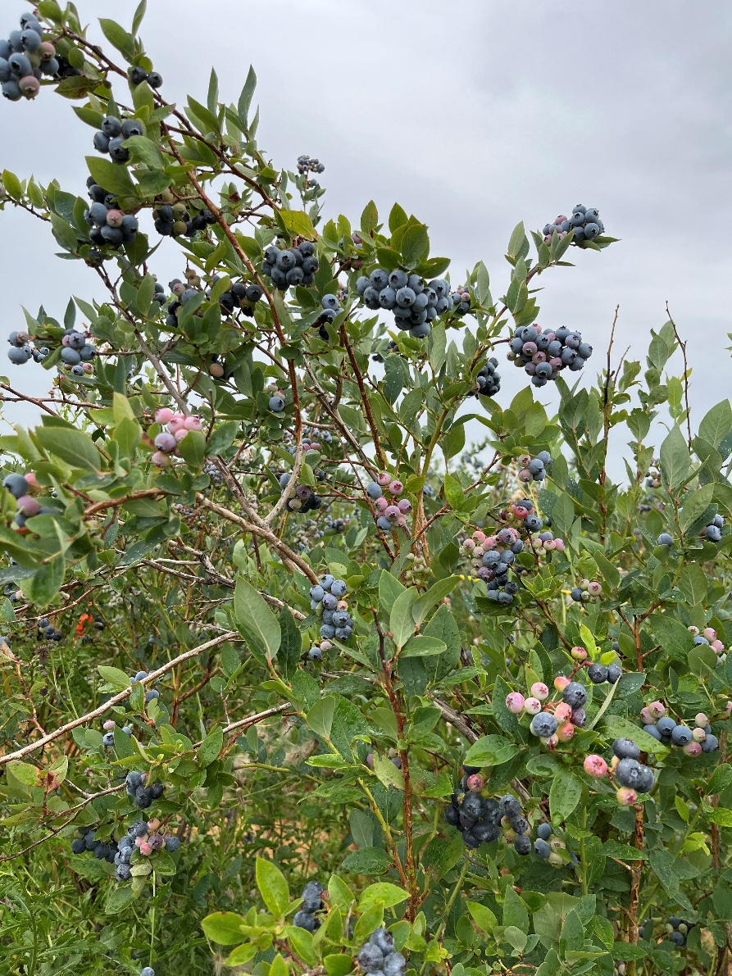
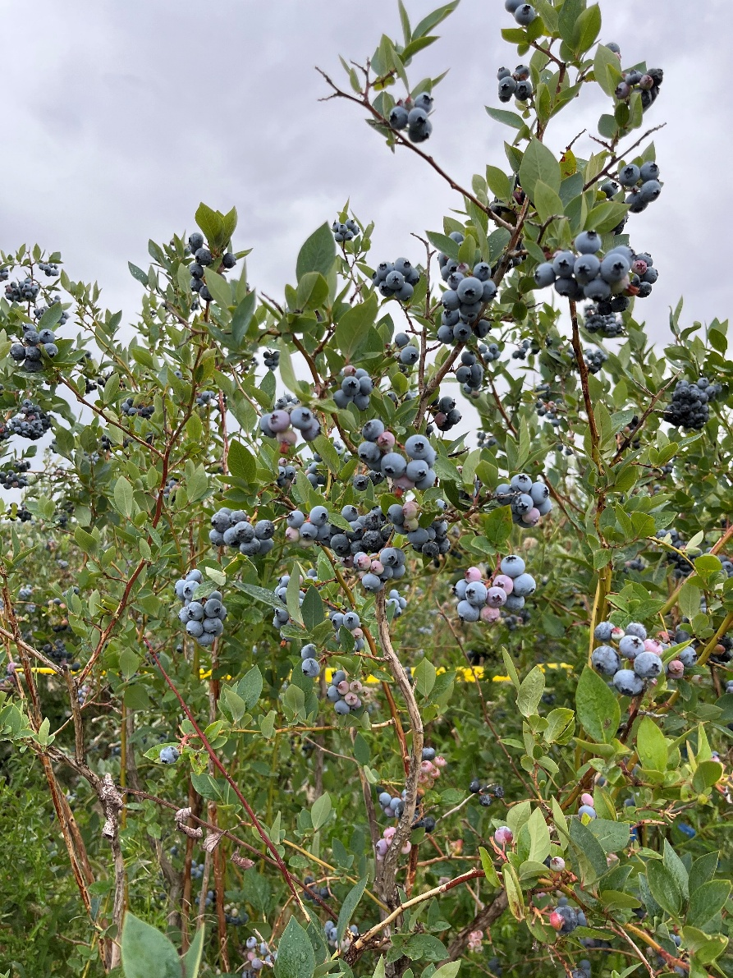
Sweetsei on Blueberries
Grower Standard
Sweetsei
8/6/2025
14 DAA

Slide 32
Sweetsei on Grapes
Lang Research & Consulting | Dinuba, CA | 2025
OVERVIEW
CROP | Table Grapes
VARIETY | Flame Seedless
DESIGN | Randomized Complete Block
CONCLUSION
Sweetsei was foliar applied, in addition to a Grower Standard (GS), 7-days after veraison. Applications were compared to the GS alone. Treatments applied with a 90% Non-Ionic Surfactant at 0.125% v/v.
35 Days after treatment (DAT) of Sweetsei, there was 12% greater fruit coloration on the treated plants compared to the GS.
The addition of Sweetsei also increased Brix 8% over the GS 21-days after treatment and at harvests yields were 2.5% greater than the GS.
GS
GS + Sweetsei
GS
GS + Sweetsei
 | TREATMENT | RATE/ACRE | TIMING
 | Sweetsei | 64 oz/ac | 6/23/2025
LOCAL WEATHER SUMMARY
July - October
Temperature: 79.0°F
Precipitation:
Total Rainfall – 1.00”
Avg Monthly Rainfall – 0.25”

Slide 33
Sweetsei on Cherries
Bisabri Ag Research | Crows Landing, CA | 2026
OVERVIEW
CROP | Cherries
VARIETY | Royal Hazel
DESIGN | Randomized complete block
GS
GS + Sweetsei
CONCLUSION
Sweetsei was foliar applied in addition to a Grower Standard (GS). Application was compared to the GS alone.
Cherry were harvested twice (4/23/26, 5/1/26). When compared to the GS, Sweetsei increased Brix 5%, burgundy fruit 24%, and shifted more yield to the first harvest, resulting in an additional $2,000 in revenue per acre.
GS
GS + Sweetsei
GS
GS + Sweetsei
Burgundy
 | TREATMENT | RATE/ACRE | TIMING
 | Sweetsei | 64 oz/ac | 4/8/2026
LOCAL WEATHER SUMMARY
April – June
Temperature: 66.0°F
Precipitation:
Total Rainfall – 1.40”
Avg Monthly Rainfall – 0.47”

Slide 34
Contains biochemical matrix to drive a fruit ripening and sizing response.
Right time, right place application improves:
  Fruit sizing
  Sugar accumulation
  Coloration
Fruit Sizing
Sugar Accumulation
Coloration

