Slide 1
SuperSede® Soybean
Training Deck

Slide 2
SuperSede® Soybean
Training Summary
1
Product Overview
2
Mode of Action
3
Application Information
4
Field Data

Slide 3
Product Overview

Slide 4

SuperSede® Soybean
Biostimulant
SuperSede Soybean is a seed treatment powered by our Transit® biostimulant and includes key soybean nutrition that increases germination and supports early root growth for uniformity and establishment. SuperSede also supports increased nodulation for improved nitrogen fixation.​

Slide 5



Features & Benefits
SuperSede Soybean
Better Germination
Enhanced Root Growth & Nodulation
Key Nutrition
SuperSede Soybean improves germination rate for better plant uniformity and stand count.
Amplify early root growth and nodulation development for improved nitrogen fixation.
Formulated with key nutrients to further aid seedling growth.

Slide 6
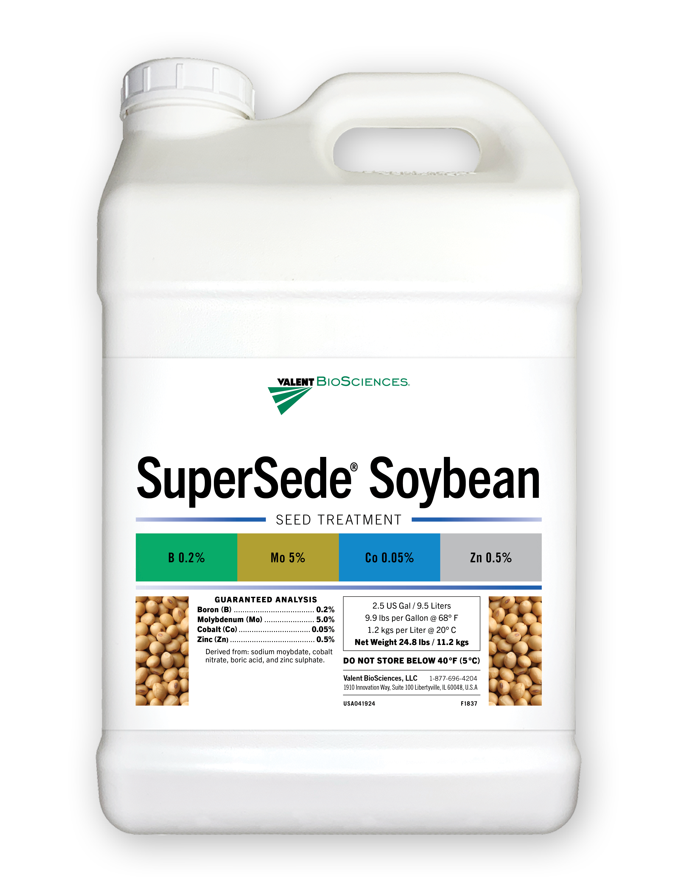

Key Nutrition
SuperSede Soybean
Guaranteed Analysis: Boron (B) ............................................................. 0.2% Cobalt (Co) ........................................................ 0.05% Molybdenum (Mo) ............................................... 5.0% Zinc (Zn) .............................................................. 0.5% 0.5% Water Soluble Zinc
Derived from: sodium molybdate, cobalt nitrate, boric acid, and zinc sulfate.

Slide 7
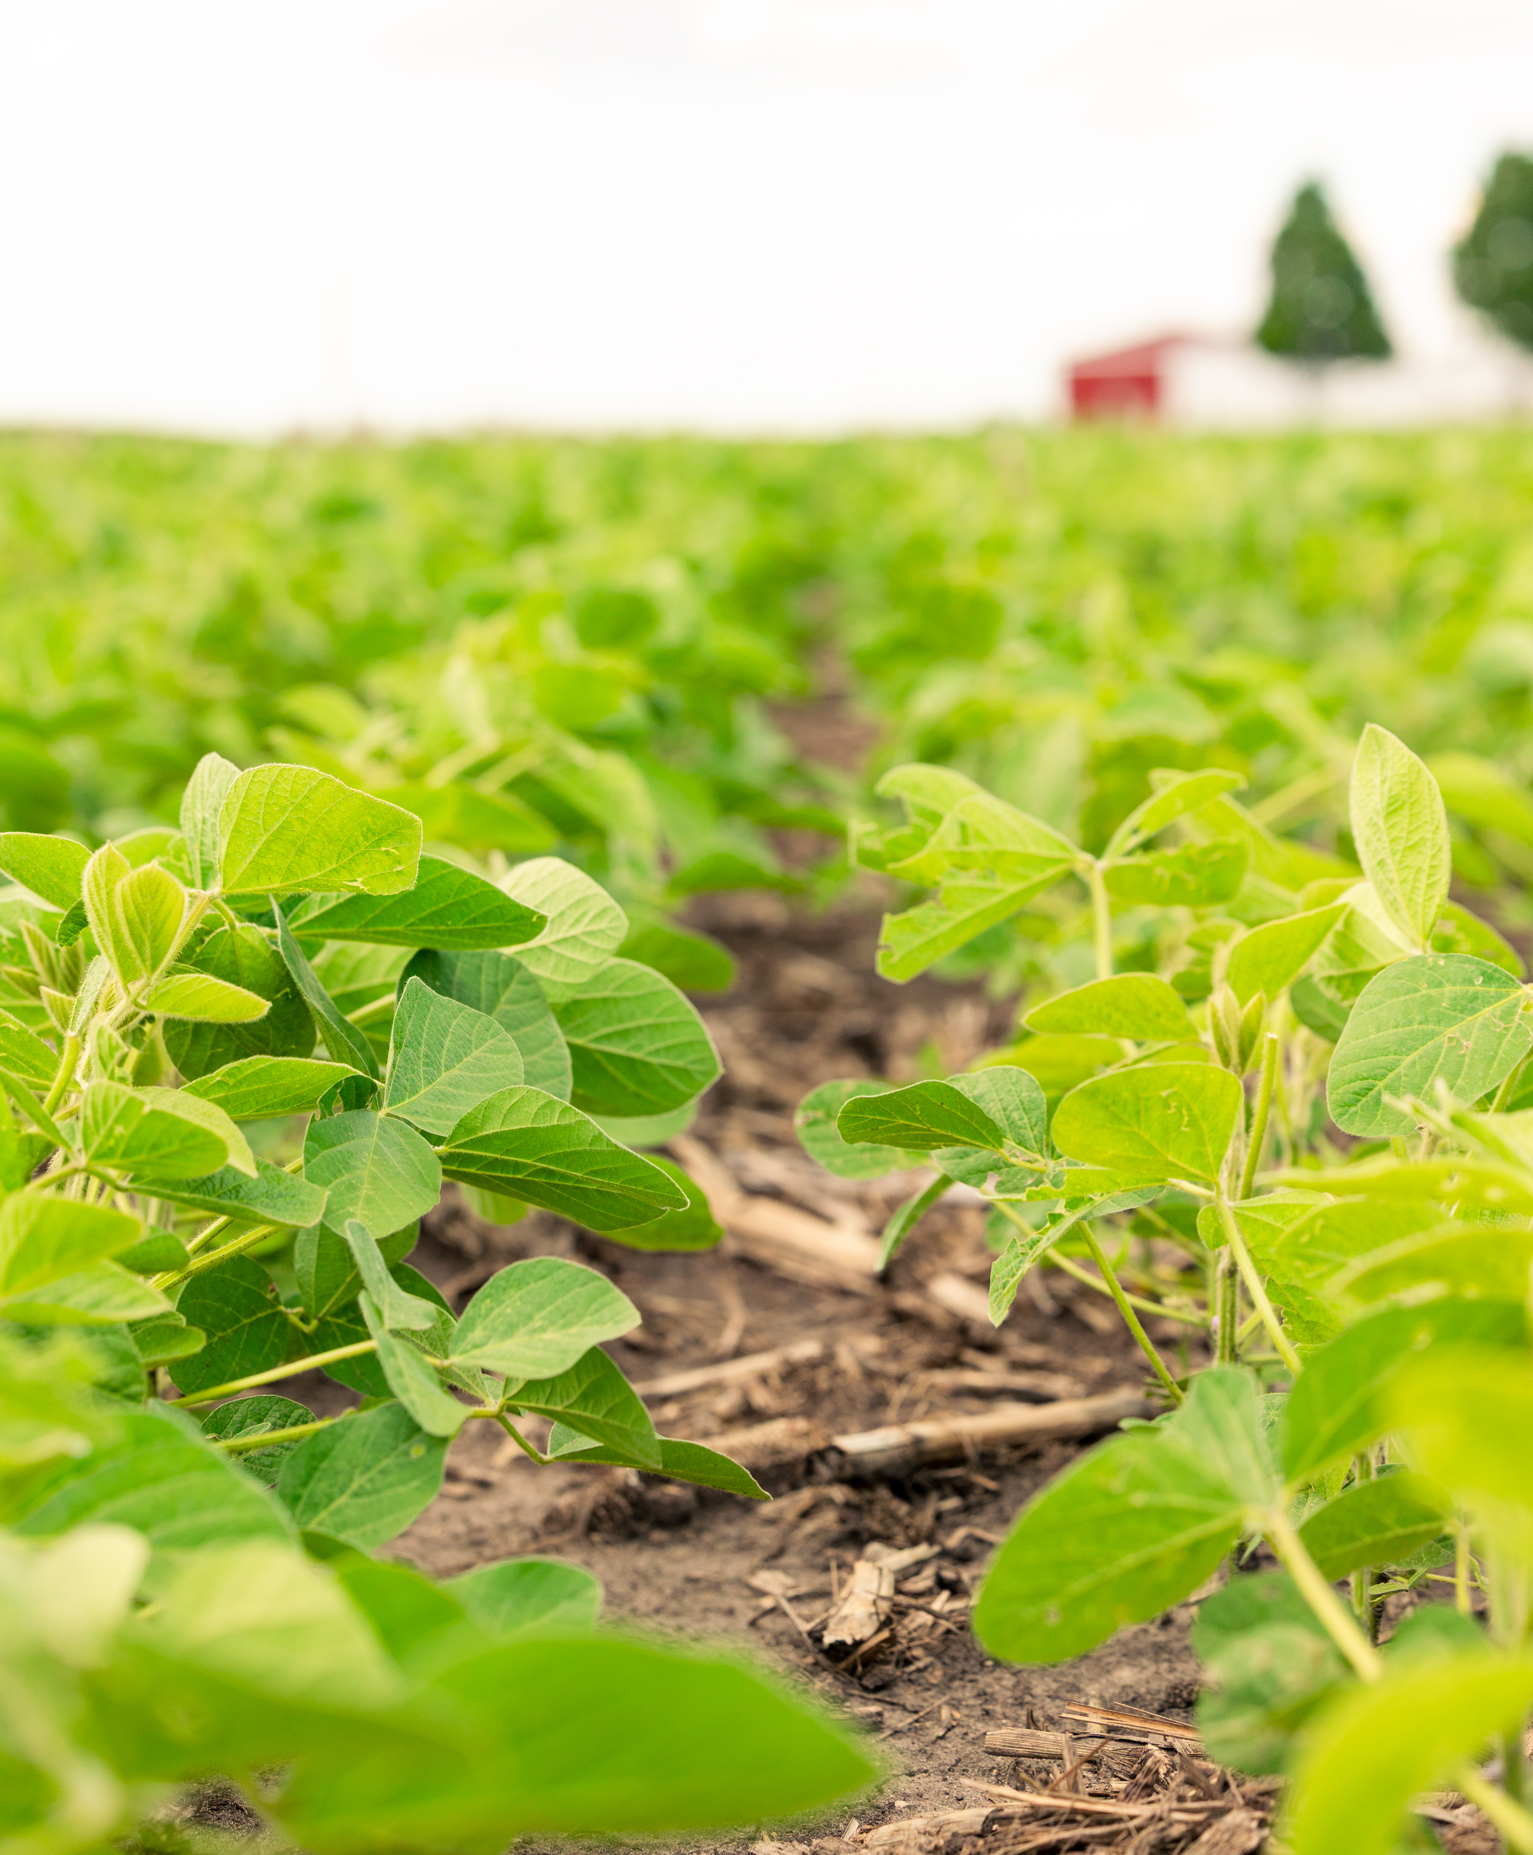
SuperSede Soybean
Formulation | Soluble Liquid
Package Size | 4 x 1 Gal, 2 x 2.5 Gal
Application | Seed treatment; Compatible with fertilizers, fungicides, and insecticides
Target Crops | Soybeans
Application Rates | 1.0 fl oz per 50 Lbs
Uses | Conventional
Shelf Life | 2 Years

Slide 8
Mode of Action

Slide 9

What is Transit?
Unique highly bioactive compound
Targeted mixture of thousands of bioactive compounds.
Transit is the result of a proprietary extraction method that uses early-stage biomass.
It contains natural, biologically active, and diverse functional groups.
Bioactive compounds in Transit have high oxygen to carbon ratios to enhance biological activity in plants.
Humic substances
Humins
B vitamins
Fulvic acids
Acids
Inorganic salts
Proteins
Amino acids
Other organic acids
Mycorrhizae, Trichoderma, other beneficial fungi
Protein hydrolysates
Fatty acids/lipids
Beneficial elements (Si, Na, Co, etc.)
Other
PGPRs
Cytokinins
Microbials
Nitrogenous
compounds
Polyamines
Peptides
Rhizobium
Phosphites
Betaines
Polyphenols
Complex communities/
consortia
Enzymatic extracts
Chitin/ chitosan
Seaweed/kelp
Phytohormones
Extracts
Laminarin, alginates, other polysaccharides
Other organic matters extracts
Botanicals
Allelochemicals

Slide 10
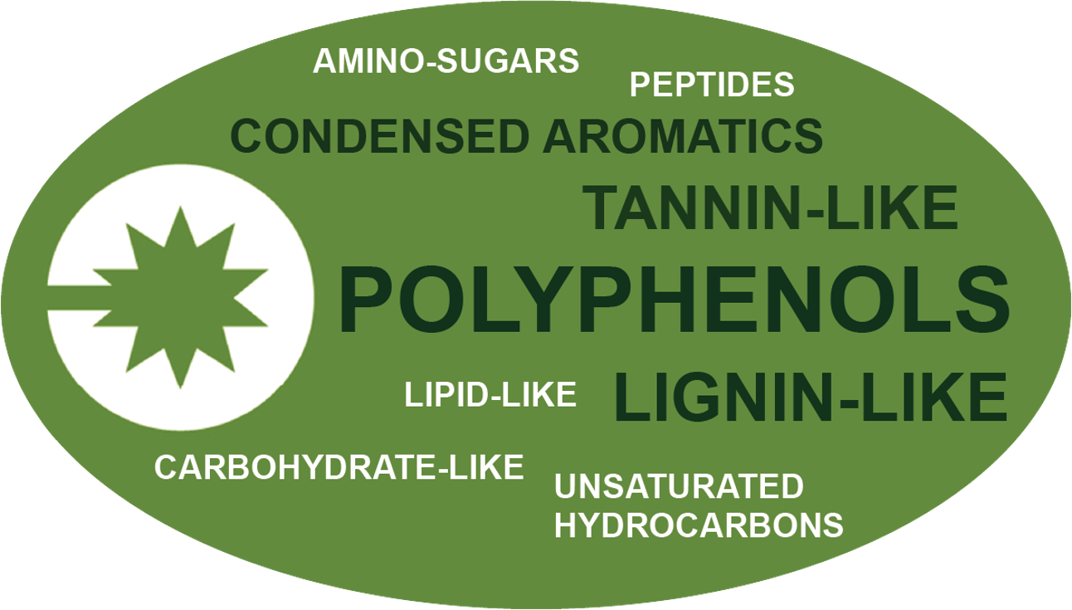
Transit Technology
What is it made of?
Key, diverse functional groups that are biologically active in plants

Slide 11
Transit Biostimulant Mode of Action
Transit technology acts systemically in the plant
Application of Transit at different plant physiological stages influences UP and DOWN regulation of various plant pathways. The result is different plant responses and different benefits
Process | Genetic Response | Expressed Response
Gibberellin catabolizing genes e.g. GmGA2ox | DOWN REGULATION | Increases seed germination Plant growth promotion
Auxin transporter genes e.g. GmLAX (AUX1/LAX) | UP REGULATION | Root growth stimulation Promotes photosynthetic activity
Cytokinin degrading enzymes e.g. GmCKX3 | DOWN REGULATION | Promotes cell division Inhibits chlorophyll breakdown
Proteins that bind Ca, Zn, & Fe e.g. Calmodulin, Zinc-finger proteins, Ferritin | DOWN REGULATION | Increases nutrient availability & mobility within the plant

Slide 12
Transit® Mode of Action
Plant Response to Transit
Benefit | How
Improved Plant Establishment | Down-regulation of catabolizing genes drives increased germination and amplifies root growth for better stand establishment.
Improved Nutrient Mobility | Down-regulation of binding proteins to improve nutrient translocation of non-mobile nutrients.

Slide 13

How it Works
Nutrition enhances biostimulant effects
SuperSede Soybean maximizes effects by directly supporting growth with key nutrition.
SuperSede Soybean supports uniform germination rate for stand uniformity.
SuperSede Soybean aids nodulation development for improved nitrogen assimilation.

Slide 14
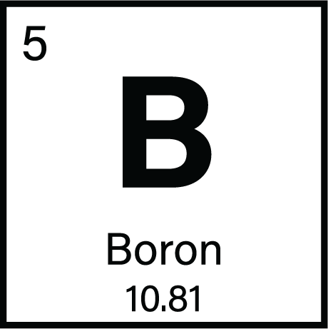
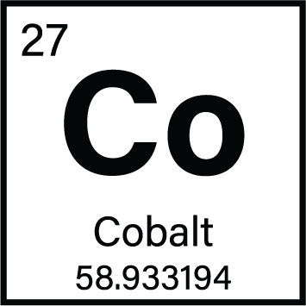

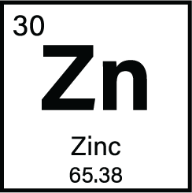
Key Nutrition
Boron supports cell division for robust early growth.
Cobalt supports the nitrogen fixation function of associated rhizobia.
Molybdenum aids nitrogen metabolism for enhanced nutrient use efficiency.
Zinc facilitates auxin signaling and enzyme activation during emergence.

Slide 15
Application Information

Slide 16

General Application Guidelines
Apply using seed treatment application equipment with sufficient liquid to ensure even coverage.
Shake bottle of SuperSede Soybean well before use.
DO NOT use treated seed for food, feed, or oil.
Can be utilized with common fungicides and insecticides.
Compatibility: Conduct a standard jar test prior to mixing a slurry.
Recommended mixing order: water, polymers, pesticides, SuperSede Soybean, fertilizers, then remaining water.
Effects on the plant last up to 3 weeks.
Does not impact soybean rhizobia.

Slide 17
Application Rates & Timing
Crop Type | Use Rate | Application Timing
Soybean | 1.0 fl oz per 50 Lbs of seed | Seed Treatment

Slide 18

Registration Status:
SuperSede Soybean
Registered
Not Registered
Registration status is subject to change and may vary by state.

Slide 19
Application, Seed Safety & Stewardship

Slide 20

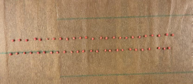
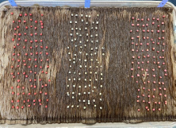

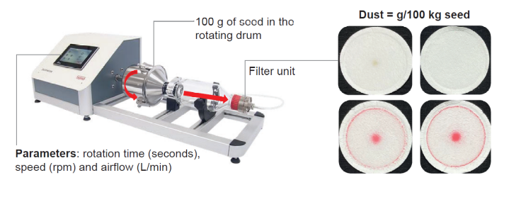
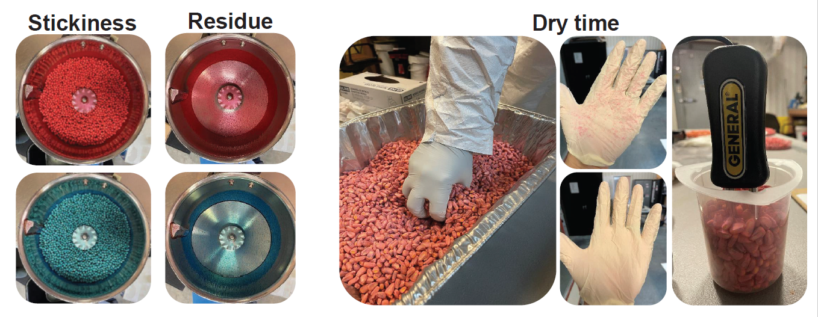
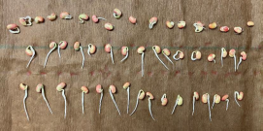
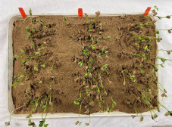
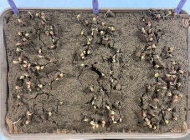
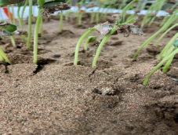
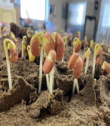
SuperSede Soybean
Along with field efficacy data our seed treatment goes through a host of additional tests:
Application
Seed Safety
Stewardship
Consistent & uniform product coverage and adhesion in a wide range of conditions.
Enduring treatments don’t adversely affect seed germination and vigor.
Minimizing potential adverse effects on people and the environment.
Paper Towel Test
Sand Test
Cold Test
Dust-off

Slide 21
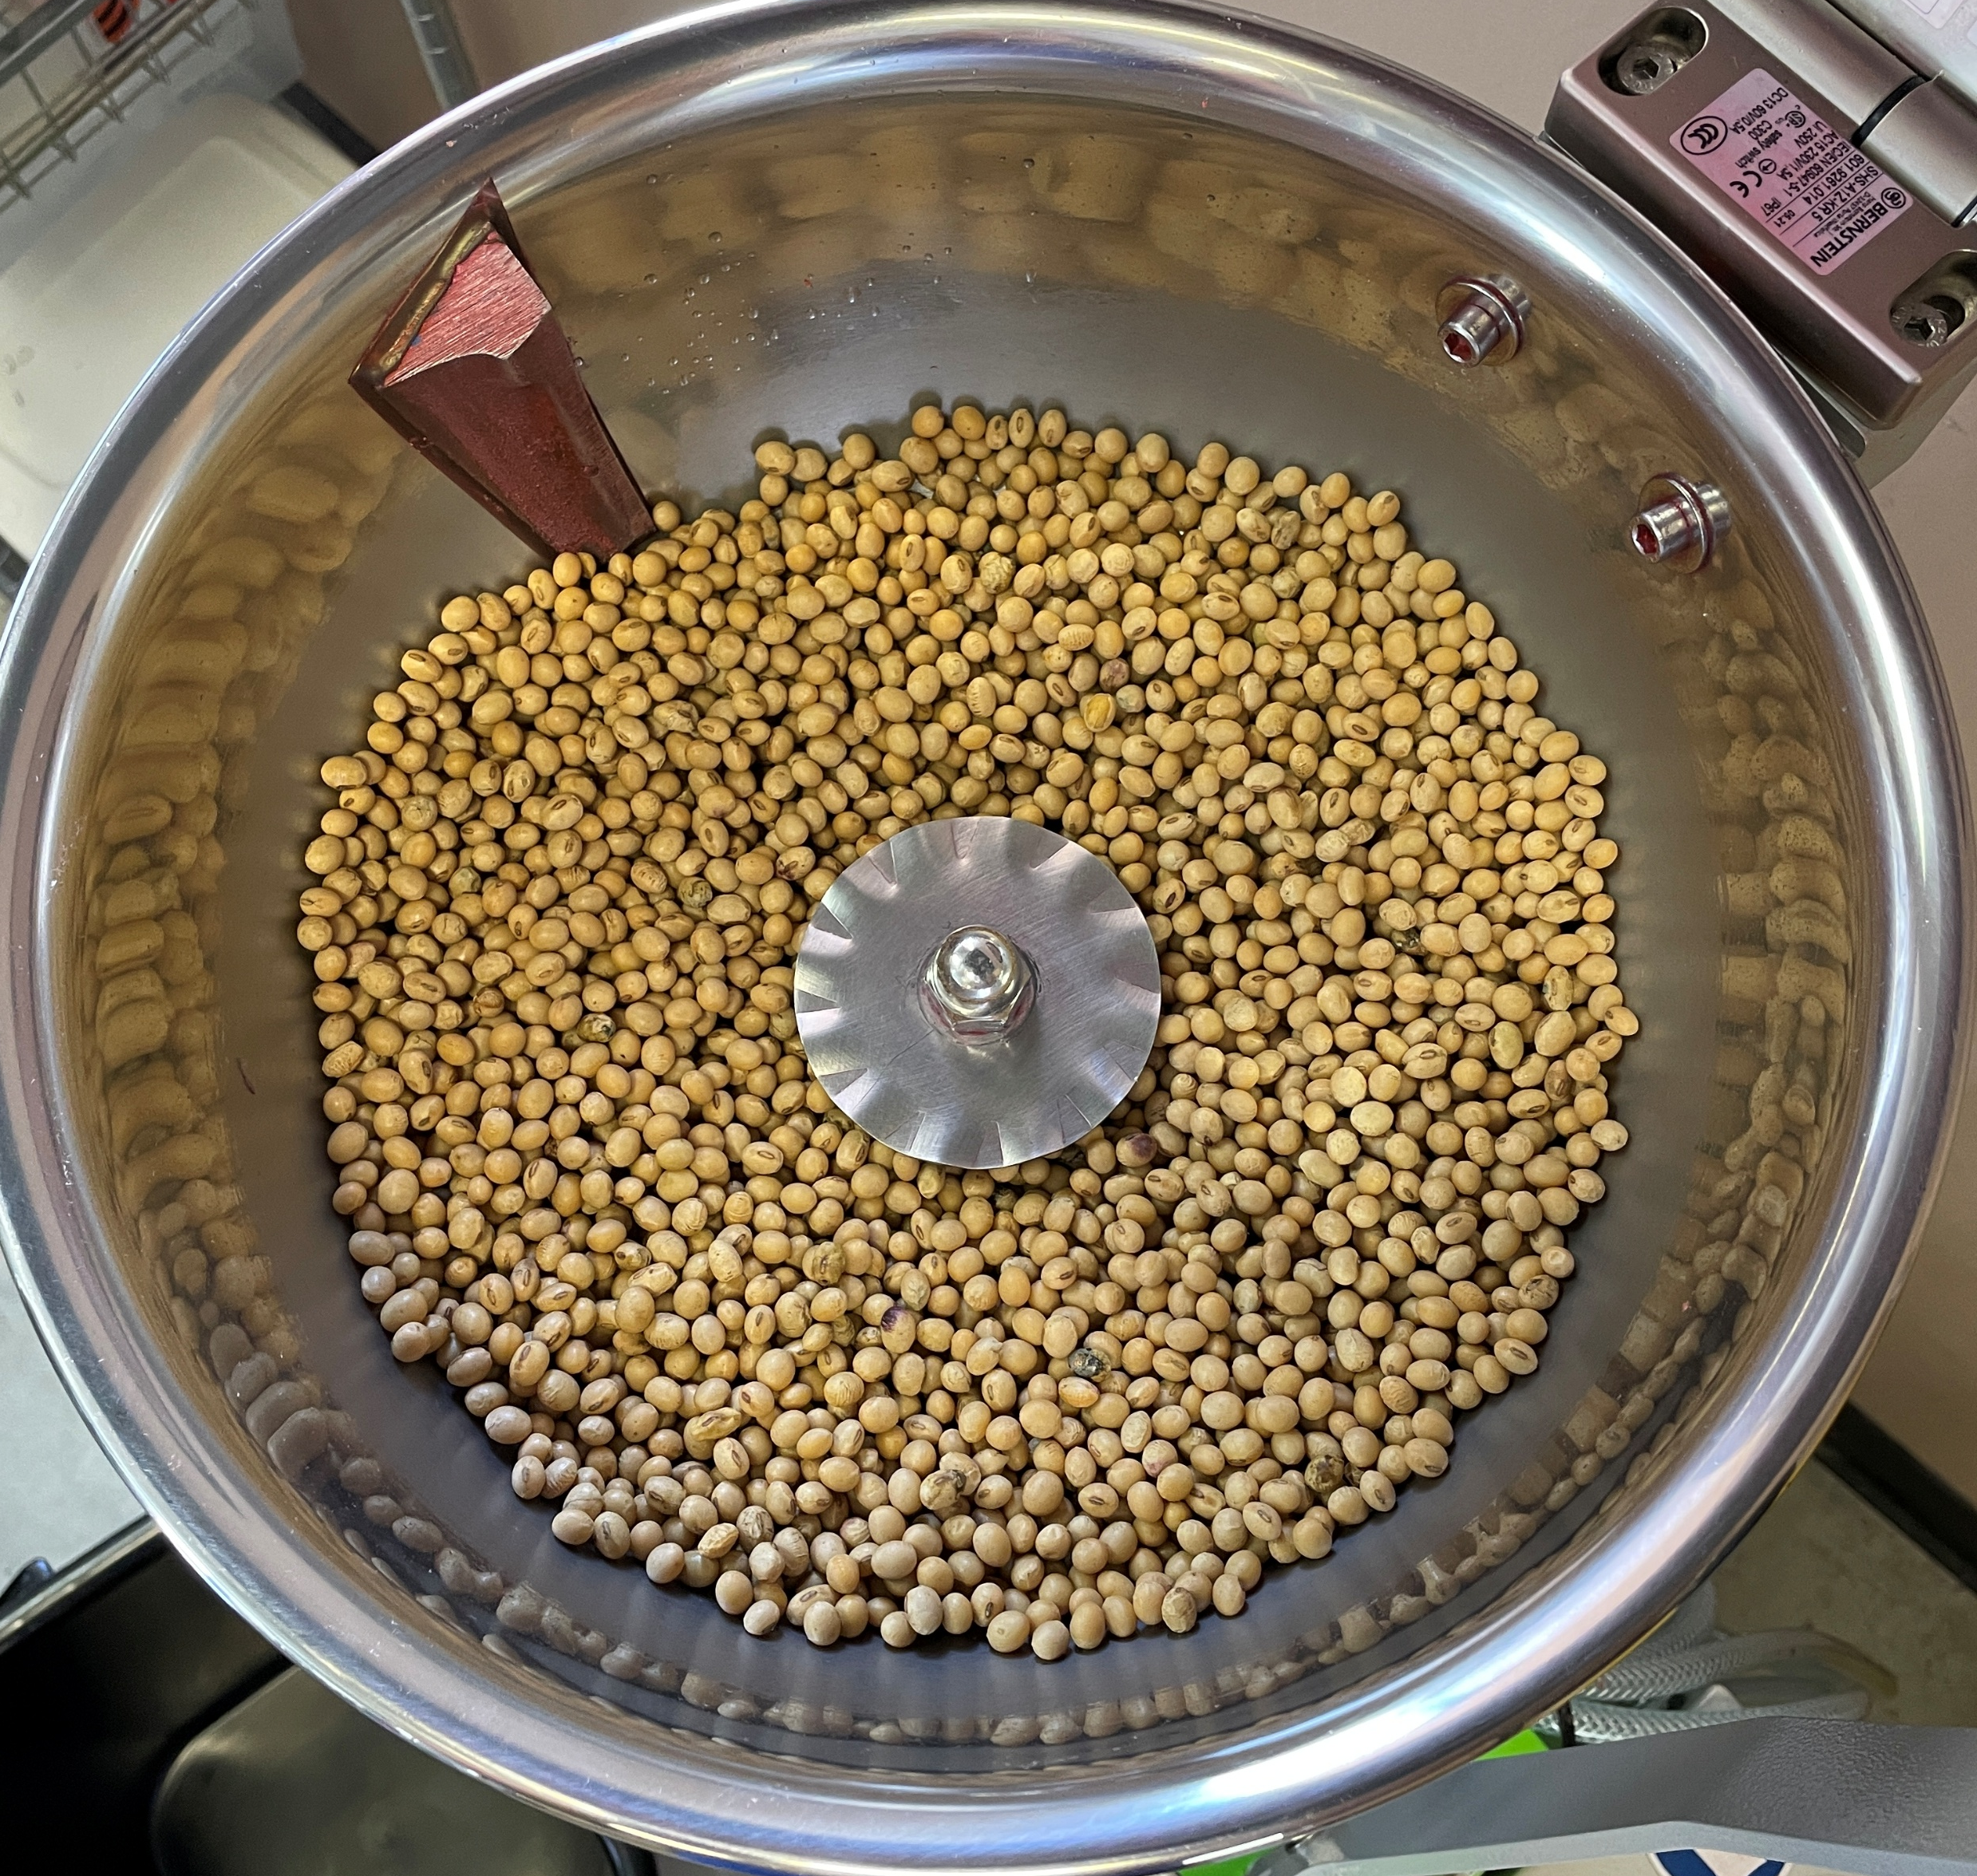
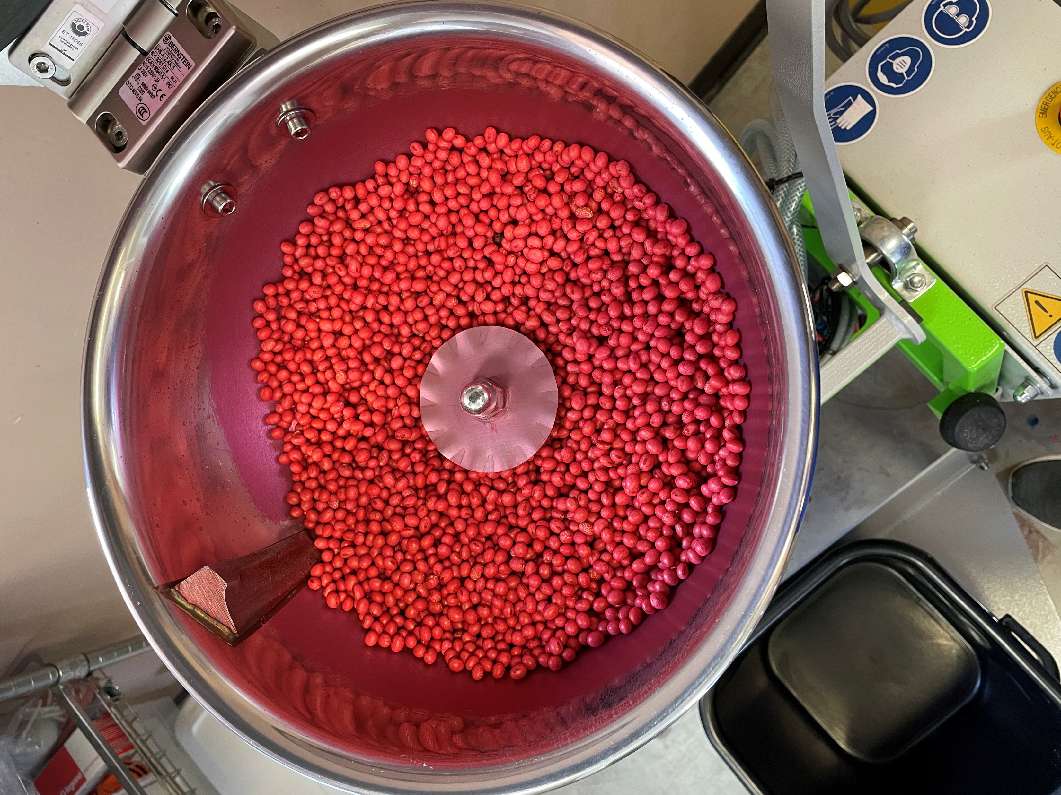
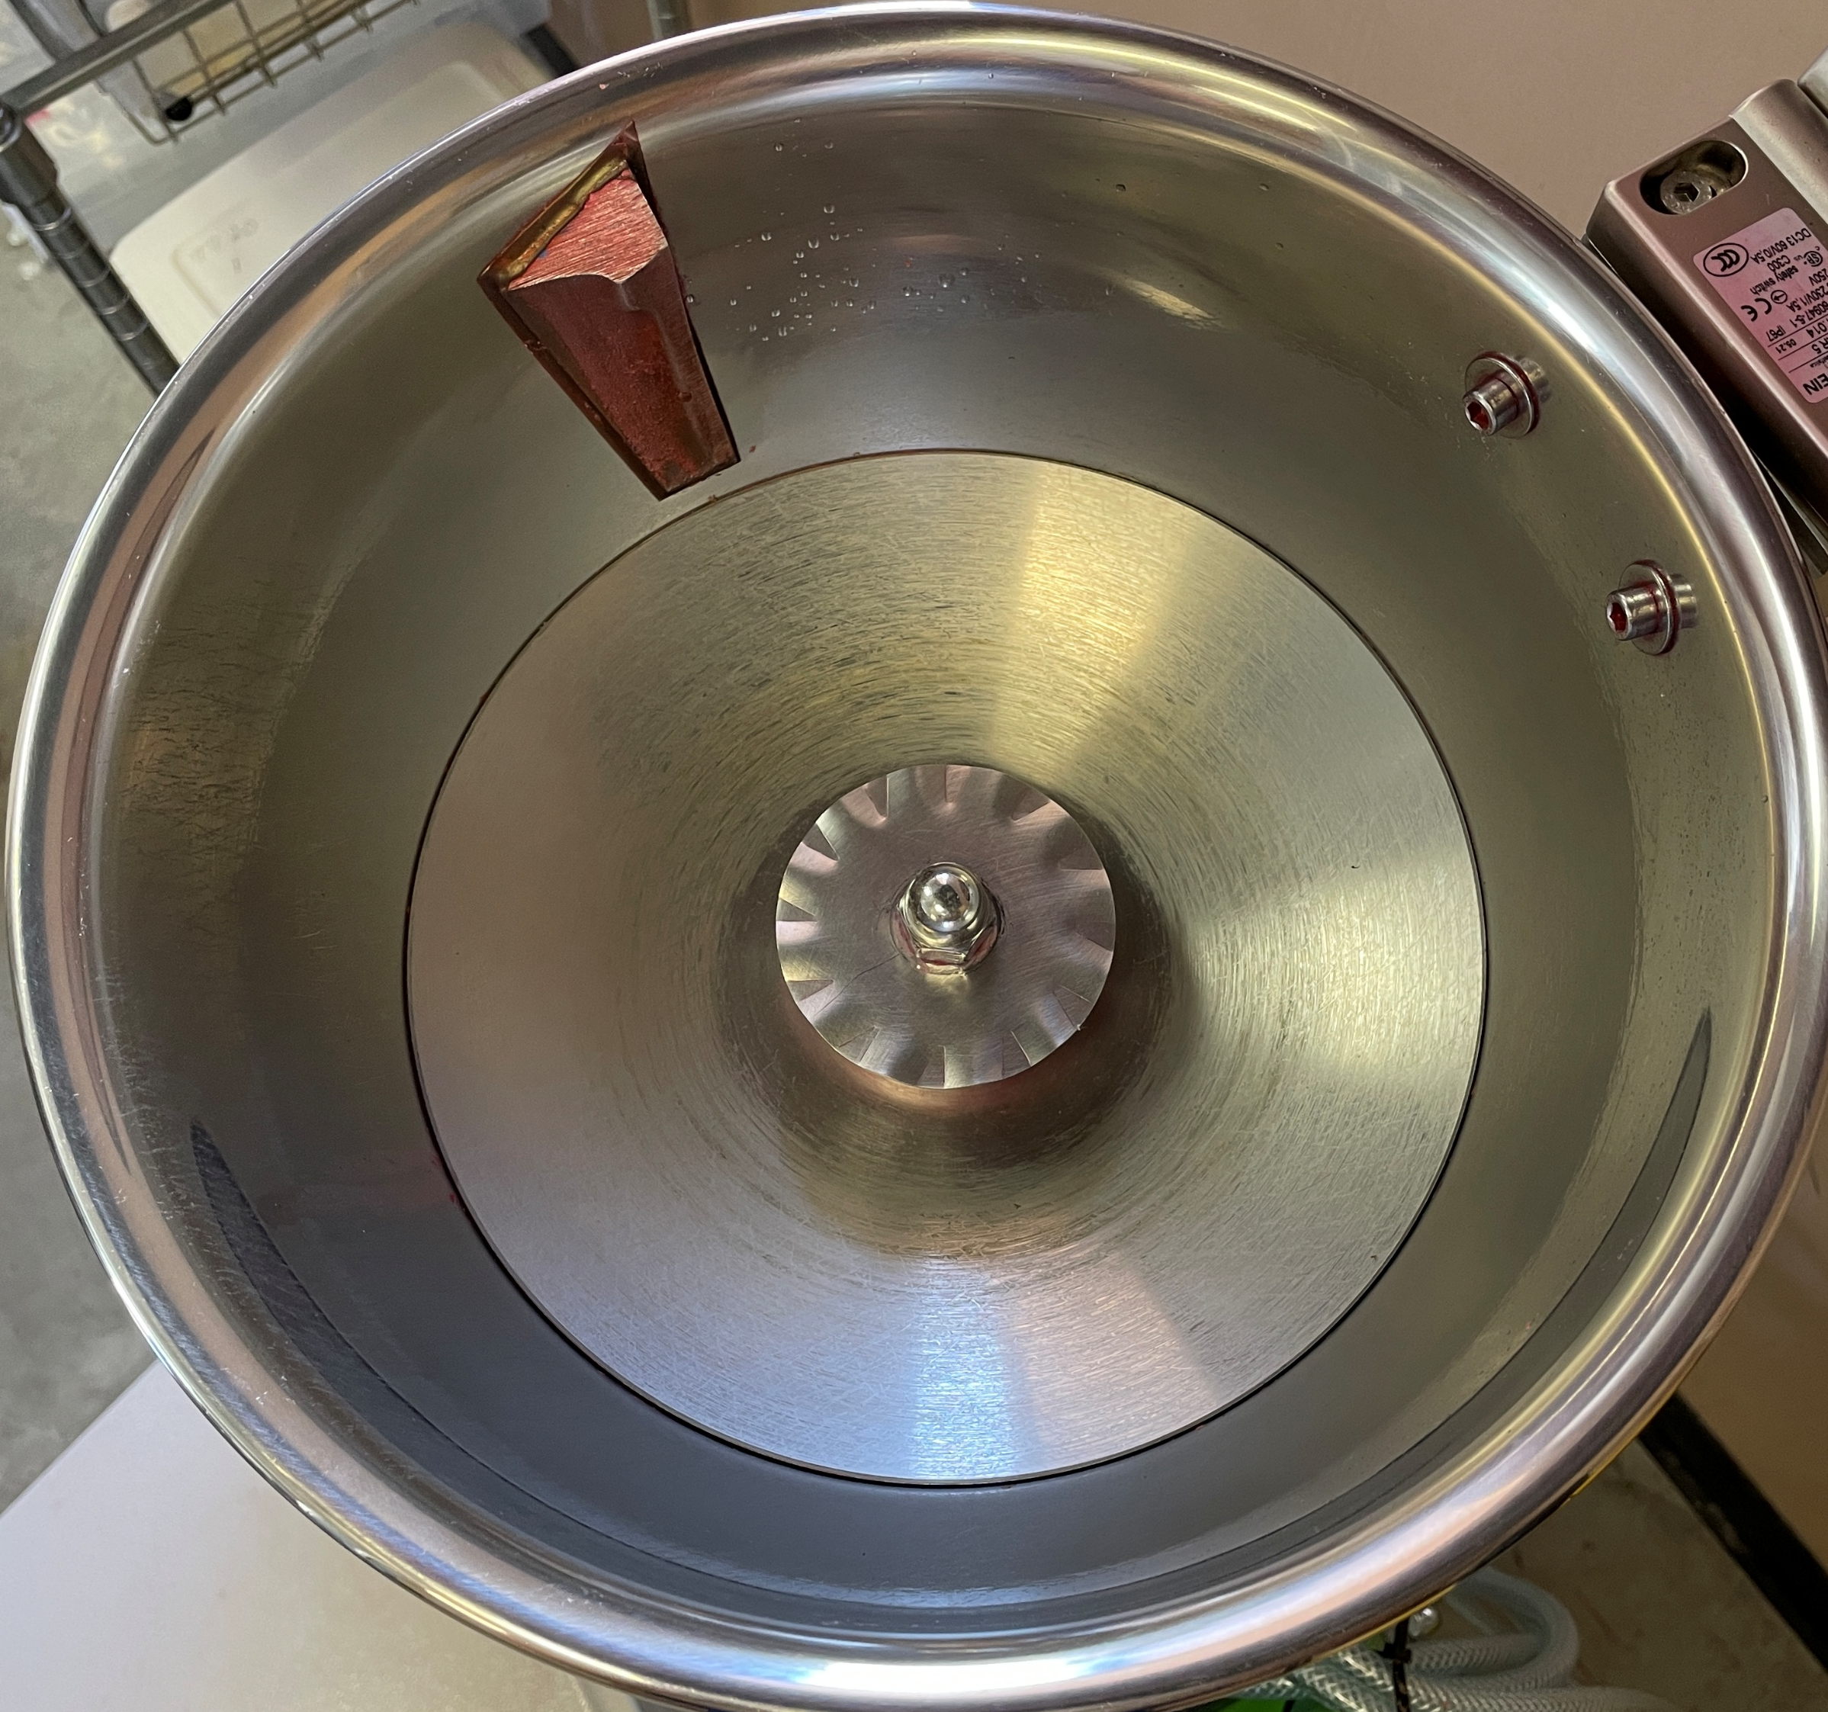
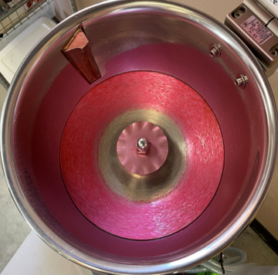
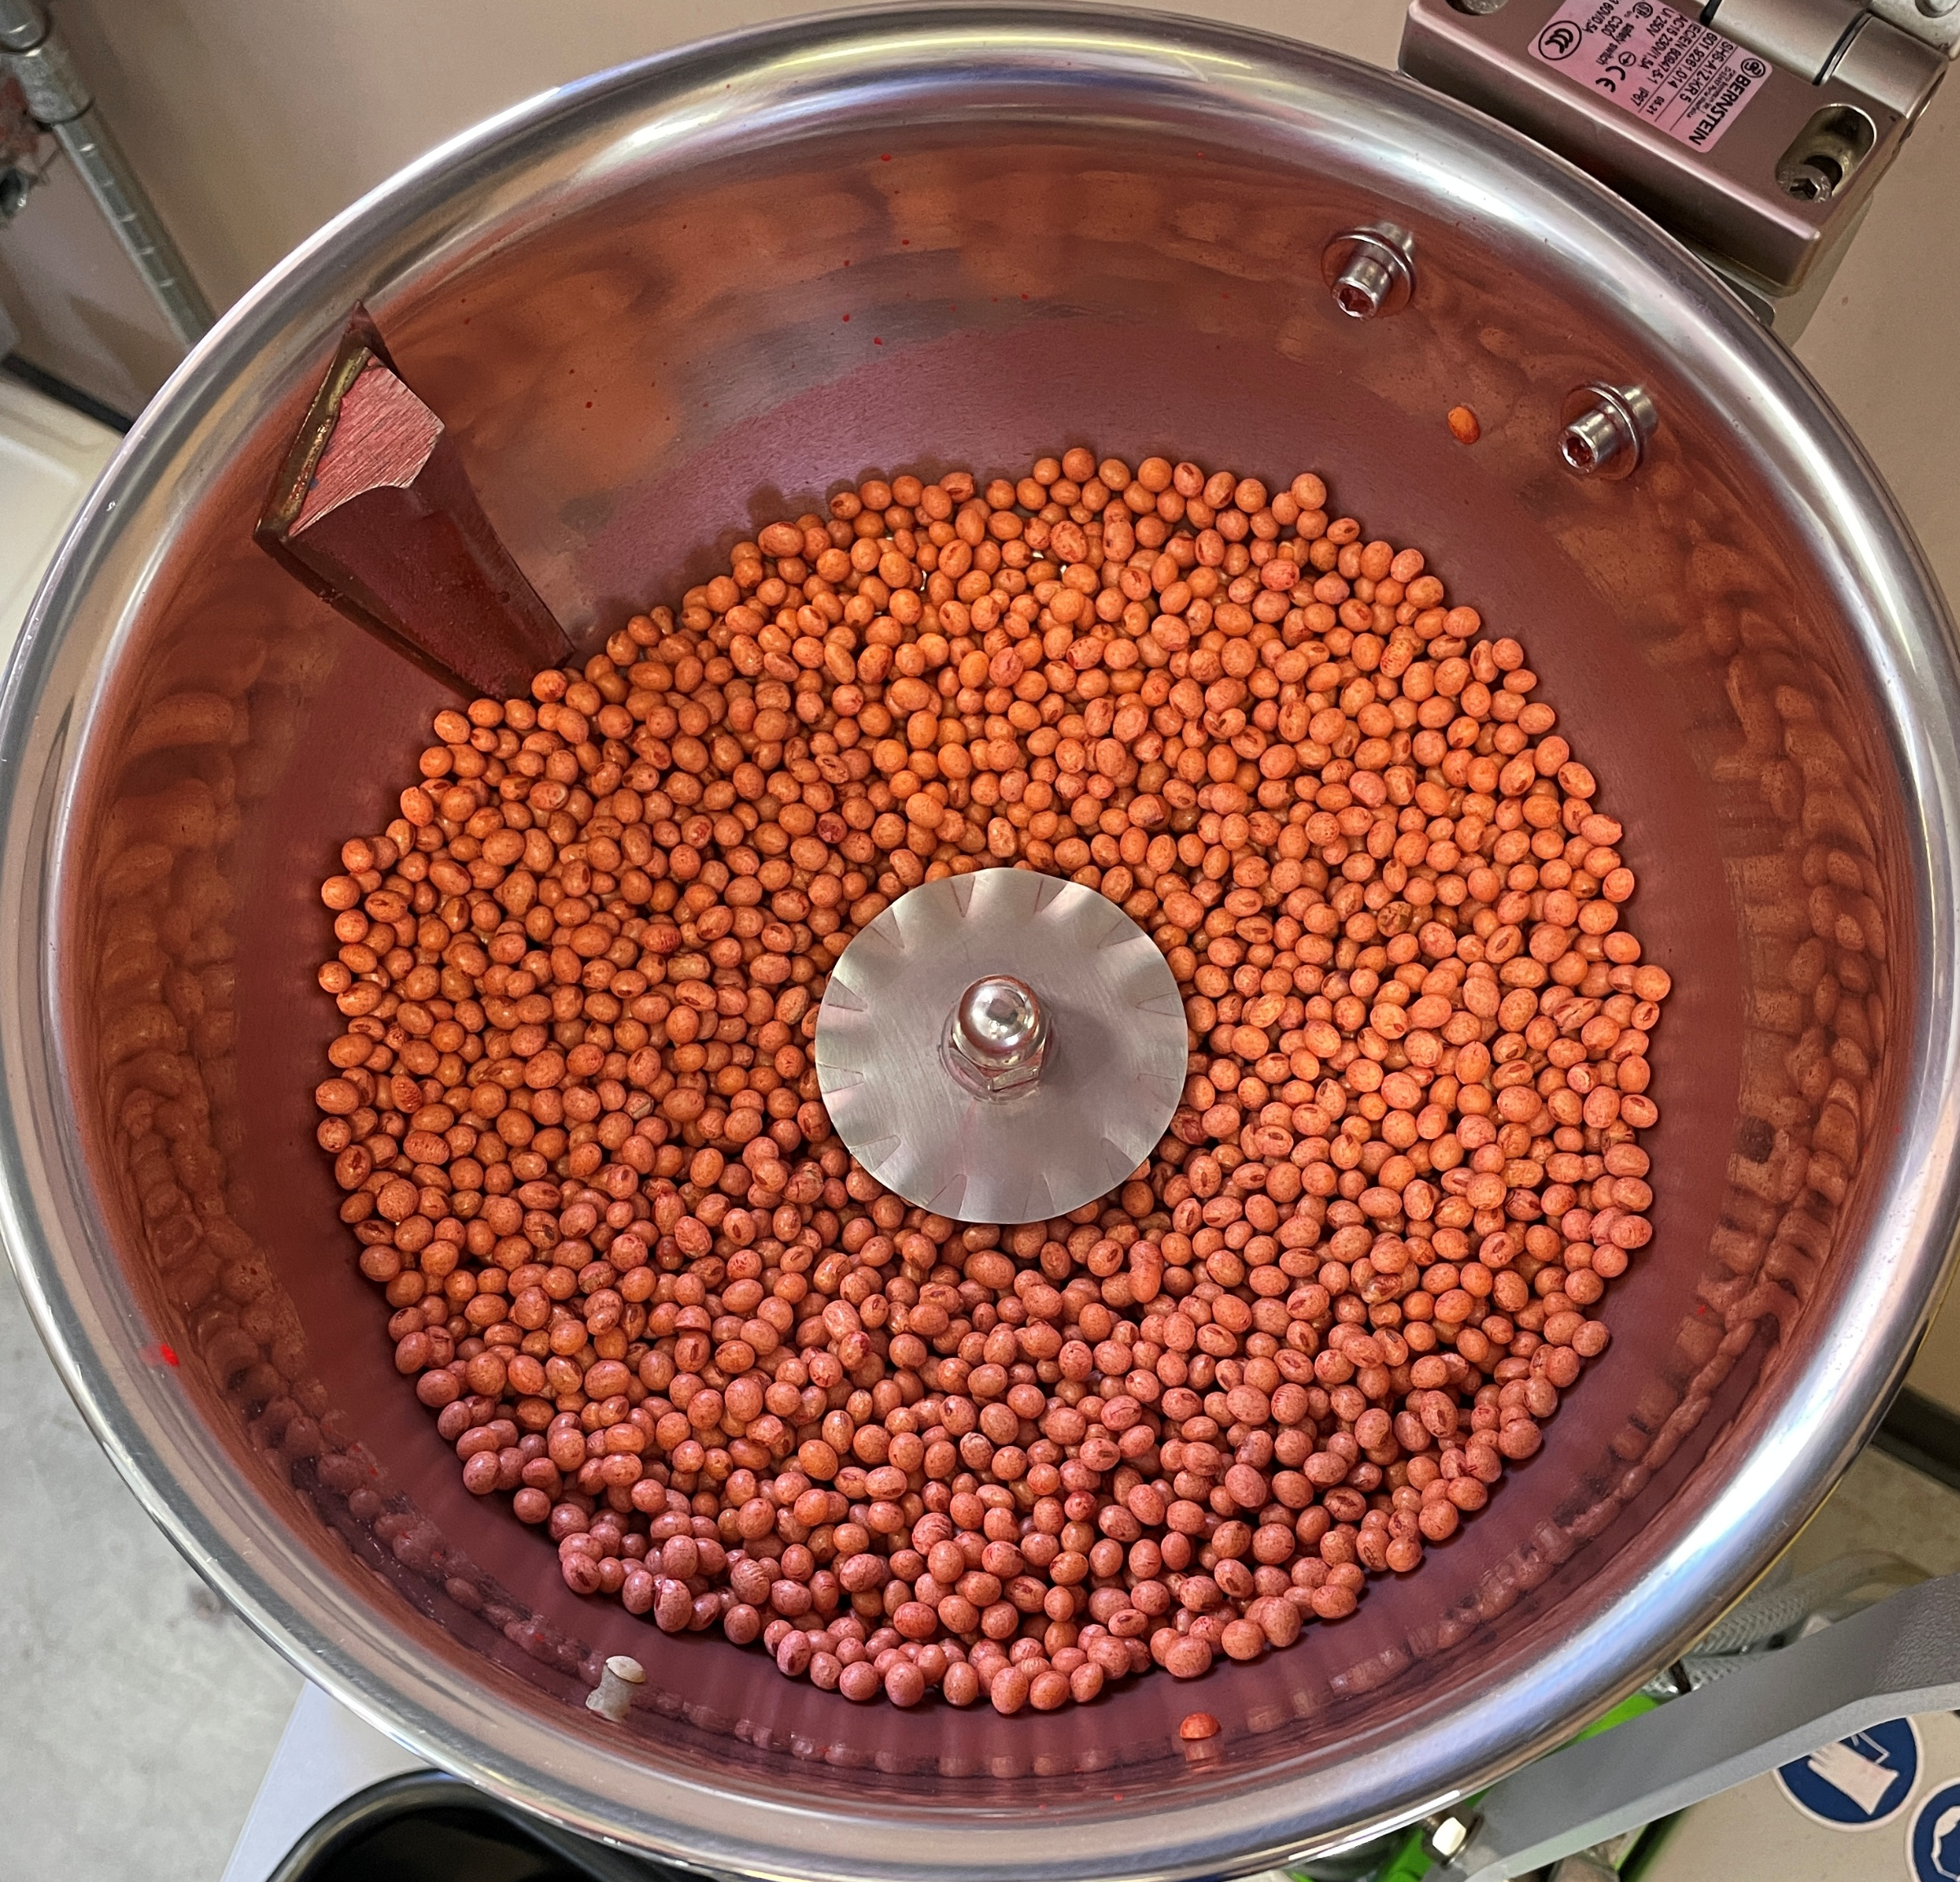
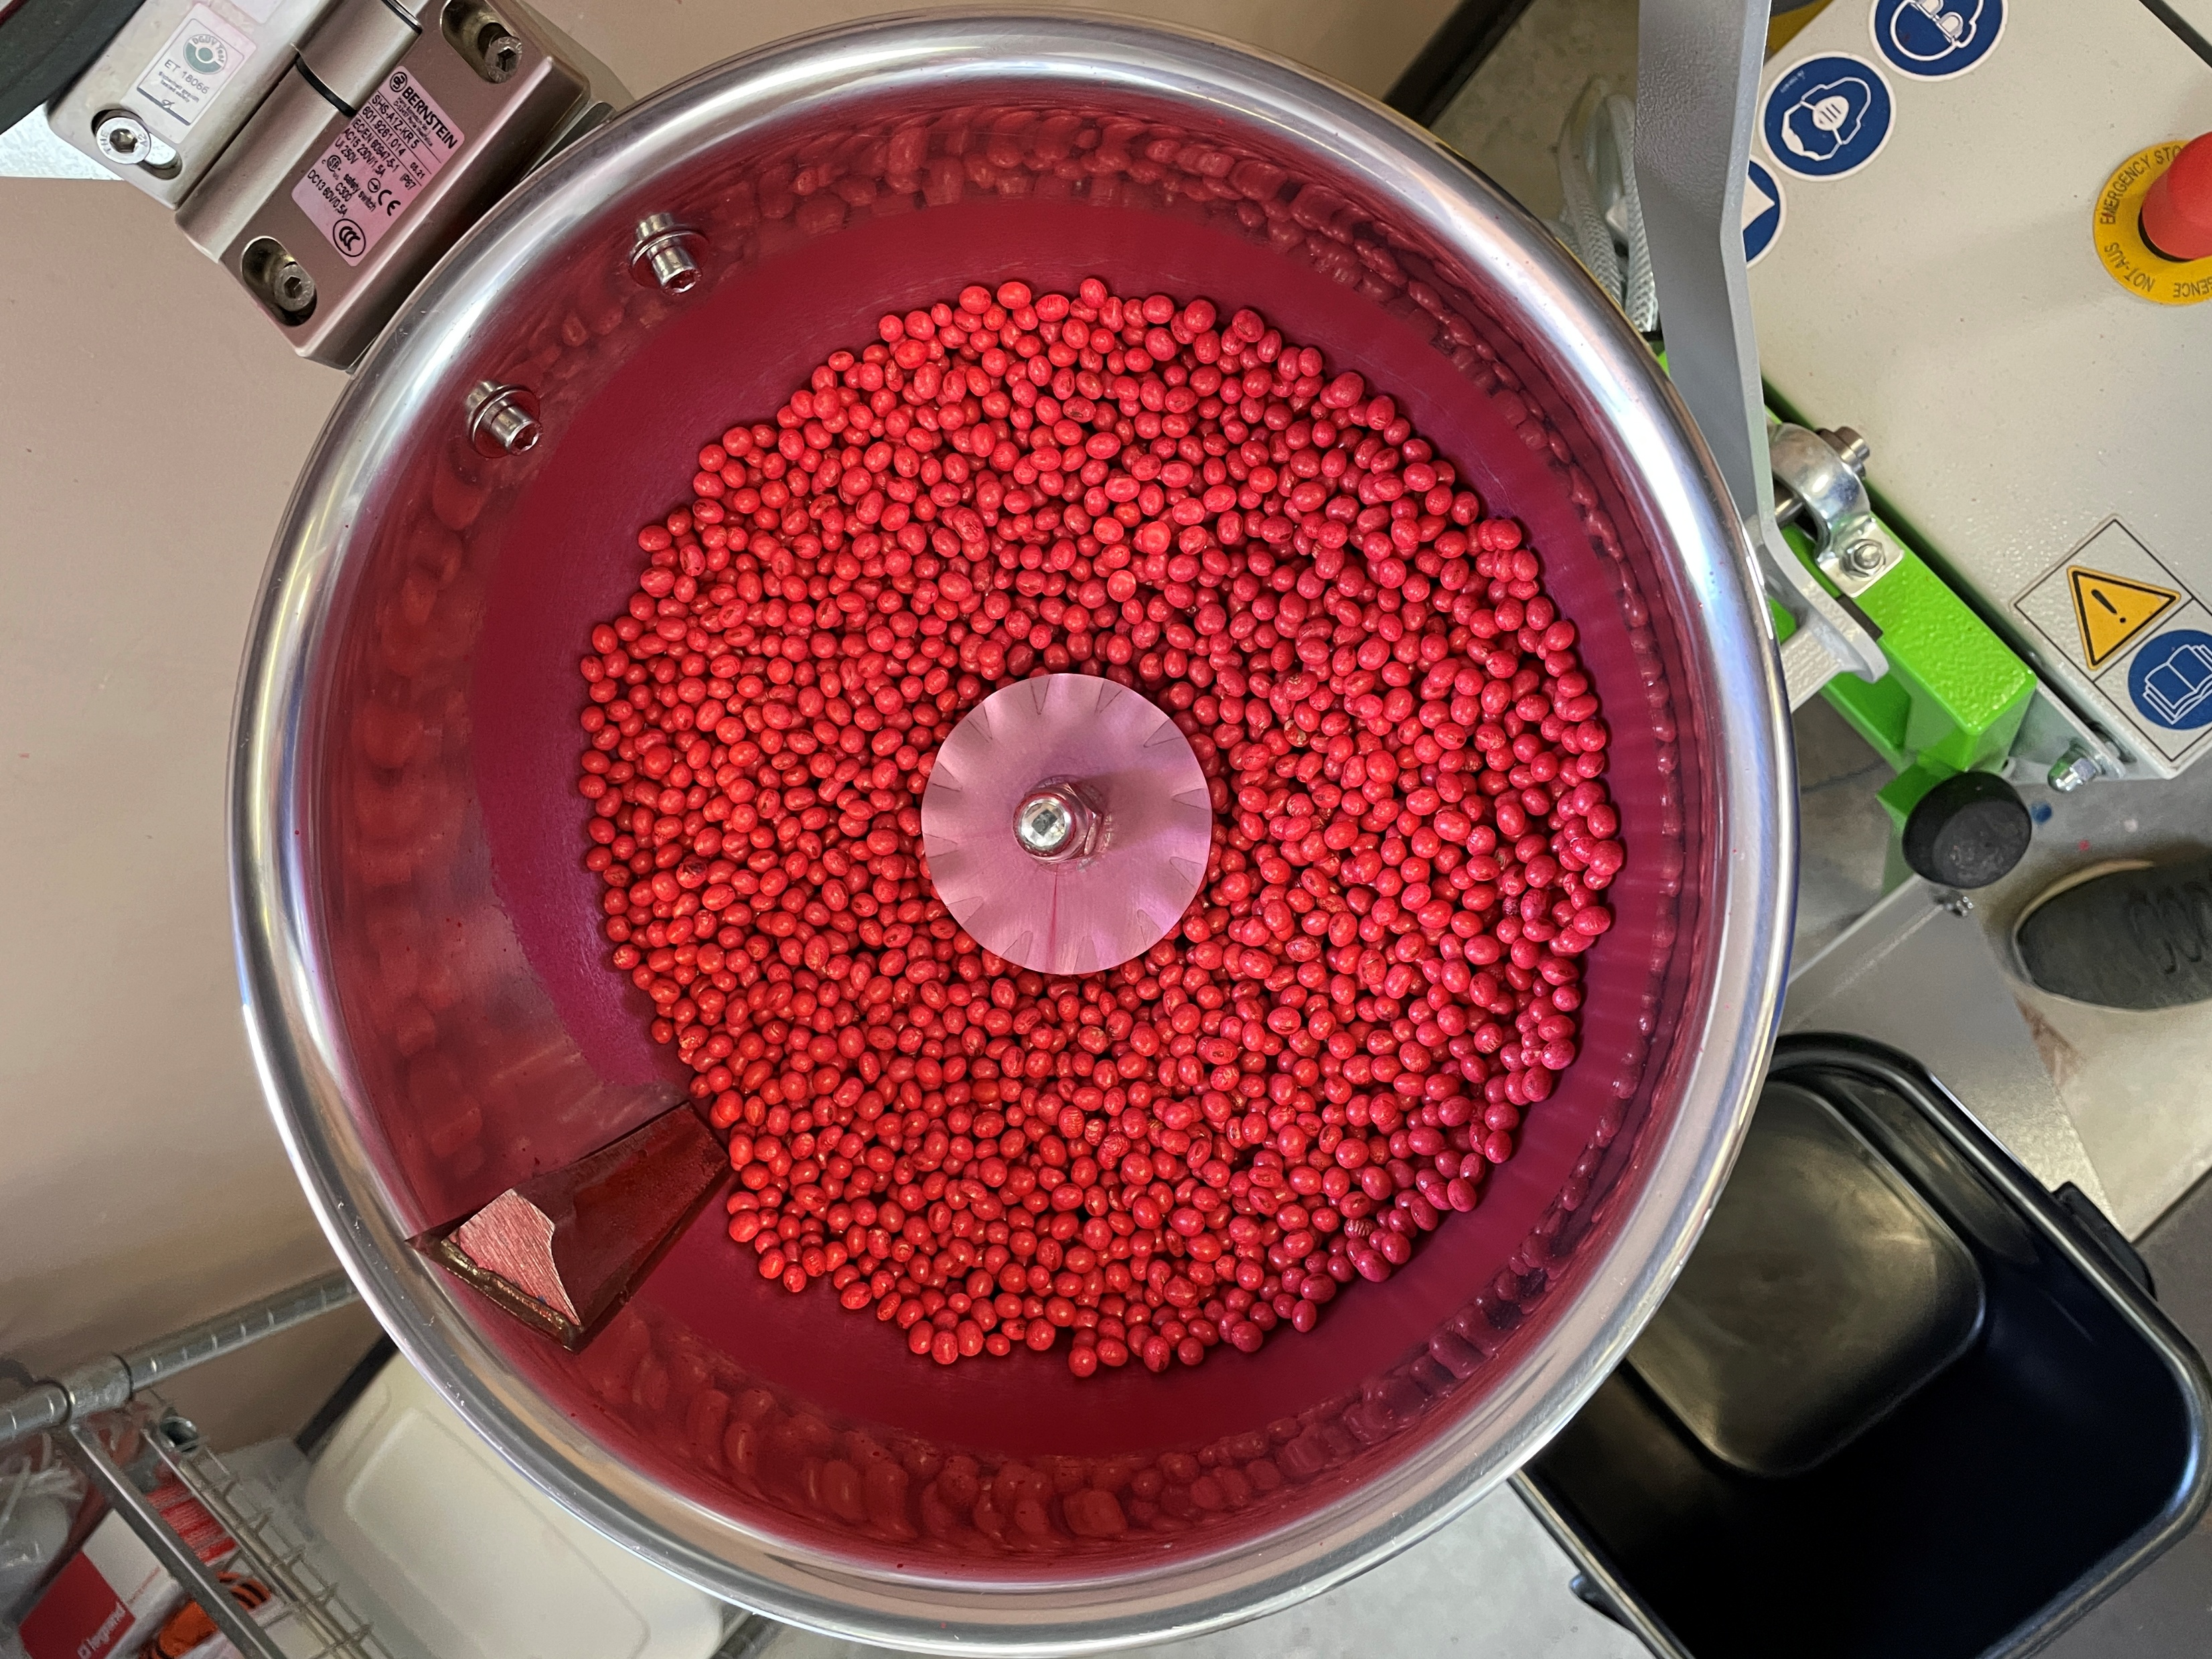
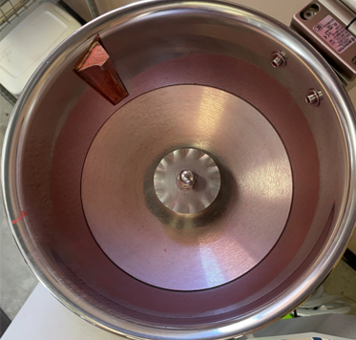
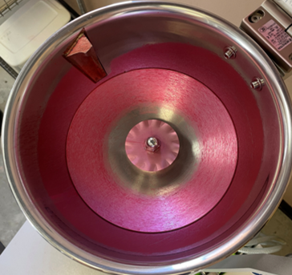
Application
Stickiness & Residue
PROTOCOL | Trt | Product (Label Rates)
 | 1 | Untreated
 | 2 | SuperSede Soybean
Methodology
Use of commercial seed treatment equipment to evaluate seed clumping and the level of residues that remain in the bowl following application of the various seed treatments.
Goal is consistent and uniform product coverage and adhesion in a wide range of conditions.
Fungicide and insecticide standard (F&I) used as a control.
Stickiness
Residue
UTC (water)
Standard
UTC (water)
Standard
SuperSede Soybean
F & I
+ SuperSede Soybean
SuperSede Soybean
F & I
+ SuperSede Soybean
Conclusion: The highest residues were observed with the treatments containing the standard F&I treatment, with very little residues observed with the SuperSede stand-alone treatment. None of the treatments caused excessive clumping.

Slide 22
Application
Dry Time
PROTOCOL | Trt | Product (Label Rates)
 | 1 | Untreated
 | 2 | F&I
 | 3 | SuperSede Soybean
 | 4 | SuperSede Soybean + F&I
Methodology
Apply seed treatment slurry to seed using commercial equipment.
Evaluate moisture content of the treated seed every two minutes for ten minutes.
Moisture Content
Acceptable Threshold
Conclusion: The SuperSede treatment had the slowest drying times. By the 8-minute evaluation, all treatments were below the acceptable threshold of 20%.

Slide 23
Seed Safety
Paper Towel Test
PROTOCOL | Trt | Product (Label Rates)
 | 1 | Untreated
 | 2 | SuperSede Soybean
 | 3 | SuperSede Soybean + F&I
Methodology
Soak germination paper towels in water until completely wet.
Plant 50 seeds/sample - 4 replications per treatment.
Cover with another paper towel and carefully roll from one side going to the other.
Place rolled towels in a plastic bag and label each bag.
Place the bags with the towels in a room with temperature set at 25°C.
Evaluate germination by counting the seedling germination, and record any dead, hard, or abnormal seeds/seedlings.
Conclusion: All treatments reached 100% from 0-9 months and were at 98% germination by the 12-month evaluation.​

Slide 24
Seed Safety
Sand Test
PROTOCOL | Trt | Product (Label Rates)
 | 1 | Untreated
 | 2 | SuperSede Soybean
 | 3 | SuperSede Soybean + F&I
Methodology
Plant 100 seed per treatment in sand-soil mixture (1:1 ratio) and replicate 4 times.
Place them in the 10ºC growth room for 7 days and then transfer to the 18 ºC growth room for 14 days.
Count emergence of normal seedlings at multiple time points after transferring to 18 ºC growth room.
Conclusion: Sand test germination was above 80% among treatments during all tests performed during 12 months. No statistical differences were observed between the untreated control (UTC), SuperSede alone, or SuperSede combined with an F&I treatment.

Slide 25
Seed Safety
Cold Test
PROTOCOL | Trt | Product (Label Rates)
 | 1 | Untreated
 | 2 | SuperSede Soybean
 | 3 | SuperSede Soybean + F&I
Methodology
Plant 100 seed per treatment in sand-soil mixture (1:1 ratio) and replicate 4 times.
Place them in the 10 °C growth room for 7 days and then transfer to the 18 °C growth room for 14 days.
Count emergence of normal seedlings at multiple time points (3, 7, 10 and 14 days) after transferring to 18 °C growth room.
Conclusion: There was no statistically significant difference between treatments in the cold test during the 0, 3, 6, and 12-month evaluation. During the 9-month evaluation, both of the SuperSede treatments (alone or in combination with F&I), had higher germination rates compared to the UTC.

Slide 26
Seed Safety
Biological Compatibility
PROTOCOL | Trt | Product (Label Rates)
 | 1 | UTC
 | 2 | F&I
 | 3 | Supersede Soybean
 | 4 | F&I + Supersede Soybean
Methodology
Bradyrhizobium japonicum was applied to the soybean seed for 10s after treating with a slurry for 20s.
50 seeds (replicated 4X per treatment) were incubated at 28°C in the dark for 10 days.
The number of rhizobia per seed was quantified and recorded once they became visible to the naked eye.
Minimum Acceptable Viability
Conclusion: All treatments were above the minimum acceptable viability for Rhizobia.

Slide 27
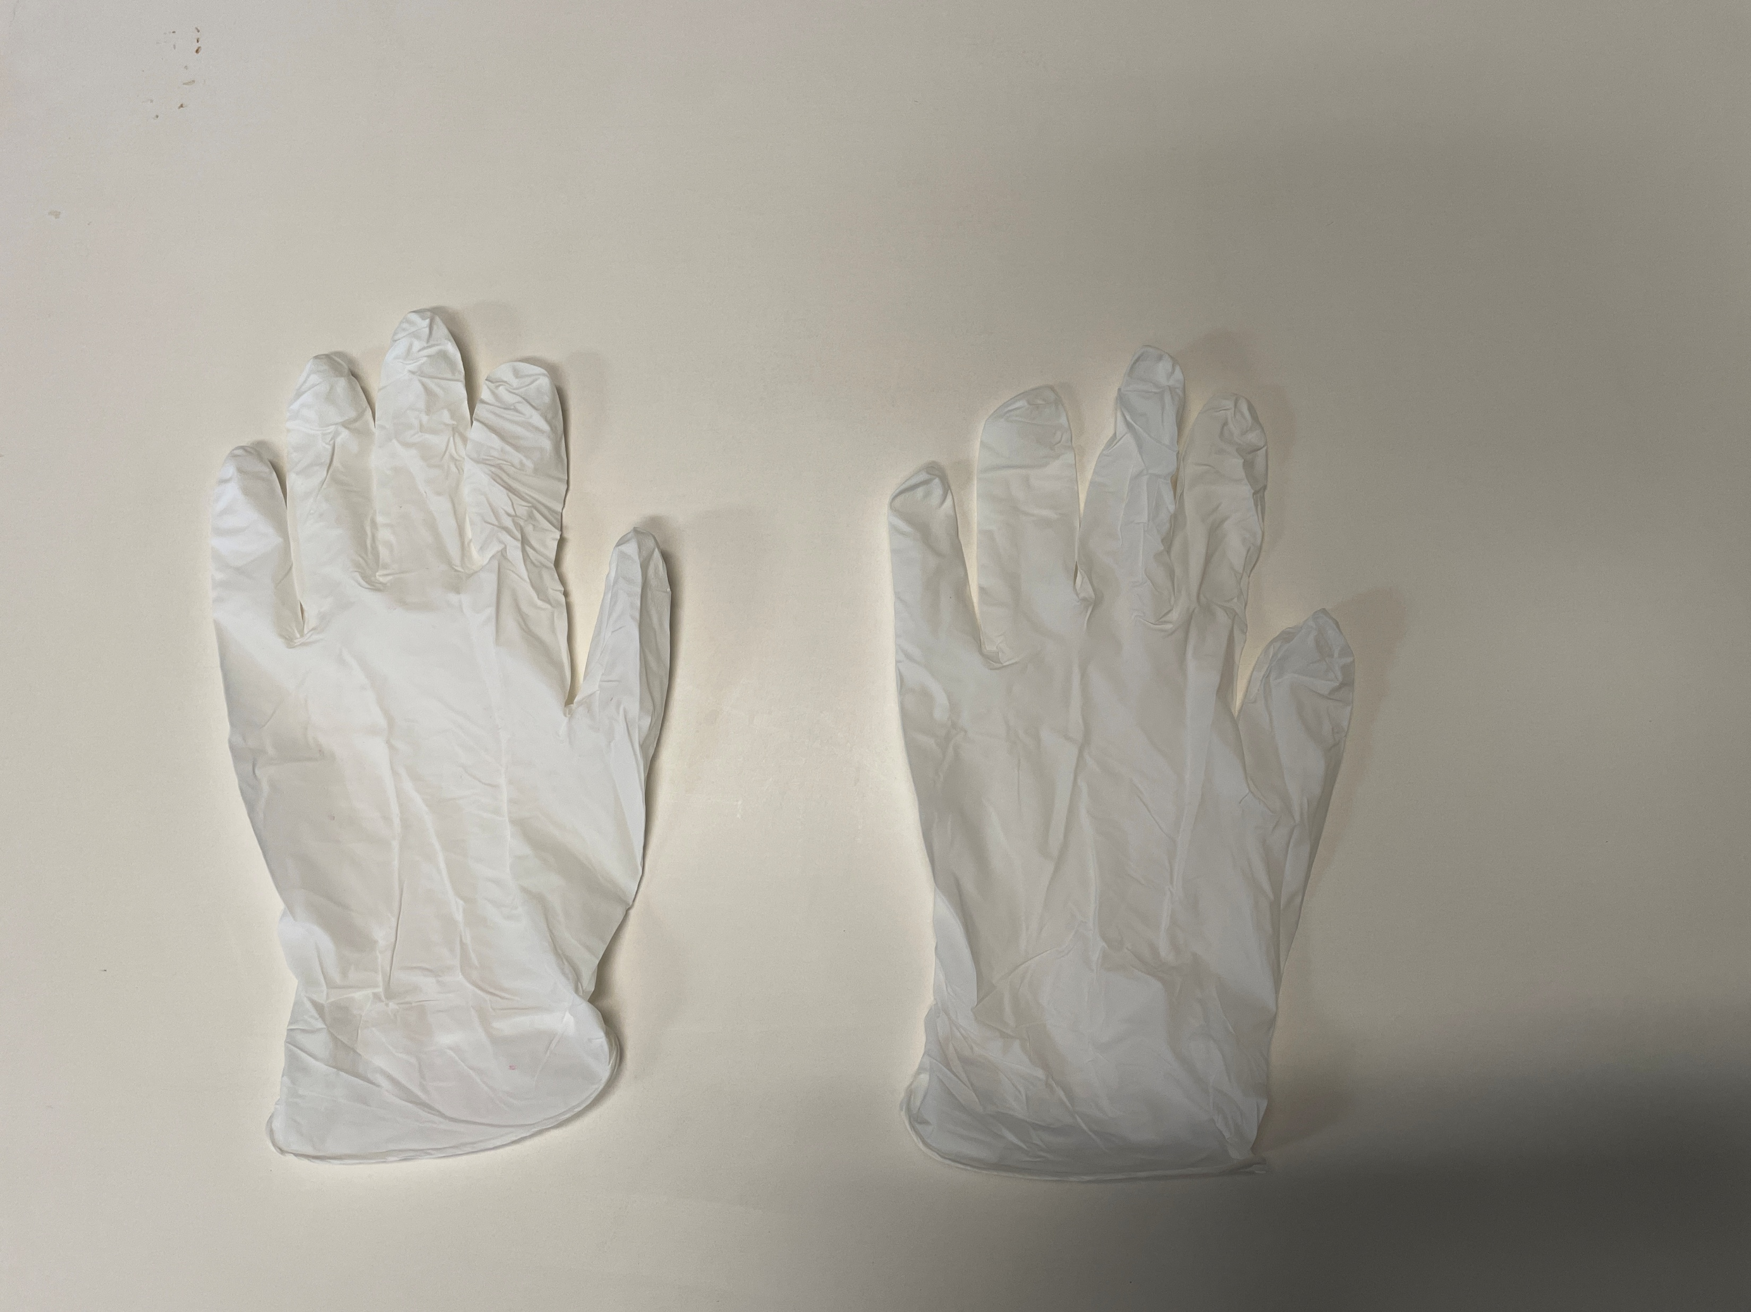
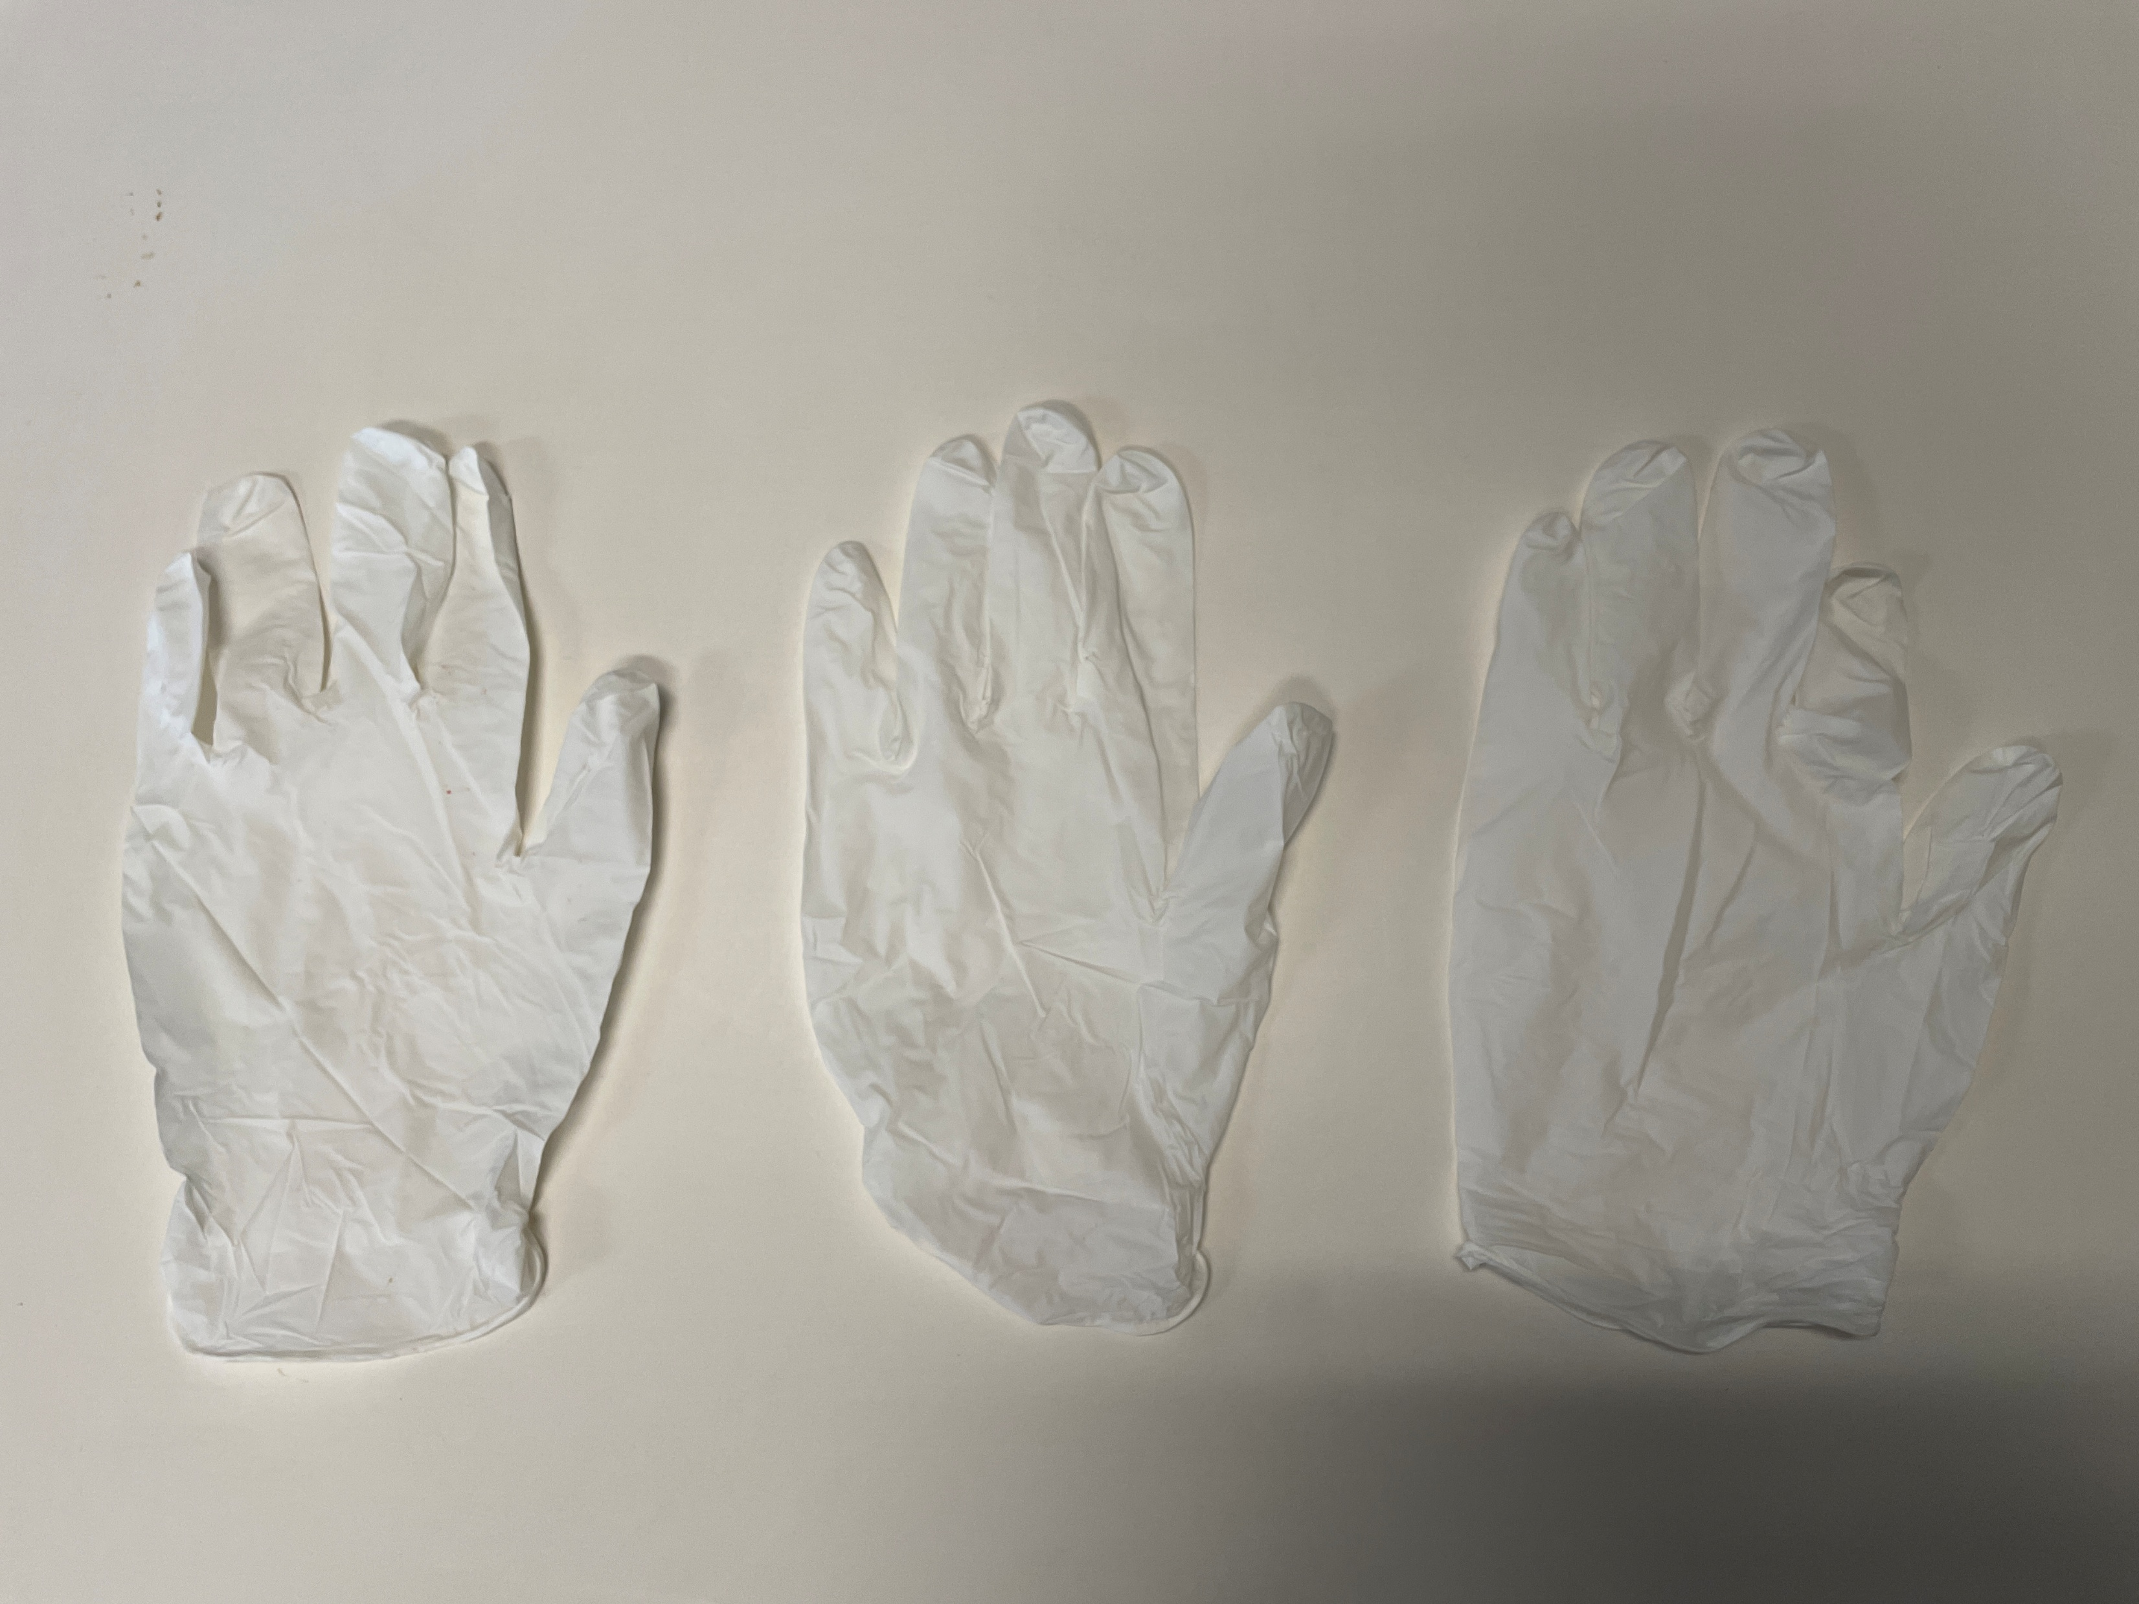
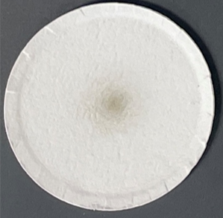
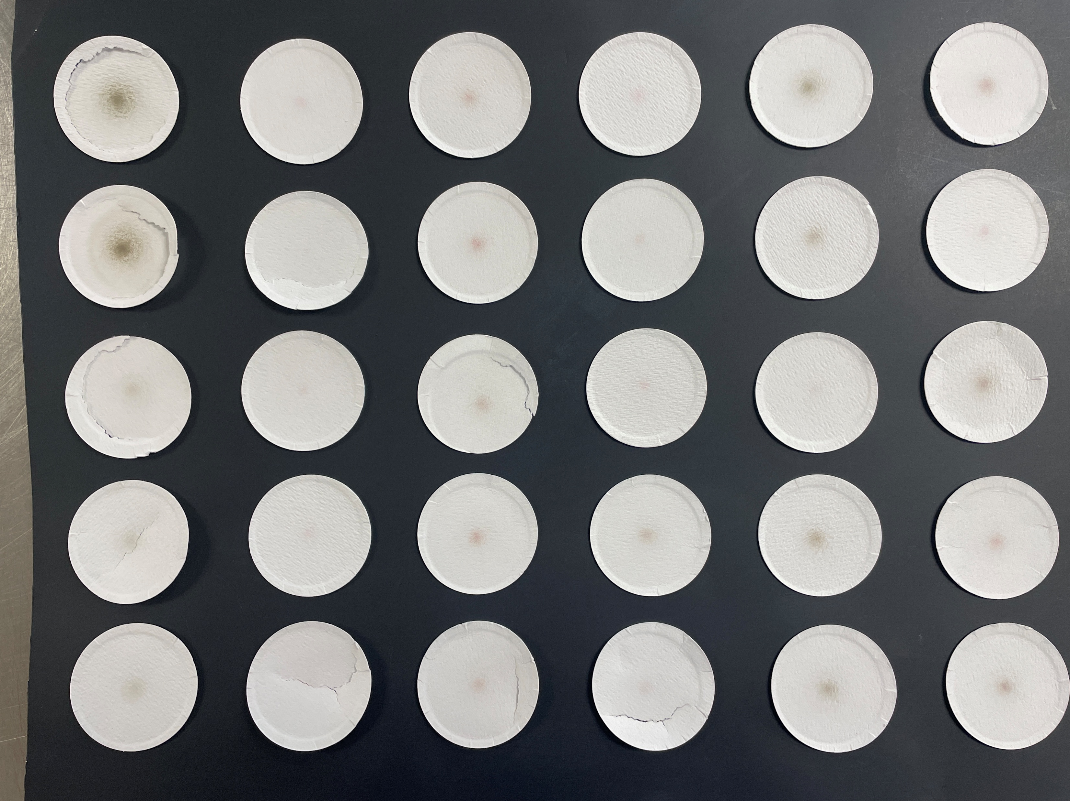
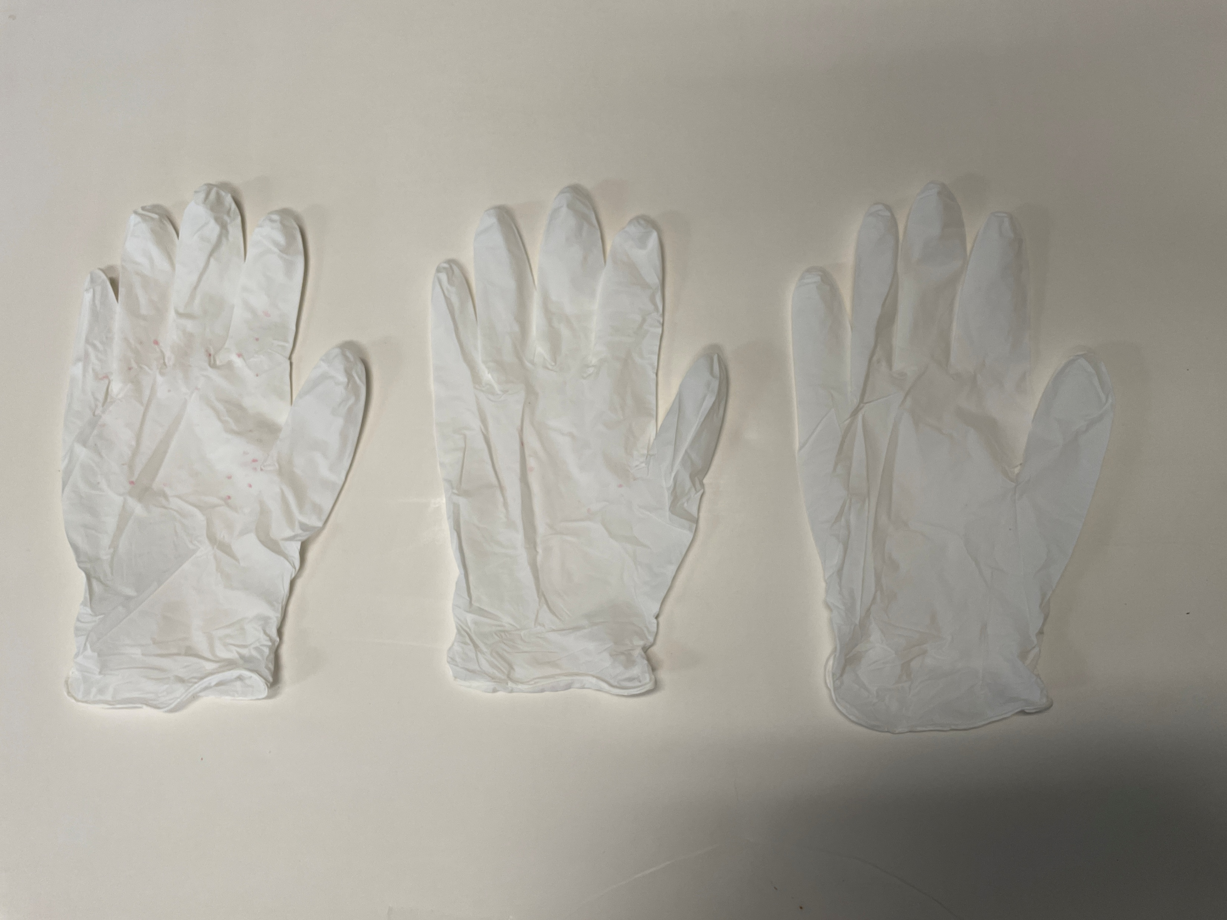
Stewardship
Dust Off
PROTOCOL | Trt | Product (Label Rates)
 | 1 | UTC
 | 2 | F&I
 | 3 | Supersede Soybean
 | 4 | F&I + Supersede Soybean
Methodology
Utilize known quantity of seed.
Tumbling seeds to generate dust; maintain identical operating parameters of time, rotation speed, and air flow.
Use vacuum system to pull out dust.
Dust was collected on Whatman GF 9 filters from 100 grams of seed.
Average dust values (g/100 kg seed) were measured and recorded from 4 replicates per treatment.
Glove Test
Dust-off
Dry
0
2
g/100 kg seed
Dry
0
2
4
Dry
0
2
4
Conclusion: There was no significant difference between treatments, with the dust content being well below the commercial threshold of 2.7 g/100kg for all treatments.

Slide 28
Field Data

Slide 29

Soybean Yield
Kansas State University | Scandia, KS | 2024
OVERVIEW
CROP | Soybeans
DESIGN | Randomized Complete Block
CONCLUSION
SuperSede Soybeans was applied as a seed treatment in addition to a Grower Standard (GS) program and compared to the GS alone.
The addition of SuperSede Soybean resulted in an additional 5.2 bu/ac more soybean yield over the GS.
LOCAL WEATHER SUMMARY
May – October
Temperature: 68.6°F
Precipitation:
Total Rainfall – 22.35”
Avg Monthly Rainfall – 3.73”
 | TREATMENT | RATE/ACRE | TIMING
 | SuperSede Soybeans | 1 oz/50 lbs seed | Seed Treatment

Slide 30

SuperSede Soybean on Soybeans
North Carolina State University | Bladen, NC | 2024
OVERVIEW
CROP | Soybeans
DESIGN | Randomized Complete Block
CONCLUSION
SuperSede Soybeans was applied as a seed treatment in addition to a Grower Standard (GS) program and compared to the GS alone.
The addition of SuperSede Soybean resulted in an additional 12.3 bu/ac more soybean yield over the GS.
LOCAL WEATHER SUMMARY
May – October
Temperature: 73.1°F
Precipitation:
Total Rainfall – 29.74”
Avg Monthly Rainfall – 4.96”
 | TREATMENT | RATE/ACRE | TIMING
 | SuperSede Soybeans | 1 oz/50 lbs seed | Seed Treatment

Slide 31

SuperSede Soybean on Soybeans
University of Illinois | Champaign, IL | 2025
OVERVIEW
CROP | Soybeans
DESIGN | Randomized Complete Block
CONCLUSION
SuperSede Soybeans was applied as a seed treatment in addition to a Grower Standard (GS) program and compared to the GS alone.
The addition of SuperSede Soybean resulted in 1.1 bu/ac more soybean yield over the GS.
LOCAL WEATHER SUMMARY
May – September
Temperature: 71.0°F
Precipitation:
Total Rainfall – 20.02”
Avg Monthly Rainfall – 4.00”
 | TREATMENT | RATE/ACRE | TIMING
 | SuperSede Soybeans | 1 oz/50 lbs seed | Seed Treatment

Slide 32
Soybean Yield
Kansas State University | Belleville, KS | 2024
OVERVIEW
CROP | Soybeans
DESIGN | Randomized Complete Block
CONCLUSION
SuperSede Soybeans was applied as a seed treatment in addition to a Grower Standard (GS) program and compared to the GS alone.
The addition of SuperSede Soybean resulted in an additional 14.2 bu/ac more soybean yield over the GS.
LOCAL WEATHER SUMMARY
May – October
Temperature: 68.9°F
Precipitation:
Total Rainfall – 23.12”
Avg Monthly Rainfall – 3.85”
 | TREATMENT | RATE/ACRE | TIMING
 | SuperSede Soybeans | 1 oz/50 lbs seed | Seed Treatment

Slide 33

SuperSede Soybean on Soybeans
Maloney | Wilton, WI | 2021
OVERVIEW
CROP | Soybeans
DESIGN | Randomized Complete Block
CONCLUSION
SuperSede Soybeans was applied as a seed treatment in addition to a Grower Standard (GS) program and compared to the GS alone.
The addition of SuperSede Soybean resulted in 15% better stand count 28 days after planting and an additional 6.4 bu/ac more soybean yield over the GS.
LOCAL WEATHER SUMMARY
May – October
Temperature: 65.2°F
Precipitation:
Total Rainfall – 25.97”
Avg Monthly Rainfall – 4.33”
 | TREATMENT | RATE/ACRE | TIMING
 | SuperSede Soybeans | 1 oz/50 lbs seed | Seed Treatment

Slide 34
SuperSede Soybean on Soybeans
Retailer Trial | Belvidere, NC | 2025
OVERVIEW
CROP | Soybeans
DESIGN | Randomized Complete Block
CONCLUSION
SuperSede Soybeans was applied as a seed treatment in addition to a Grower Standard (GS) program and compared to the GS alone.
The addition of SuperSede Soybean resulted in 5.3 bu/ac more soybean yield over the GS.
LOCAL WEATHER SUMMARY
May – October
Temperature: 74.0°F
Precipitation:
Total Rainfall – 31.68”
Avg Monthly Rainfall – 5.28”
 | TREATMENT | RATE/ACRE | TIMING
 | SuperSede Soybeans | 1 oz/50 lbs seed | Seed Treatment

Slide 35

SuperSede Soybean on Soybeans
Retailer Trial | Emporia, VA | 2025
OVERVIEW
CROP | Soybeans
DESIGN | Randomized Complete Block
CONCLUSION
SuperSede Soybeans was applied as a seed treatment in addition to a Grower Standard (GS) program and compared to the GS alone.
The addition of SuperSede Soybean resulted in 3.8 bu/ac more soybean yield over the GS.
LOCAL WEATHER SUMMARY
May – October
Temperature: 72.4°F
Precipitation:
Total Rainfall – 26.80”
Avg Monthly Rainfall – 4.47”
 | TREATMENT | RATE/ACRE | TIMING
 | SuperSede Soybeans | 1 oz/50 lbs seed | Seed Treatment

Slide 36

SuperSede Soybean on Soybeans
Retailer Trial | Clio, SC | 2025
OVERVIEW
CROP | Soybeans
DESIGN | Randomized Complete Block
CONCLUSION
SuperSede Soybeans was applied as a seed treatment in addition to a Grower Standard (GS) program and compared to the GS alone.
The addition of SuperSede Soybean resulted in 2.4 bu/ac more soybean yield over the GS.
LOCAL WEATHER SUMMARY
May – October
Temperature: 72.9°F
Precipitation:
Total Rainfall – 26.60”
Avg Monthly Rainfall – 4.43”
 | TREATMENT | RATE/ACRE | TIMING
 | SuperSede Soybeans | 1 oz/50 lbs seed | Seed Treatment

Slide 37
SuperSede Soybean on Soybeans
Retailer Trial | LeGrange, NC | 2025
OVERVIEW
CROP | Soybeans
DESIGN | Randomized Complete Block
CONCLUSION
SuperSede Soybeans was applied as a seed treatment in addition to a Grower Standard (GS) program and compared to the GS alone.
The addition of SuperSede Soybean resulted in 3.6 bu/ac more soybean yield over the GS.
LOCAL WEATHER SUMMARY
May – October
Temperature: 73.0°F
Precipitation:
Total Rainfall – 30.46”
Avg Monthly Rainfall – 5.08”
 | TREATMENT | RATE/ACRE | TIMING
 | SuperSede Soybeans | 1 oz/50 lbs seed | Seed Treatment

Slide 38
SuperSede Soybean on Soybeans
Grower Trial | Sutherland, VA | 2025
OVERVIEW
CROP | Soybeans
DESIGN | Side-by-Side
CONCLUSION
SuperSede Soybeans was applied as a seed treatment in addition to a Grower Standard (GS) program and compared to the GS alone.
The addition of SuperSede Soybean resulted in 1.3 bu/ac more soybean yield over the GS.
LOCAL WEATHER SUMMARY
May – October
Temperature: 72.3°F
Precipitation:
Total Rainfall – 24.02”
Avg Monthly Rainfall – 4.00”
 | TREATMENT | RATE/ACRE | TIMING
 | SuperSede Soybeans | 1 oz/50 lbs seed | Seed Treatment

Slide 39

SuperSede Soybean on Soybeans
Grower Trial | Camden, IN | 2025
OVERVIEW
CROP | Soybeans
DESIGN | Randomized Complete Block
CONCLUSION
SuperSede Soybean was applied as a seed treatment in addition to a Grower Standard (GS) program and compared to the GS alone.
The addition of SuperSede Soybean resulted in a 5.4 bu/acre increase in yield when compared to the GS.
LOCAL WEATHER SUMMARY
May – October
Temperature: 66.7°F
Precipitation:
Total Rainfall – 23.89”
Avg Monthly Rainfall – 3.98”
 | TREATMENT | RATE/ACRE | TIMING
 | SuperSede Soybeans | 1 oz/50 lbs seed | Seed Treatment

Slide 40
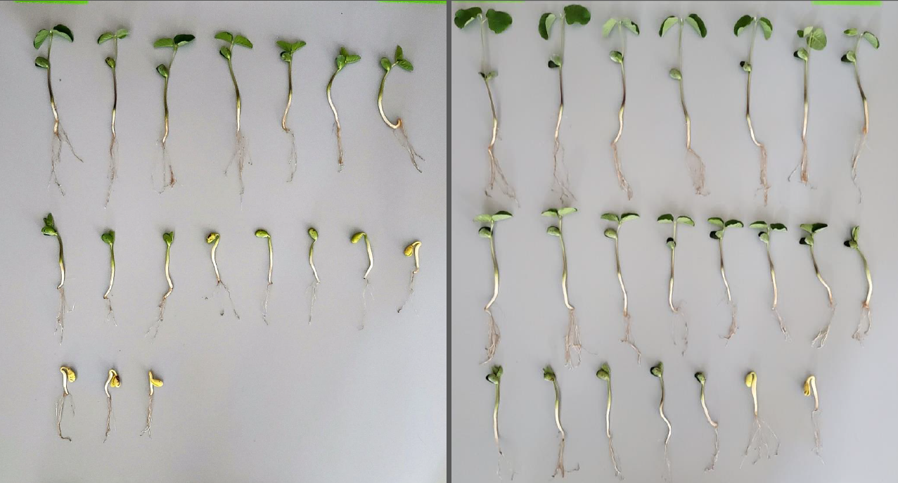
SuperSede Soybean on Soybeans
SuperSede Soybean Bioassay | 2021
Untreated Control
SuperSede Soybean

Slide 41
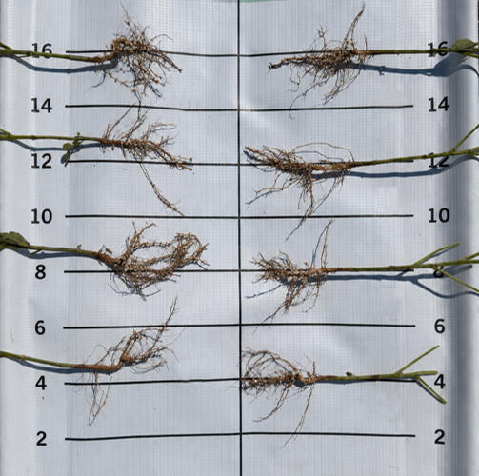
SuperSede Soybean on Soybeans
Grower Trial | 2026
Grower Standard
SuperSede Soybean

Slide 42
Contains Transit biostimulant for root development and enhanced nutrient mobility.
Includes key nutrition to enhance Transit biostimulant effects.
Right time, right place application improves:
  Better germination
  Enhanced root growth & nodulation
  Key nutrition
Better Germination
Enhanced Root Growth & Nodulation
Key Nutrition

