Slide 1
GrainStar®
Plant Growth Regulator
Training Deck

Slide 2
GrainStar®
Training Summary
1
Product Overview
2
Mode of Action
3
Application Information
4
Field Data
Wheat & Barley
Soybeans
Corn
Rice

Slide 3
Product Overview

Slide 4

GrainStar®
Plant Growth Regulator
GrainStar® Plant Growth Regulator is a first-of-its-kind abscisic acid formulation. It simultaneously primes plants for stress tolerance and enhances mobilization of carbohydrates to the developing grains, supporting improved grain fill and ROI in wheat, barley, corn, soybeans, and rice.

Slide 5



Features & Benefits
Wheat, Barley, Corn, Soybeans, and Rice
Carbohydrate Mobility
Increased Grain & Pod Fill
Stress Mitigation
GrainStar drives carbohydrate storage from the leaves and stem to the grain.
Translocation of carbohydrates increases grain and pod fill and weight for higher ROI.
GrainStar primes plants for unforeseen drought and heat events, securing yields.

Slide 6

Guaranteed Analysis
Active Ingredients
S-Abscisic Acid…………………….……………………….....8.6% Other Ingredients ........................................................... 91.4% TOTAL ..........................................................................100.0%
Contains a total of 8.6 g of S-Abscisic Acid in 100 g of product.
EPA Reg. No. 73049-535 EPA Est. No. 33762-IA-001

Slide 7
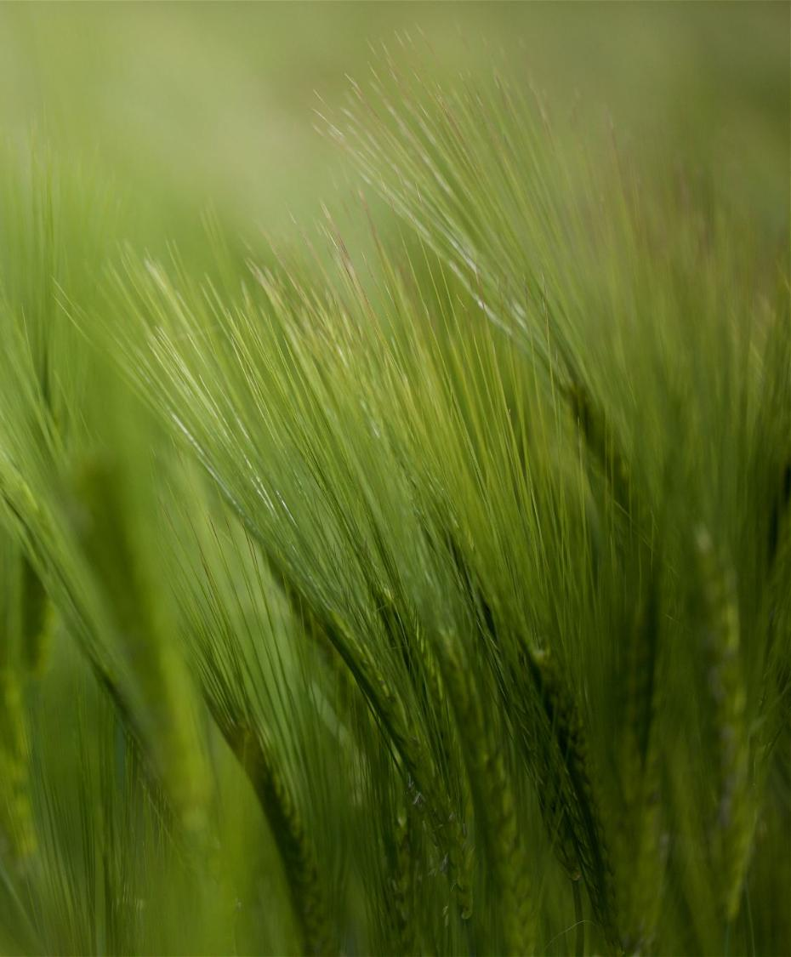
GrainStar Plant Growth Regulator
Formulation | 8.6% Soluble Granule
Package Size | 2 x 64 oz
Application | Foliar; Compatible with herbicides, insecticides, and fungicides
Target Crops | Wheat, barley, corn, soybeans, rice
Application Rates | Wheat: 1.0 oz/ac
 | Barley: 1.0 oz/ac
 | Corn: 0.7 oz/ac
 | Soybeans: 1.0 oz/ac
 | Rice: 0.7 oz/ac
Uses | Conventional
Shelf Life | 2 Years

Slide 8
Mode of Action

Slide 9


Plant Growth Regulators
Plant growth regulators are naturally-occurring or synthetic substances which influence some qualitative and/or quantitative aspect of plant growth (Yopp 1986).
Plant growth regulators are federally regulated by the EPA.
The label is the law.
Application rate and timing must be by the label.
Over-application can have unintended effects.

Slide 10
Abscisic Acid Mode of Action
Plant responses to S-Abscisic Acid
Benefit | How
Carbohydrate Movement | ABA triggers translocation of glucose from the stems and leaves into the developing grain.
Drought Stress Mitigation | ABA induces stomatal closure, reducing transpiration and helping the plant conserve water under drought stress conditions.
Stress Primer | ABA acts as a stress primer, facilitating development of resistance.

Slide 11
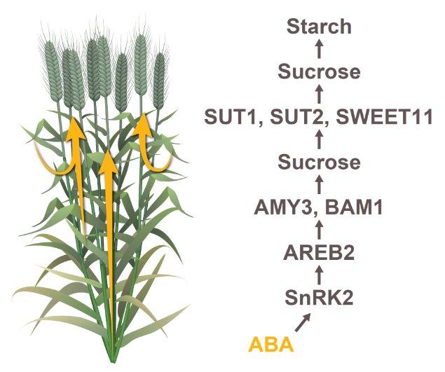
The Role of ABA in Grain Fill
Starch Break Down
Abscisic acid (ABA) influences the expression of genes that code for starch-degrading enzymes
The starch degrading enzymes drive the breakdown of starch into smaller, soluble sugars.
Sugar Movement
ABA also influences the expression of sugar transporter genes, leading to increased movement of sugars into sink tissues like seed heads and kernels.
Notes:
Abscisic acid (ABA) activates a signaling pathway that includes specific transcription factors (like ABF4 and ABR1) that are responsive to ABA.
These transcription factors then activate the expression of genes that code for starch-degrading enzymes, particularly β-amylase (BAM).
The BAM enzymes (e.g., BAM1 and BAM3) then catalyze the breakdown of starch (a complex carbohydrate) into smaller, soluble sugars.
ABA also influences the expression of sugar transporter genes, leading to increased movement of sugars into sink tissues like seed heads, contributing to their filling and development.

Slide 12
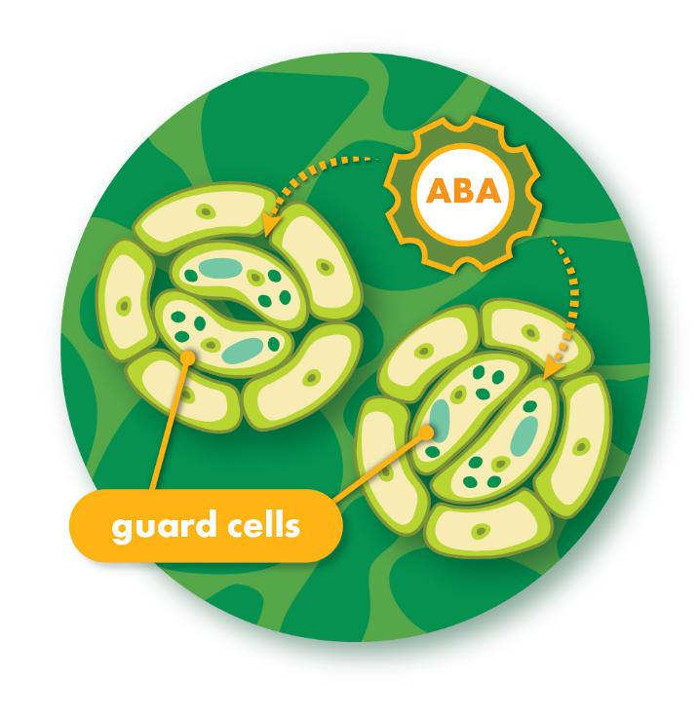
The Role of ABA on
Drought Stress Mitigation
ABA induces stomatal closure, reducing transpiration and aiding water conservation.
ABA supports internal control of water flow, improving the response to drought stress.
ABA serves as a source of energy and carbon during drought stress.

Slide 13
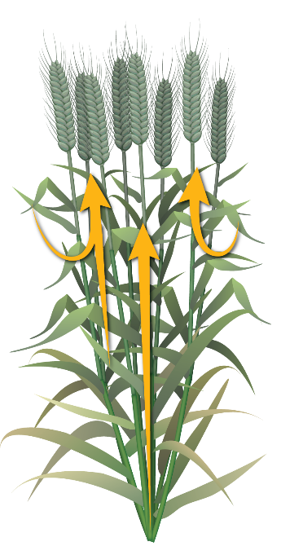
Benefits of Abscisic Acid
Increased Sugar Mobilization
Converts sugars to starches in the seedhead
Abscisic acid triggers conversion of starch stored in the leaves and stems to sugars and aids remobilization to the developing grain.
Transports sugars from stem to the panicle
Increased Grain Fill
Abscisic acid influences the conversion of sugars to starches in the developing grains to enhance grain fill.
Transports sugars from the leaf to the panicle
Converts starch in stem to sugar
ABA
Greater Yield
ABA
Improved grain fill supports improved panicle development and ultimately greater yields, even under drought stress.

Slide 14
Application Information

Slide 15
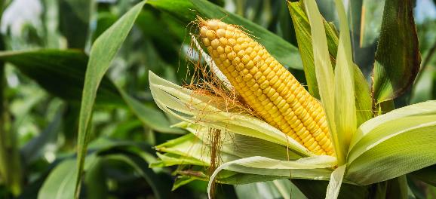
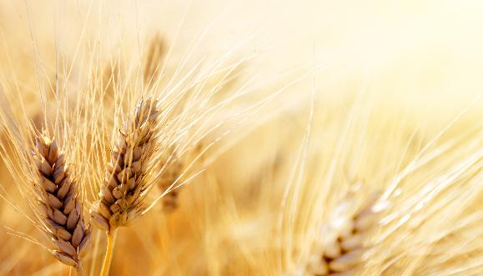
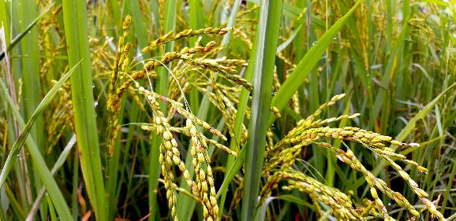

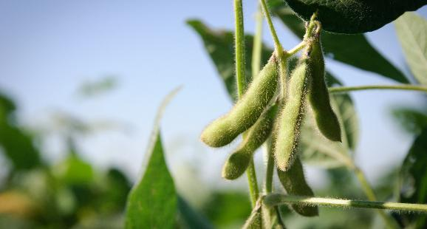
General Application Guidelines
GrainStar Plant Growth Regulator
Can be utilized with many common fungicides and insecticides.
Do not apply GrainStar if rain is expected within 6 hours following application.
Do not overhead irrigate crop for at least 6 hours following application.
Injured or stressed plants may show a reduced response to GrainStar.
Do not enter or allow worker entry into treated areas during the restricted entry interval (REI) of 12 hours.

Slide 16
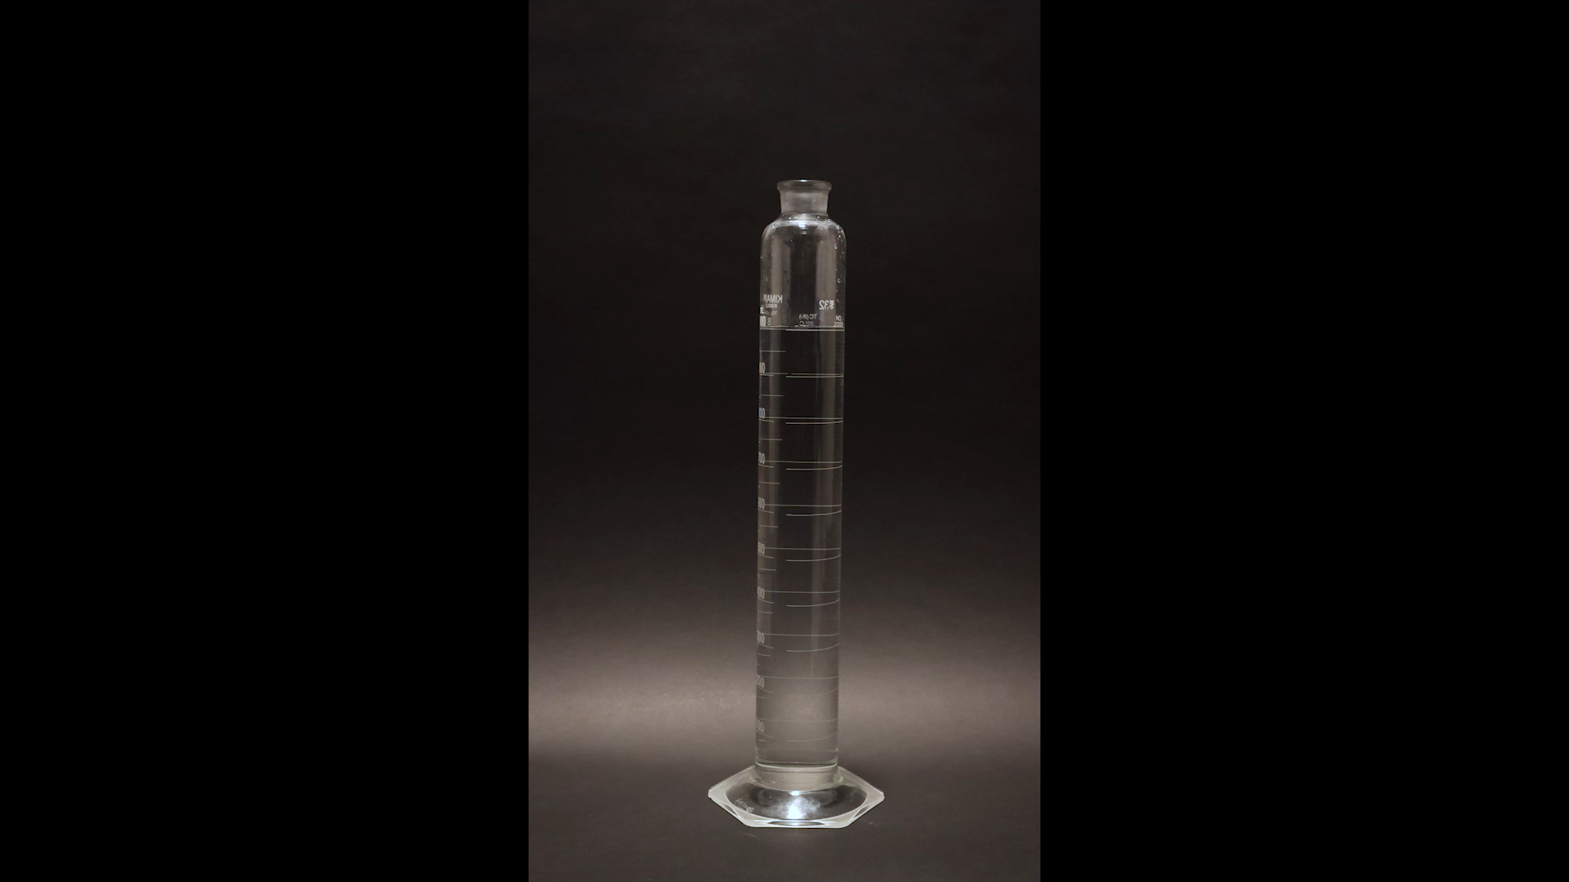
GrainStar Solubility

Slide 17
Application Rates & Timing
Crop Type | Use Rate/Acre | Recommended Timing
Wheat, Barley | 1.0 oz/acre | Flag leaf – early grain fill
Corn | 0.7 oz/acre | Late vegetative R
Soybeans | 1.0 oz/acre | R3
Rice | 0.7 oz/acre | Late boot to early heading

Slide 18
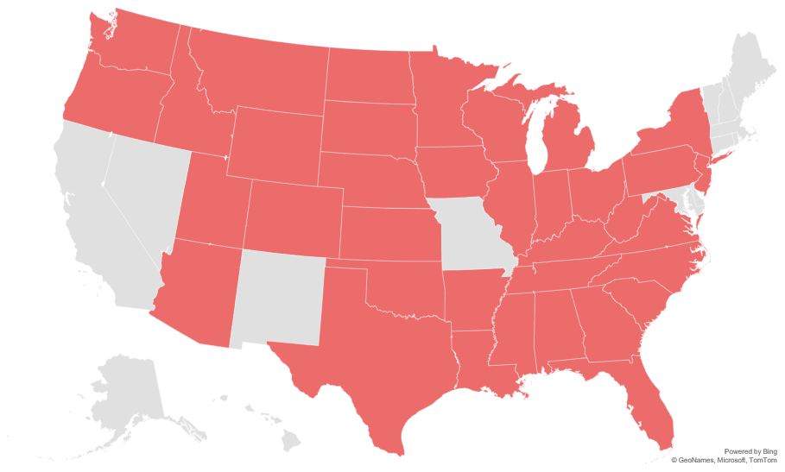
Registration Status:
GrainStar
Registered
Not Registered
Registration status is subject to change and may vary by state.

Slide 19
Wheat & Barley

Slide 20
Grain Fill
Environmental factors that reduce grain fill in wheat & barley
Carbohydrate Accumulation | Influencing Factor | Impact
X | Temperature extremes | Shorter grain fill (>86°F), reduced kernel weight (<59°F)
X | Drought | Limited starch supply, reducing kernel development
X | Insufficient nitrogen | Reduced kernel size and number
X | Healthy flag-leaves | Reduced photosynthesis and ultimately starch for kernel development
X | Heat stress | Reduced starch for kernel development
X | Early frost | Halt grain fill
X | Reduced photosynthesis | Aborted spikelets leading to shorter seed heads

Slide 21

When is Grain Fill?
Percent of grain fill determined at each growing stage in wheat and barley
Tillering
14-35 Days
Stem Elongation
36-60 Days
Boot/
Flag Leaf
61-75 Days
Heading/
Anthesis
76-85 Days
Grain Fill
86-115 Days
Maturity
116-130+ Days
~10-15%
~25-30%
~10-15%
~35-40%
~20-30%
Contribution to Final Yield

Slide 22





U.S. Trials on Wheat & Barley
Timeline
3rd Party Evaluations
Field Trials
109
2022 - 2025
Variables Evaluated
Application
Treatments
Yield
1000 Grain Weight
Protein
Seed Head Length
Phytotoxicity
Grower Standard
GrainStar
1.0 oz/ac

Slide 23

Increased Wheat Yields
Summary of Twenty Trials | Washington, Oregon, Idaho | 2022 - 2025
OVERVIEW
CROP | Soft White Wheat
DESIGN | Randomized Complete Block Summary of Twenty Trials
CONCLUSION
GrainStar was foliar applied in addition to a Grower Standard (GS) between flag leaf and 50% heading. Applications were compared to the GS alone.
Results showed that application of GrainStar improved soft white winter wheat yield on average 4.1 bu/ac more than the GS.
n=20
Summary of Twenty Trials Across WA, OR, & ID
 | TREATMENT | RATE/ACRE | TIMING
 | GrainStar | 1 oz/ac | Flag Leaf to 50% Heading

Slide 24

Increased Grain Weight
Summary of Fifteen Trials | WA, ID, MT | 2025
OVERVIEW
CROP | Wheat
DESIGN | Randomized Complete Block Summary of Fifteen Trials
CONCLUSION
GrainStar was foliar applied in addition to a Grower Standard (GS) between flag leaf and 50% heading. Applications were compared to the GS alone.
Results showed that application of GrainStar resulted in 2.9% greater thousand grain weight (TGW) as compared the GS.
GS + GrainStar
n=15
Summary of Fifteen Trials Across WA, ID, MT
 | TREATMENT | RATE/ACRE | TIMING
 | GrainStar | 1 oz/ac | Flag Leaf to 50% Heading

Slide 25


Increased Seed Head Length
Summary of Seven Trials | WA, OR, NE, KS | 2024 – 2025
OVERVIEW
CROP | Wheat
DESIGN | Randomized Complete Block Summary of Seven Trials
CONCLUSION
GrainStar was foliar applied in addition to a Grower Standard (GS) between flag leaf and 50% heading. Applications were compared to the GS alone.
Results showed that application of GrainStar on wheat resulted in 2% longer primary seed head length compared to the GS.
n=7
Summary of Seven Trials Across WA, OR, NE, & KS
 | TREATMENT | RATE/ACRE | TIMING
 | GrainStar | 1 oz/ac | Flag Leaf to 50% Heading

Slide 26

GrainStar in Oregon
Helena Research | Culver, OR | 2022
OVERVIEW
CROP | Hard Red Spring Wheat
DESIGN | Randomized Complete Block
CONCLUSION
GrainStar was foliar applied in addition to a Grower Standard (GS) between flag leaf and 50% heading. Applications were compared to the GS alone.
Results showed GrainStar increased thousand grain weight (TGW) 0.9 g and wheat yield 6.3 bu/ac when compared to the GS.
GS + GrainStar
GS + GrainStar
LOCAL WEATHER SUMMARY
April - August
Temperature: 57.5°F
Precipitation:
Total Rainfall – 7.0”
Avg Monthly Rainfall – 1.4”
 | TREATMENT | RATE/ACRE | TIMING
 | GrainStar | 1 oz/ac | Flag Leaf to 50% Heading

Slide 27

GrainStar in Washington
Rosalia, Palouse, Davenport, Fairfield, Pullman, Latah, Thorton, WA | 2022 - 2025
OVERVIEW
CROP | Soft White Winter Wheat
DESIGN | Randomized Complete Block Summary of Ten Trials
CONCLUSION
GrainStar was foliar applied in addition to a Grower Standard (GS) between flag leaf and 50% heading. Applications were compared to the GS alone.
Results showed GrainStar improved soft white winter wheat yield on average 5 bu/ac greater than the GS.
n=10
LOCAL WEATHER SUMMARY
Summary of Ten Trials Across WA
September - July
Temperature: 43.9°F
Precipitation:
Avg Monthly Rainfall – 2.46”
 | TREATMENT | RATE/ACRE | TIMING
 | GrainStar | 1 oz/ac | Flag Leaf to 50% Heading

Slide 28
GrainStar in Washington
Crop Matters | Colfax, WA | 2025
OVERVIEW
CROP | Soft White Spring Wheat
DESIGN | Randomized Complete Block
CONCLUSION
GrainStar was foliar applied in addition to a Grower Standard (GS) between flag leaf and 50% heading. Applications were compared to the GS alone.
Results showed GrainStar improved soft white spring wheat yield 4.1 bu/ac greater than the GS.
LOCAL WEATHER SUMMARY
April - July
Temperature: 61.8°F
Precipitation:
Total Rainfall – 3.97”
Avg Monthly Rainfall – 0.99”
 | TREATMENT | RATE/ACRE | TIMING
 | GrainStar | 1 oz/ac | Flag Leaf to 50% Heading

Slide 29

GrainStar in Idaho
Worley, Harvard, Bonners Ferry, Tensed, Genesee, ID | 2022 - 2025
OVERVIEW
CROP | Soft White Winter Wheat
DESIGN | Randomized Complete Block Summary of Six Trials
CONCLUSION
GrainStar was foliar applied in addition to a Grower Standard (GS) between flag leaf and 50% heading. Applications were compared to the GS alone.
Results showed GrainStar improved soft white winter wheat yield on average 8.2 bu/ac greater than the GS.
n=6
LOCAL WEATHER SUMMARY
Summary of Six Trials Across ID
September - July
Temperature: 42.9°F
Precipitation:
Avg Monthly Rainfall – 1.98”
 | TREATMENT | RATE/ACRE | TIMING
 | GrainStar | 1 oz/ac | Flag Leaf to 50% Heading

Slide 30
GrainStar in Oregon
Oregon State University & Helena Research | Pendleton & Wasco, OR | 2023 - 2025
OVERVIEW
CROP | Soft White Winter Wheat
DESIGN | Randomized Complete Block Summary of Four Trials
CONCLUSION
GrainStar was foliar applied in addition to a Grower Standard (GS) between flag leaf and 50% heading. Applications were compared to the GS alone.
Results showed GrainStar improved soft white winter wheat yield on average 3.5 bu/ac greater than the GS.
n=4
LOCAL WEATHER SUMMARY
October – July, 2023 – 2025
Temperature: 47.89°F
Precipitation:
Total Rainfall – 10.84”
Avg Monthly Rainfall – 1.08”
 | TREATMENT | RATE/ACRE | TIMING
 | GrainStar | 1 oz/ac | Flag Leaf to 50% Heading

Slide 31

GrainStar in Montana
Hubbard Ag Science | Fairfield, MT | 2023
OVERVIEW
CROP | Hard Red Spring Wheat
DESIGN | Randomized Complete Block
CONCLUSION
GrainStar was foliar applied in addition to a Grower Standard (GS) between flag leaf and 50% heading. Applications were compared to the GS alone.
Results showed GrainStar improved hard red spring wheat yield 6.7 bu/ac greater than the GS.
LOCAL WEATHER SUMMARY
April - August
Temperature: 59.43°F
Precipitation:
Total Rainfall – 9.62”
Avg Monthly Rainfall – 1.92”
 | TREATMENT | RATE/ACRE | TIMING
 | GrainStar | 1 oz/ac | Flag Leaf to 50% Heading

Slide 32
GrainStar in Montana
Hubbard Ag Science | Choteau, MT | 2023
OVERVIEW
CROP | Malt Barley
DESIGN | Randomized Complete Block
CONCLUSION
GrainStar was foliar applied in addition to a Grower Standard (GS) between flag leaf and 50% heading. Applications were compared to the GS alone.
Results showed GrainStar improved malt barley yield 8.8 bu/ac greater than the GS.
LOCAL WEATHER SUMMARY
April - August
Temperature: 56.0°F
Precipitation:
Total Rainfall – 7.10”
Avg Monthly Rainfall – 1.42”
 | TREATMENT | RATE/ACRE | TIMING
 | GrainStar | 1 oz/ac | Flag Leaf to 50% Heading

Slide 33

GrainStar in Minnesota
Cropwise Research | St. Cloud, MN | 2022
OVERVIEW
CROP | Hard Red Spring Wheat
DESIGN | Randomized Complete Block
CONCLUSION
GrainStar was foliar applied in addition to a Grower Standard (GS) between flag leaf and 50% heading. Applications were compared to the GS alone.
Results showed GrainStar improved hard red spring wheat yield 3 bu/ac greater than the GS.
LOCAL WEATHER SUMMARY
April - August
Temperature: 61.6°F
Precipitation:
Total Rainfall – 23.00”
Avg Monthly Rainfall – 4.60”
 | TREATMENT | RATE/ACRE | TIMING
 | GrainStar | 1 oz/ac | Flag Leaf to 50% Heading

Slide 34

GrainStar in Missouri
AgIdea | Marshall, MO | 2024
OVERVIEW
CROP | Soft Red Winter Wheat
DESIGN | Randomized Complete Block
CONCLUSION
GrainStar was foliar applied in addition to a Grower Standard (GS) between flag leaf and 50% heading. Applications were compared to the GS alone.
Results showed GrainStar improved soft red winter wheat yield 4.2 bu/ac greater than the GS.
LOCAL WEATHER SUMMARY
October – June
Temperature: 48.4°F
Precipitation:
Total Rainfall – 20.21”
Avg Monthly Rainfall – 2.25”
 | TREATMENT | RATE/ACRE | TIMING
 | GrainStar | 1 oz/ac | Flag Leaf to 50% Heading

Slide 35

GrainStar in North Dakota
Riverton Research | Ayr, ND | 2024
OVERVIEW
CROP | Hard Red Winter Wheat
DESIGN | Randomized Complete Block
CONCLUSION
GrainStar was foliar applied in addition to a Grower Standard (GS) between flag leaf and 50% heading. Applications were compared to the GS alone.
Results showed GrainStar improved hard red spring wheat yield 3 bu/ac greater than the GS.
LOCAL WEATHER SUMMARY
September - July
Temperature: 38.6°F
Precipitation:
Total Rainfall – 16.85”
Avg Monthly Rainfall – 1.53”
 | TREATMENT | RATE/ACRE | TIMING
 | GrainStar | 1 oz/ac | Flag Leaf to 50% Heading

Slide 36

GrainStar in Texas
Great Plains Research & Richburg Research | Claude & Kress, TX | 2023
OVERVIEW
CROP | Hard Red Winter Wheat
DESIGN | Randomized Complete Block Summary of Two Trials
CONCLUSION
GrainStar was foliar applied in addition to a Grower Standard (GS) between flag leaf and 50% heading. Applications were compared to the GS alone.
Results showed GrainStar improved hard red winter wheat yield on average 6 bu/ac greater than the GS.
LOCAL WEATHER SUMMARY
September - July
Temperature: 38.6°F
Precipitation:
Total Rainfall – 16.85”
Avg Monthly Rainfall – 1.53”
 | TREATMENT | RATE/ACRE | TIMING
 | GrainStar | 1 oz/ac | Flag Leaf to 50% Heading

Slide 37

Study Performance
2021-2025 GrainStar Study Findings on Wheat & Barley
GrainStar studies in the U.S. support the following:
GrainStar increases grain yield (Bu/Ac)
Phytotoxicity was not observed with GrainStar
GrainStar increases thousand grain weight
GrainStar increases primary seed head length
GrainStar has been shown to be compatible with commonly applied fungicides

Slide 38
Soybeans

Slide 39
U.S. Trials on Soybeans
Timeline
3rd Party Evaluations
Field Trials
14
2025
Variables Evaluated
Application
Treatments
Yield
Phytotoxicity
Grower Standard
GrainStar
1.0 oz/ac

Slide 40

GrainStar in Louisiana
Delta Crop Research | Lake Providence, MS | 2025
OVERVIEW
CROP | Soybeans
DESIGN | Randomized Complete Block Summary of Two Trials
CONCLUSION
GrainStar was foliar applied in addition to a Grower Standard (GS) at R2-R3. Applications were compared to the GS alone.
Results showed GrainStar improved soybean yields on average 5.1 bu/ac greater than the GS.
LOCAL WEATHER SUMMARY
Summary of Two Trials Across LA
April - September
Temperature: 79.1°F
Precipitation:
Total Rainfall: 26.47”
Avg Monthly Rainfall – 4.41”
 | TREATMENT | RATE/ACRE | TIMING
 | GrainStar | 1 oz/ac | R2 – R3

Slide 41

GrainStar in Mississippi
Delta Crop Research | Indianola, MS | 2025
OVERVIEW
CROP | Soybeans
DESIGN | Randomized Complete Block
CONCLUSION
GrainStar was foliar applied in addition to a Grower Standard (GS) at R2-R3. Applications were compared to the GS alone.
Results showed GrainStar improved soybean yields 4.1 bu/ac greater than the GS.
LOCAL WEATHER SUMMARY
April - September
Temperature: 78.3°F
Precipitation:
Total Rainfall – 29.87”
Avg Monthly Rainfall – 4.98”
 | TREATMENT | RATE/ACRE | TIMING
 | GrainStar | 1 oz/ac | R2 – R3

Slide 42

GrainStar in Iowa
AgIdea | Nevada, IA | 2024
OVERVIEW
CROP | Soybeans
DESIGN | Randomized Complete Block
CONCLUSION
GrainStar was foliar applied in addition to a Grower Standard (GS) at R2-R3. Applications were compared to the GS alone.
Results showed GrainStar improved soybean yields 6.4 bu/ac greater than the GS.
LOCAL WEATHER SUMMARY
April - September
Temperature: 68.5°F
Precipitation:
Total Rainfall – 26.08”
Avg Monthly Rainfall – 4.35”
 | TREATMENT | RATE/ACRE | TIMING
 | GrainStar | 1 oz/ac | R2 – R3

Slide 43

GrainStar in Arkansas
Delta Crop Research | Eudora, AR | 2024
OVERVIEW
CROP | Soybeans
DESIGN | Randomized Complete Block
CONCLUSION
GrainStar was foliar applied in addition to a Grower Standard (GS) at R2-R3. Applications were compared to the GS alone.
Results showed GrainStar improved soybean yields 3.5 bu/ac greater than the GS.
LOCAL WEATHER SUMMARY
April - September
Temperature: 78.1°F
Precipitation:
Total Rainfall – 24.73”
Avg Monthly Rainfall – 4.12”
 | TREATMENT | RATE/ACRE | TIMING
 | GrainStar | 1 oz/ac | R2 – R3

Slide 44
GrainStar in Arkansas
Delta Crop Research | Winchester, AR | 2024
OVERVIEW
CROP | Soybeans
DESIGN | Randomized Complete Block Summary of Two Trials
CONCLUSION
GrainStar was foliar applied in addition to a Grower Standard (GS) at R2-R3. Applications were compared to the GS alone.
Results showed GrainStar improved soybean yields on average 5.2 bu/ac greater than the GS.
LOCAL WEATHER SUMMARY
April - September
Temperature: 77.0°F
Precipitation:
Total Rainfall – 22.84”
Avg Monthly Rainfall – 3.81”
 | TREATMENT | RATE/ACRE | TIMING
 | GrainStar | 1 oz/ac | R2 – R3

Slide 45
GrainStar in Louisiana
Delta Crop Research | Lake Providence, LA | 2025
OVERVIEW
CROP | Soybeans
DESIGN | Randomized Complete Block
CONCLUSION
GrainStar was foliar applied in addition to a Grower Standard (GS) at R2-R3. Applications were compared to the GS alone.
Results showed GrainStar improved soybean yields 5.1 bu/ac greater than the GS.
LOCAL WEATHER SUMMARY
April - September
Temperature: 78.5°F
Precipitation:
Total Rainfall – 23.07”
Avg Monthly Rainfall – 3.85”
 | TREATMENT | RATE/ACRE | TIMING
 | GrainStar | 1 oz/ac | R2 – R3

Slide 46
Study Performance
2025 GrainStar Study Findings on Soybeans
GrainStar studies in the U.S. support the following:
GrainStar increases soybean yield (Bu/Ac)
Phytotoxicity was not observed with GrainStar

Slide 47
Corn

Slide 48
U.S. Trials on Corn
Timeline
3rd Party Evaluations
Field Trials
79
2024-2025
Variables Evaluated
Application
Treatments
Yield
Phytotoxicity
Grower Standard
GrainStar
0.7 oz/ac

Slide 49

GrainStar on Corn Yield
Summary of Ten Trials | IA, IL, IN, KS, KY, MO, NE, OH, SD | 2025
OVERVIEW
CROP | Corn
DESIGN | Randomized Complete Block Summary of Ten Trials
CONCLUSION
GrainStar was foliar applied in addition to a Grower Standard (GS) at VT-R1. Applications were compared to the GS alone.
Results showed GrainStar improved corn yields on average 6.8 bu/ac greater than the GS.
n=10
LOCAL WEATHER SUMMARY
Summary of Ten Trials Across IA, IL, IN, KS, KY, MO, NE, OH, SD
April - October
Temperature: 68.5°F
Precipitation:
Total Rainfall – 25.20”
Avg Monthly Rainfall – 4.19”
 | TREATMENT | RATE/ACRE | TIMING
 | GrainStar | 0.7 oz/ac | VT – R1

Slide 50

GrainStar on Grain Weight
Summary of Seven Trials | IA, IN, MO, OH, SD | 2025
OVERVIEW
CROP | Corn
DESIGN | Randomized Complete Block Summary of Seven Trials
CONCLUSION
GrainStar was foliar applied in addition to a Grower Standard (GS) at VT-R1. Applications were compared to the GS alone.
Results showed GrainStar improved thousand grain weight of the kernel on average 21.4 g more than the GS.
n=10
LOCAL WEATHER SUMMARY
Summary of Seven Trials Across IA, IN, MO, OH, SD
April - October
Temperature: 68.5°F
Precipitation:
Total Rainfall – 24.60”
Avg Monthly Rainfall – 4.08”
 | TREATMENT | RATE/ACRE | TIMING
 | GrainStar | 0.7 oz/ac | VT – R1

Slide 51

GrainStar in Illinois
AgIdea | Sparta, IL | 2024
OVERVIEW
CROP | Corn
DESIGN | Randomized Complete Block Summary of Two Trials
CONCLUSION
GrainStar was foliar applied in addition to a Grower Standard (GS) at VT-R1. Applications were compared to the GS alone.
The addition of GrainStar increased corn yields on average 4.8 bu/ac compared to the GS.
LOCAL WEATHER SUMMARY
April - August
Temperature: 75.0°F
Precipitation:
Total Rainfall – 20.0”
Avg Monthly Rainfall – 4.0”
 | TREATMENT | RATE/ACRE | TIMING
 | GrainStar | 0.7 oz/ac | VT – R1

Slide 52

GrainStar in Kansas
AgIdea | Lawrence, KS | 2024
OVERVIEW
CROP | Corn
DESIGN | Randomized Complete Block Summary of Two Trials
CONCLUSION
GrainStar was foliar applied in addition to a Grower Standard (GS) at VT-R1. Applications were compared to the GS alone.
Results showed GrainStar improved corn yields 8.1 bu/ac greater than the GS.
LOCAL WEATHER SUMMARY
April - September
Temperature: 71.2°F
Precipitation:
Total Rainfall – 23.44”
Avg Monthly Rainfall – 3.91”
 | TREATMENT | RATE/ACRE | TIMING
 | GrainStar | 0.7 oz/ac | VT – R1

Slide 53

GrainStar in Ohio
Buckeye Ag Testing | Troy, OH | 2024
OVERVIEW
CROP | Corn
DESIGN | Randomized Complete Block
CONCLUSION
GrainStar was foliar applied in addition to a Grower Standard (GS) at VT-R1. Applications were compared to the GS alone.
Results showed GrainStar improved corn yields 10.3 bu/ac greater than the GS.
LOCAL WEATHER SUMMARY
April - September
Temperature: 69.2°F
Precipitation:
Total Rainfall – 21.87”
Avg Monthly Rainfall – 3.65”
 | TREATMENT | RATE/ACRE | TIMING
 | GrainStar | 0.7 oz/ac | VT – R1

Slide 54

GrainStar in Nebraska
Elite Research | Aurora, NE | 2025
OVERVIEW
CROP | Corn
DESIGN | Randomized Complete Block Summary of Two Trials
CONCLUSION
GrainStar was foliar applied in addition to a Grower Standard (GS) at VT-R1. Applications were compared to the GS alone.
Results showed GrainStar improved corn yields on average 5.0 bu/ac greater than the GS.
n=2
LOCAL WEATHER SUMMARY
April - September
Temperature: 68.4°F
Precipitation:
Total Rainfall – 22.91”
Avg Monthly Rainfall – 3.82”
 | TREATMENT | RATE/ACRE | TIMING
 | GrainStar | 0.7 oz/ac | VT – R1

Slide 55
GrainStar in Kansas
Performance Research | Great Bend, KS | 2025
OVERVIEW
CROP | Corn
DESIGN | Randomized Complete Block’ Summary of Two Trials
CONCLUSION
GrainStar was foliar applied in addition to a Grower Standard (GS) at VT-R1. Applications were compared to the GS alone.
Results showed GrainStar improved corn yields on average 6.2 bu/ac greater than the GS.
n=2
LOCAL WEATHER SUMMARY
April - September
Temperature: 72.5°F
Precipitation:
Total Rainfall – 23.37”
Avg Monthly Rainfall – 3.90”
 | TREATMENT | RATE/ACRE | TIMING
 | GrainStar | 0.7 oz/ac | VT – R1

Slide 56
GrainStar in Iowa
SynTech | Nevada, IA | 2025
OVERVIEW
CROP | Corn
DESIGN | Randomized Complete Block
CONCLUSION
GrainStar was foliar applied in addition to a Grower Standard (GS) at VT-R1. Applications were compared to the GS alone.
Results showed GrainStar improved corn yields 8.3 bu/ac greater than the GS.
LOCAL WEATHER SUMMARY
April - September
Temperature: 66.5°F
Precipitation:
Total Rainfall – 35.64”
Avg Monthly Rainfall – 5.94”
 | TREATMENT | RATE/ACRE | TIMING
 | GrainStar | 0.7 oz/ac | VT – R1

Slide 57
GrainStar in Iowa
KMR | Carroll & Storm Lake, IA | 2025
OVERVIEW
CROP | Corn
DESIGN | Randomized Complete Block Summary of Two Trials
CONCLUSION
GrainStar was foliar applied in addition to a Grower Standard (GS) at VT-R1. Applications were compared to the GS alone.
Results showed GrainStar improved corn yields on average 8.3 bu/ac greater than the GS.
n=2
LOCAL WEATHER SUMMARY
April - September
Temperature: 66.2°F
Precipitation:
Total Rainfall – 29.83”
Avg Monthly Rainfall – 4.97”
 | TREATMENT | RATE/ACRE | TIMING
 | GrainStar | 0.7 oz/ac | VT – R1

Slide 58

GrainStar in South Dakota
ABG | Toronto, SD | 2025
OVERVIEW
CROP | Corn
DESIGN | Randomized Complete Block
CONCLUSION
GrainStar was foliar applied in addition to a Grower Standard (GS) at VT-R1. Applications were compared to the GS alone.
Results showed GrainStar improved corn yields 9.9 bu/ac greater than the GS.
LOCAL WEATHER SUMMARY
April - September
Temperature: 64.7°F
Precipitation:
Total Rainfall – 24.31”
Avg Monthly Rainfall – 4.05”
 | TREATMENT | RATE/ACRE | TIMING
 | GrainStar | 0.7 oz/ac | VT – R1

Slide 59

GrainStar in Indiana
ABG | Sheridan, IN | 2025
OVERVIEW
CROP | Corn
DESIGN | Randomized Complete Block Summary of Two Trials
CONCLUSION
GrainStar was foliar applied in addition to a Grower Standard (GS) at VT-R1. Applications were compared to the GS alone.
Results showed GrainStar improved corn yields on average 18.7 bu/ac greater than the GS.
n=2
LOCAL WEATHER SUMMARY
April - September
Temperature: 68.0°F
Precipitation:
Total Rainfall – 25.18”
Avg Monthly Rainfall – 4.20”
 | TREATMENT | RATE/ACRE | TIMING
 | GrainStar | 0.7 oz/ac | VT – R1

Slide 60

GrainStar in Kentucky
Alliance Research | Rumsey, KY | 2025
OVERVIEW
CROP | Corn
DESIGN | Randomized Complete Block
CONCLUSION
GrainStar was foliar applied in addition to a Grower Standard (GS) at VT-R1. Applications were compared to the GS alone.
Results showed GrainStar improved corn yields 4.3 bu/ac greater than the GS.
LOCAL WEATHER SUMMARY
April - September
Temperature: 72.6°F
Precipitation:
Total Rainfall – 32.04”
Avg Monthly Rainfall – 5.34”
 | TREATMENT | RATE/ACRE | TIMING
 | GrainStar | 0.7 oz/ac | VT – R1

Slide 61
Study Performance
2024-2025 GrainStar Study Findings on Corn
GrainStar studies in the U.S. support the following:
GrainStar increases corn yield (Bu/Ac)
Phytotoxicity was not observed with GrainStar

Slide 62
Rice

Slide 63
U.S. Trials on Rice
Timeline
3rd Party Evaluations
Field Trials
9
2025
Variables Evaluated
Application
Treatments
Yield
Phytotoxicity
Grower Standard
GrainStar
0.7 oz/ac

Slide 64
GrainStar in Louisiana
Louisiana State University | Baton Rouge, LA | 2025
OVERVIEW
CROP | Rice
VARIETY | Hybrid
DESIGN | Randomized Complete Block
CONCLUSION
GrainStar was foliar applied in addition to a Grower Standard (GS) at 50% heading. Applications were compared to the GS alone.
Results showed GrainStar improved hybrid rice yields 5.4 bu/ac greater than the GS.
LOCAL WEATHER SUMMARY
March - August
Temperature: 77.1°F
Precipitation:
Total Rainfall – 37.46”
Avg Monthly Rainfall – 6.24”
 | TREATMENT | RATE/ACRE | TIMING
 | GrainStar | 0.7 oz/ac | 50% Heading

Slide 65
GrainStar in Louisiana
Delta Crop Research | Lake Providence, LA | 2025
OVERVIEW
CROP | Rice
VARIETY | Inbred
DESIGN | Randomized Complete Block
CONCLUSION
GrainStar was foliar applied in addition to a Grower Standard (GS) at 50% heading. Applications were compared to the GS alone.
Results showed GrainStar improved inbred rice yields 4.3 bu/ac greater than the GS.
LOCAL WEATHER SUMMARY
March – August
Temperature: 78.2°F
Precipitation:
Total Rainfall – 25.14”
Avg Monthly Rainfall – 4.19”
 | TREATMENT | RATE/ACRE | TIMING
 | GrainStar | 0.7 oz/ac | 50% Heading

Slide 66

GrainStar in Missouri
University of Missouri | Portageville, MO | 2025
OVERVIEW
CROP | Rice
VARIETY | Conventional
DESIGN | Randomized Complete Block
CONCLUSION
GrainStar was foliar applied in addition to a Grower Standard (GS) at 50% heading. Applications were compared to the GS alone.
Results showed GrainStar improved conventional rice yields 88.3 bu/ac greater than the GS.
LOCAL WEATHER SUMMARY
April - September
Temperature: 74.0°F
Precipitation:
Total Rainfall – 27.00”
Avg Monthly Rainfall – 4.49”
 | TREATMENT | RATE/ACRE | TIMING
 | GrainStar | 0.7 oz/ac | 50% Heading

Slide 67
GrainStar in Missouri
University of Missouri | Portageville, MO | 2025
OVERVIEW
CROP | Rice
VARIETY | Hybrid
DESIGN | Randomized Complete Block
CONCLUSION
GrainStar was foliar applied in addition to a Grower Standard (GS) at 50% heading. Applications were compared to the GS alone.
Results showed GrainStar improved hybrid rice yields 50 bu/ac greater than the GS.
LOCAL WEATHER SUMMARY
April - September
Temperature: 74.0°F
Precipitation:
Total Rainfall – 27.00”
Avg Monthly Rainfall – 4.49”
 | TREATMENT | RATE/ACRE | TIMING
 | GrainStar | 0.7 oz/ac | 50% Heading

Slide 68
GrainStar in Arkansas
River Bend Ag | Haynes, AR | 2025
OVERVIEW
CROP | Rice
VARIETY | Conventional
DESIGN | Randomized Complete Block
CONCLUSION
GrainStar was foliar applied in addition to a Grower Standard (GS) at 50% heading. Applications were compared to the GS alone.
Results showed GrainStar improved conventional rice yields 11.6 bu/ac greater than the GS.
LOCAL WEATHER SUMMARY
April - September
Temperature: 74.6°F
Precipitation:
Total Rainfall – 20.00”
Avg Monthly Rainfall – 3.33”
 | TREATMENT | RATE/ACRE | TIMING
 | GrainStar | 0.7 oz/ac | 50% Heading

Slide 69
GrainStar in Arkansas
River Bend Ag | Haynes, AR | 2025
OVERVIEW
CROP | Rice
VARIETY | Hybrid
DESIGN | Randomized Complete Block
CONCLUSION
GrainStar was foliar applied in addition to a Grower Standard (GS) at 50% heading. Applications were compared to the GS alone.
Results showed GrainStar improved hybrid rice yields 7.1 bu/ac greater than the GS.
LOCAL WEATHER SUMMARY
April - September
Temperature: 74.6°F
Precipitation:
Total Rainfall – 20.00”
Avg Monthly Rainfall – 3.33”
 | TREATMENT | RATE/ACRE | TIMING
 | GrainStar | 0.7 oz/ac | 50% Heading

Slide 70

GrainStar in Mississippi
Delta Crop Research | Leland, MS | 2025
OVERVIEW
CROP | Rice
VARIETY | Inbred
DESIGN | Randomized Complete Block
CONCLUSION
GrainStar was foliar applied in addition to a Grower Standard (GS) at 50% heading. Applications were compared to the GS alone.
Results showed GrainStar improved inbred rice yields 3.4 bu/ac greater than the GS.
LOCAL WEATHER SUMMARY
March - August
Temperature: 77.2°F
Precipitation:
Total Rainfall – 25.46”
Avg Monthly Rainfall – 4.24”
 | TREATMENT | RATE/ACRE | TIMING
 | GrainStar | 0.7 oz/ac | 50% Heading

Slide 71
GrainStar in Texas
Texas A&M | Beaumont, TX | 2025
OVERVIEW
CROP | Rice
VARIETY | Inbred
DESIGN | Randomized Complete Block
CONCLUSION
GrainStar was foliar applied in addition to a Grower Standard (GS) at 50% heading. Applications were compared to the GS alone.
Results showed GrainStar improved inbred rice yields 7.8 bu/ac greater than the GS.
LOCAL WEATHER SUMMARY
March - August
Temperature: 78.7°F
Precipitation:
Total Rainfall – 19.59”
Avg Monthly Rainfall – 3.27”
 | TREATMENT | RATE/ACRE | TIMING
 | GrainStar | 0.7 oz/ac | 50% Heading

Slide 72
Study Performance
2025 GrainStar Study Findings on Rice
GrainStar studies in the U.S. support the following:
GrainStar increases rice yield (Bu/Ac)
Phytotoxicity was not observed with GrainStar

Slide 73

Contains S-ABA plant growth regulator
Right time, right place application improves:
  Carbohydrate mobility
  Increased grain fill
  Drought stress mitigation
Carbohydrate Mobility
Increased Grain Fill
Drought Stress Mitigation

