Slide 1
BenePhite® Expand
Training Deck

Slide 2
BenePhite® Expand
Training Summary
1
Product Overview
2
Mode of Action
3
Application Information
4
Field Data

Slide 3
Product Overview

Slide 4

BenePhite® Expand
Nutrition
BenePhite® Expand is a phosphorus product built with our Transit® biostimulant. By pairing phosphite, a highly plant-available form of phosphorus, with targeted organic acids and key nutrition, BenePhite Expand delivers a readily available nutritive boost to enhance photosynthetic activity for improved canopy development and fruit quality.

Slide 5
Features & Benefits
Benephite Expand
Improved Fruit Quality
Enhanced Canopy Development
Optimized Formulation
Enhances phosphate mobility for increased cell wall strength to support fruit firmness.
Supports new leaf growth for robust canopy development.
Formulated to reduce the risk of phytotoxicity.

Slide 6


Guaranteed Analysis
Benephite Expand
Guaranteed Analysis: Total Phosphoric Acid (P₂O₅)…............................ 19.0% Cobalt (Co) …….................................................... 0.05% Iron (Fe) ……........................................................ 0.75% Manganese (Mn) ……........................................... 1.75% Molybdenum (Mo) ……......................................... 0.10% Zinc (Zn) ……......................................................... 4.0%
Derived from: Phosphorous acid, zinc phosphite, manganese phosphite, iron phosphite, cobalt nitrate, and sodium molybdate.

Slide 7
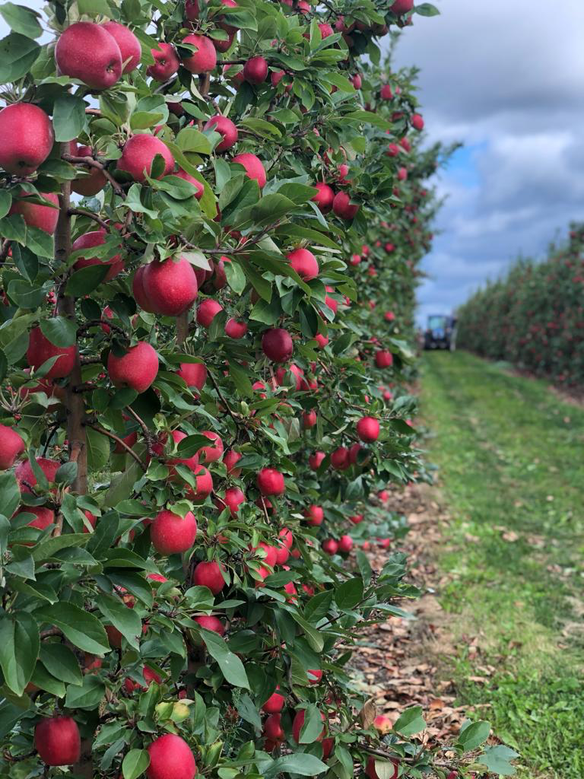
BenePhite Expand
Formulation | Soluble Liquid
Package Size | 2 x 2.5 Gal, 275 Gal
Application | Foliar; Compatible with herbicides, insecticides, and fungicides
Target Crops | Tree fruit, tree nuts, fruiting vegetables
Application Rates | 0.5 – 4.0 qt/ac
Uses | Conventional
Shelf Life | 2 Years

Slide 8
Mode of Action

Slide 9

What is Transit?
Unique highly bioactive compound
Targeted mixture of thousands of bioactive compounds
Transit is the result of a proprietary extraction method that uses early-stage biomass
It contains natural, biologically active, and diverse functional groups
Bioactive compounds in Transit have high oxygen to carbon ratios to enhance biological activity in plants
Humic substances
Humins
B vitamins
Fulvic acids
Acids
Inorganic salts
Proteins
Amino acids
Other organic acids
Mycorrhizae, Trichoderma, other beneficial fungi
Protein hydrolysates
Fatty acids/lipids
Beneficial elements (Si, Na, Co, etc.)
Other
PGPRs
Cytokinins
Microbials
Nitrogenous
compounds
Polyamines
Peptides
Rhizobium
Phosphites
Betaines
Polyphenols
Complex communities/
consortia
Enzymatic extracts
Chitin/ chitosan
Seaweed/kelp
Phytohormones
Extracts
Laminarin, alginates, other polysaccharides
Other organic matters extracts
Botanicals
Allelochemicals

Slide 10
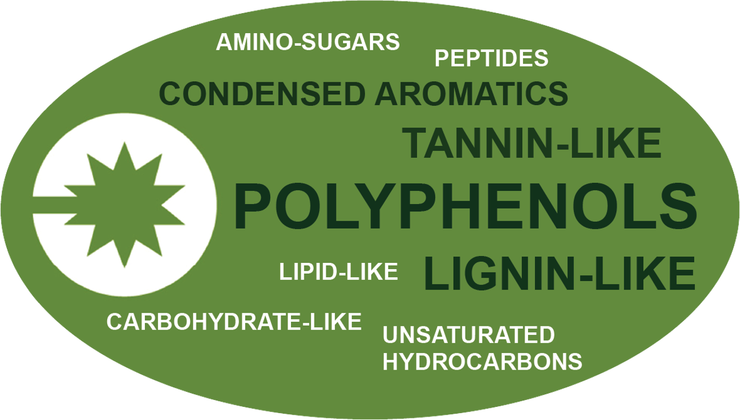
Transit Technology
What is it made of?
Key, diverse functional groups that are biologically active in plants

Slide 11
Transit® Mode of Action
Plant Response to Transit
Benefit | How
Improved Nutrient Mobility | Down regulation of binding proteins to improve nutrient translocation of non-mobile nutrients.

Slide 12
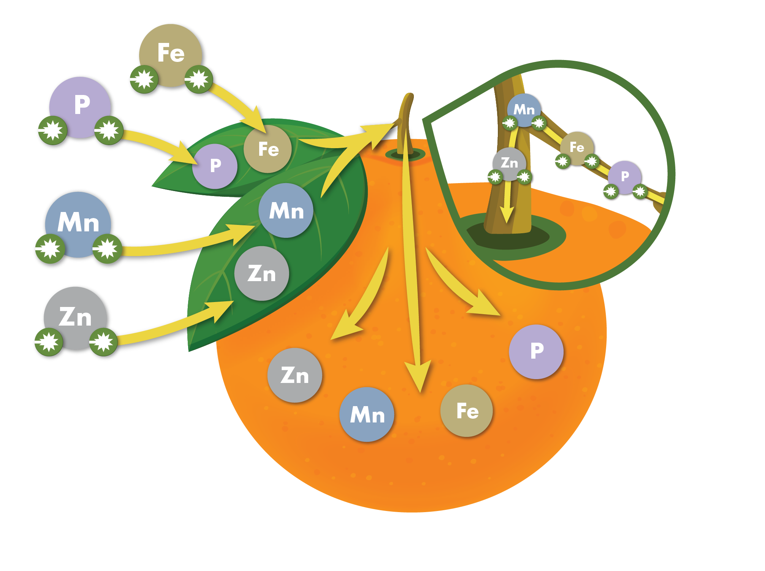
How it Works
Transit Biostimulant enhances nutrition

Slide 13
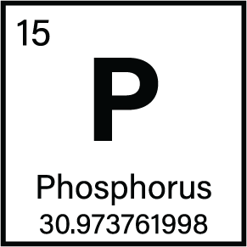
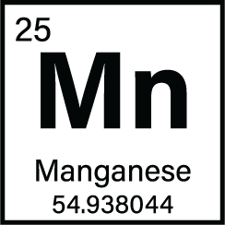

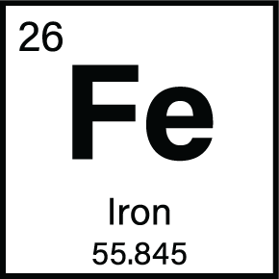
Key Roles of Nutrients on Crop Development
Phosphorous supports fruit sizing and maturity.
Manganese supports photosynthesis and nitrogen and auxin metabolism.
Zinc improves photosynthetic efficiency.
Iron supports chlorophyll formation and photosynthesis.

Slide 14
Application Information

Slide 15

General Application Guidelines
Can be utilized with many common fungicides, insecticides, and fertilizers
  A standard jar test is recommended before tank mixing
  Recommended mixing sequence: water, adjuvants, BenePhite Expand, pesticides, other fertilizers, balance of water while agitating
If BenePhite Expand is blended with other products, always mix prior to application
Maintain continuous agitation during application
Use as fine of a spray mist as possible
DO NOT spray in the heat of the day or when the plant is under moisture stress
DO NOT spray to the point of runoff
DO NOT irrigate 3-4 hours after application or apply if rainfall is expected within 3-4 hours

Slide 16
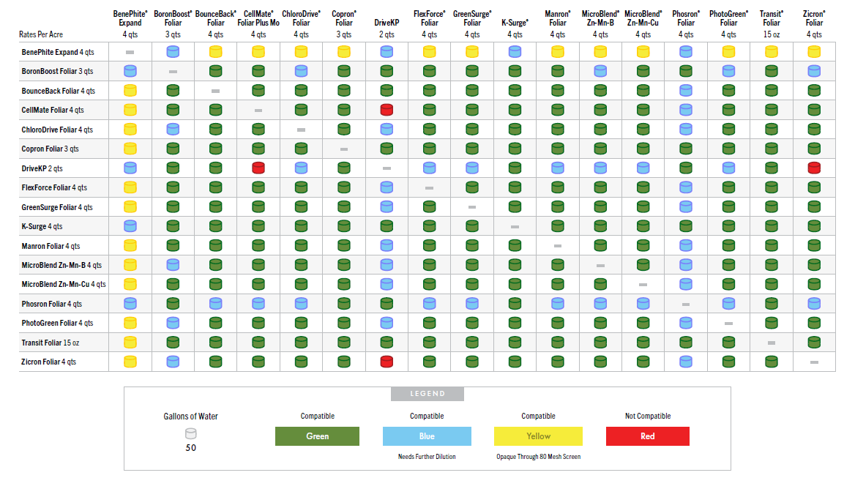
BenePhite Expand Compatibility
A standard jar test is recommended before tank mixing. Always read and follow label instructions.

Slide 17
Application Rates & Timing
Crop Type | Use Rate/Acre | Application Timing
All crops | 0.5 – 4.0 qt/ac | Repeat every 2-3 weeks

Slide 18

Registration Status:
Benephite Expand
Registered
Not Registered
Registration status is subject to change and may vary by state.

Slide 19
Field Data

Slide 20

BenePhite Expand Increased Leaf Tissue Nutrients
Retailer | Willows, CA | 2022
OVERVIEW
CROP | Almonds
VARIETY | Nonpareil, Carmel, and Aldrich
DESIGN | Side-by-Side
CONCLUSION
BenePhite Expand was foliar applied monthly in addition to a Grower Standard (GS) program and compared to the GS alone, inclusive of a competitive product.
The addition of BenePhite Expand resulted in higher leaf tissue concentrations of boron, zinc, manganese and iron compared to the GS plus a competitive product.
 | TREATMENT | RATE/ACRE | TIMING
 | BenePhite | 1 qt/ac | 3/10/2022 4/1/2022 6/28/2022
LOCAL WEATHER SUMMARY
March – August
Temperature: 68.6°F
Precipitation:
Total Rainfall – 2.56”
Avg Monthly Rainfall – 0.43”

Slide 21
BenePhite Expand on Almonds
Grower | Willows, CA | 2022
OVERVIEW
CROP | Almonds (3rd leaf)
VARIETY | Nonpareil, var. Bennet
DESIGN | Randomized complete block
CONCLUSION
BenePhite Expand was foliar applied in addition to a Grower Standard (GS) program and compared to the GS alone and two competitive phosphite nutritional products.
The addition of BenePhite Expand resulted in an average 7.4% increase in young almond tree trunk diameter compared to the competitive products.
 | TREATMENT | RATE/ACRE | TIMING
 | BenePhite | 1 qt/ac | 5/26/2022 6/16/2022 7/12/2022
 | Competitive Product A 0-25-0 +Fe | 1 qt/ac
 | Competitive Product B 0-35-0 | 1 qt/ac
LOCAL WEATHER SUMMARY
March – August
Temperature: 68.6°F
Precipitation:
Total Rainfall – 2.56”
Avg Monthly Rainfall – 0.43”

Slide 22
BenePhite Expand on Walnuts
Grower Trial | Colusa County, CA | 2021
OVERVIEW
CROP | Walnuts
DESIGN | Large Scale Split Plot
CONCLUSION
BenePhite Expand was foliar applied in addition to a Grower Standard (GS) program and compared to a competitive 0-20-0 product applied in addition to the GS.
The application of BenePhite Expand resulted in an average 13.1% increase in leaf tissue nutrients compared to the competitive product.
 | TREATMENT | RATE/ACRE | Leaf Tissue Samples Taken
 | BenePhite | 1 qt/ac | 5/26/2022 6/16/2022 7/12/2022
 | Competitive Product 0-20-0 | 1 qt/ac
LOCAL WEATHER SUMMARY
April – October
Temperature: 72.6°F
Precipitation:
Total Rainfall – 4.57”
Avg Monthly Rainfall – 0.65”

Slide 23



Contains Transit biostimulant for enhanced nutrient mobility
Right time, right place application improves:
  Fruit quality
  Canopy development
  Optimized formulation
Improved Fruit Quality
Enhanced Canopy Development
Optimized Formulation

