Slide 1
SugarMax Sales Presentation
Name
Date

Slide 2
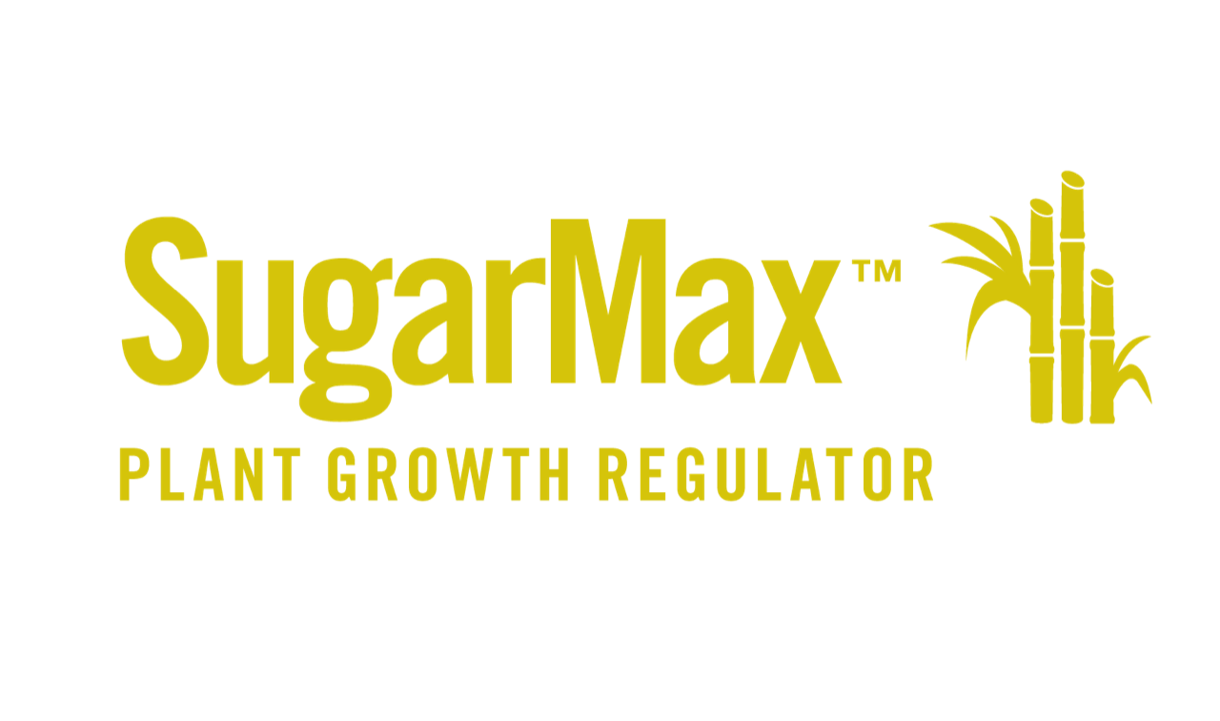
SugarMaxTM
Plant Growth Regulator
SugarMax, a plant growth regulator, is a novel ripening agent for sugarcane. SugarMax promotes ripening and sugar accumulation in plant stems, resulting in greater sucrose availability, higher cane yield, and increased sugar productivity per acre, without damaging regrowth in the ratoon crop.
Notes:
Build your capacity – FlexForce increases leaf area and photosynthetic pathways therefore you have enhanced nutrient storage potential such that when you transition to reproductive stages you have more stored nutrition in the leaves to pull from.
More leaf area, more storage stability in the leaves
Transition to R stages, move to pulling from soil to pulling from leaves (which was maximized in the V stages)

Slide 3
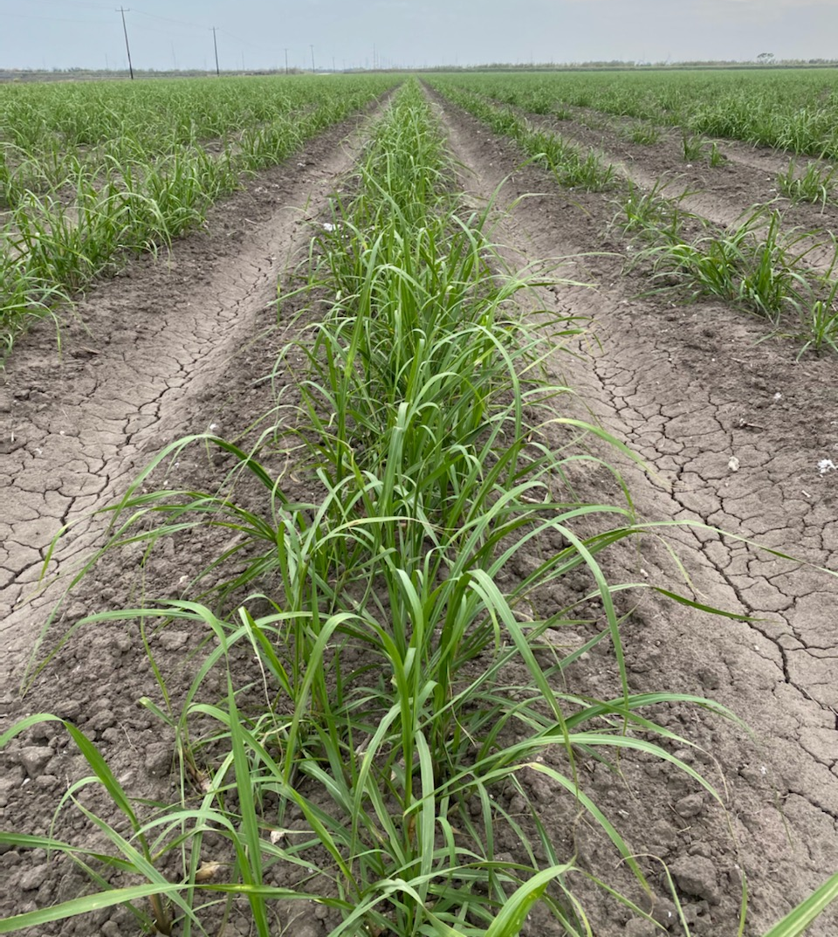
Overview
Water-soluble formulation
Contains s-abscisic acid (S-ABA)
For use on sugarcane and sugar beets
Promotes ripening and tonnage for greater sugar production per acre
Notes:
Plays an important role in growth hormone production (KF).

Slide 4


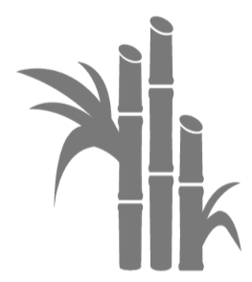
Features & Benefits
SugarMax Plant Growth Regulator
Improved Ripening
Cane Yield
Better Regrowth
SugarMax promotes ripening and increases sugar accumulation in the cane for greater sugar recovery.
Applications of SugarMax increase cane growth for higher sucrose yield per acre.
SugarMax does not negatively affect the cane regrowth in the ratoon crop, leading to more profitable plantings.
Notes:
Applications help accelerate ripening for harvest management control.

Slide 5
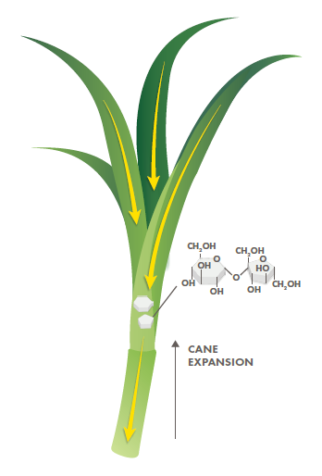
How it Works
SugarMax increases sugar movement from the leaves to the cane
SugarMax increases cane expansion for greater tonnage

Slide 6
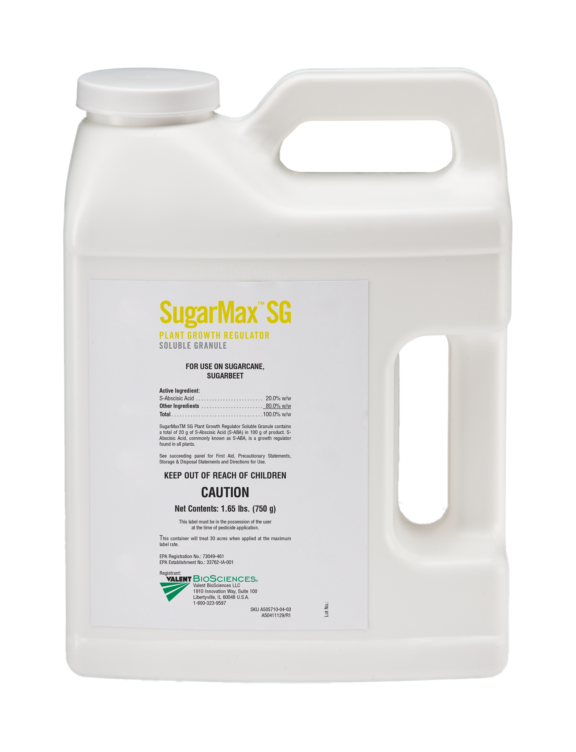

Ingredient Statement
Active Ingredient: S-Abscisic Acid……………................. 20.0% Other Ingredients………………………………….…………80.0% TOTAL........................................................................... 100.0%
Contains a total of 20 g S-Abscisic Acid (S-ABA) in 100 g of product.
EPA Reg. No. 73049-461 EPA Est. No. 33762-IA-001

Slide 7
Application Rates & Timing
Crop Type | Use Rate/Acre | Application Timing
Sugarcane | 0.5 oz/ac | Apply 4-8 weeks prior to harvest

Slide 8
SugarMax on Sugarcane
Rate | Timing
0.5 oz/ac | 4-8 Weeks Before Harvest
Across 10 studies, application of SugarMax resulted in a higher average concentration of sugar per ton of cane as compared to competitive ripener products and the untreated control (UTC).
Notes:
Studies completed in Guatemala 2020-2022

Slide 9
SugarMax on Sugarcane
600 lbs/acre increase in sugar is an additional $222/ac in ROI
Rate | Timing
0.5 oz/ac | 4-8 Weeks Before Harvest
Application Timing: 6 weeks before harvest
Trial Location: Cheneyville, LA
Variety: L 01-299

Slide 10
SugarMax on Sugarcane
Up to 897 lbs/acre increase in sugar is an additional $332/ac in ROI
Rate | Timing
0.5 oz/ac | 4-8 Weeks Before Harvest
Trial Location: Washington, LA
Variety: L 01-299

Slide 11
SugarMax on Sugarcane
1,289 lbs/acre increase in sugar is an additional $477/ac in ROI
Rate | Timing
0.5 oz/ac | 4-8 Weeks Before Harvest
Trial Location: Dover, FL
Variety: CP 06-2042

Slide 12

Improved Ripening
Foliar Plant Growth Regulator
As much as 6.1 ton/ac increase in cane tonnage
Average increase of 945 lbs/acre in extractable sugars
Water-soluble formulation
Does not stunt regrowth of the ratoon crop, resulting in improved yields from successive harvests
Cane Yield
Better Regrowth

Slide 13
Thank You

