Slide 1
SuperSede® Corn
Training Deck

Slide 2
SuperSede® Corn
Training Summary
1
Product Overview
2
Mode of Action
3
Application Information
4
Field Data

Slide 3
Product Overview

Slide 4

SuperSede® Corn
Biostimulant
SuperSede Corn is a seed treatment powered by our Transit® biostimulant and includes key corn nutrition that increases germination and supports early root growth for uniformity and establishment.

Slide 5



Features & Benefits
SuperSede Corn
Better Germination
Enhanced Root Growth
Key Nutrition
SuperSede Corn improves germination rate for better plant uniformity and stand count.
Amplify early root growth for resilient plants with improved access to nutrients and water.
Formulated with key nutrients to further aid seedling growth.

Slide 6
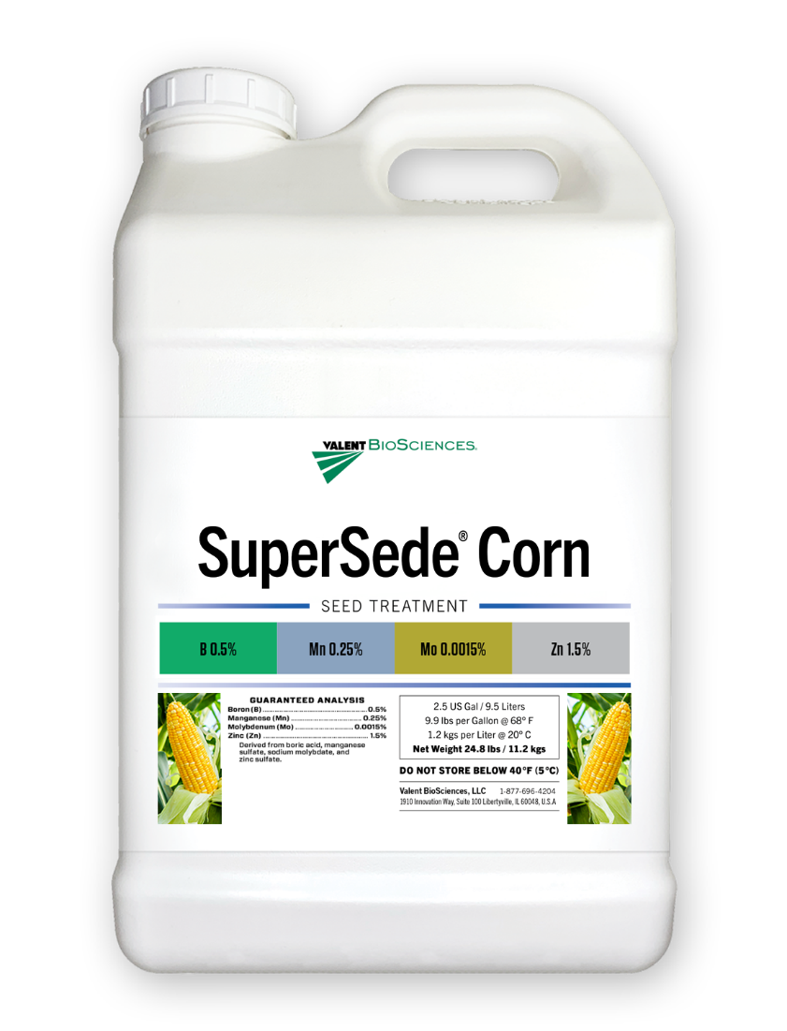

Key Nutrition
SuperSede Corn
Guaranteed Analysis: Boron (B) ........................................................... 0.5% Manganese (Mn) .............................................. 0.25% Molybdenum (Mo) ........................................ 0.0015% Zinc (Zn) ............................................................ 1.5%
Derived from: Boric acid, manganese sulfate, sodium molybdate, and zinc sulfate.

Slide 7

SuperSede Corn
Formulation | Soluble Liquid
Package Size | 4 x 1 Gal, 2 x 2.5 Gal
Application | Seed treatment; Compatible with fertilizers, fungicides, and insecticides
Target Crops | Corn
Application Rates | 1.0 fl oz per 50 Lbs
Uses | Conventional
Shelf Life | 2 Years

Slide 8
Mode of Action

Slide 9

What is Transit?
Unique highly bioactive compound
Targeted mixture of thousands of bioactive compounds
Transit is the result of a proprietary extraction method that uses early-stage biomass
It contains natural, biologically active, and diverse functional groups
Bioactive compounds in Transit have high oxygen to carbon ratios to enhance biological activity in plants
Humic substances
Humins
B vitamins
Fulvic acids
Acids
Inorganic salts
Proteins
Amino acids
Other organic acids
Mycorrhizae, Trichoderma, other beneficial fungi
Protein hydrolysates
Fatty acids/lipids
Beneficial elements (Si, Na, Co, etc.)
Other
PGPRs
Cytokinins
Microbials
Nitrogenous
compounds
Polyamines
Peptides
Rhizobium
Phosphites
Betaines
Polyphenols
Complex communities/
consortia
Enzymatic extracts
Chitin/ chitosan
Seaweed/kelp
Phytohormones
Extracts
Laminarin, alginates, other polysaccharides
Other organic matters extracts
Botanicals
Allelochemicals

Slide 10
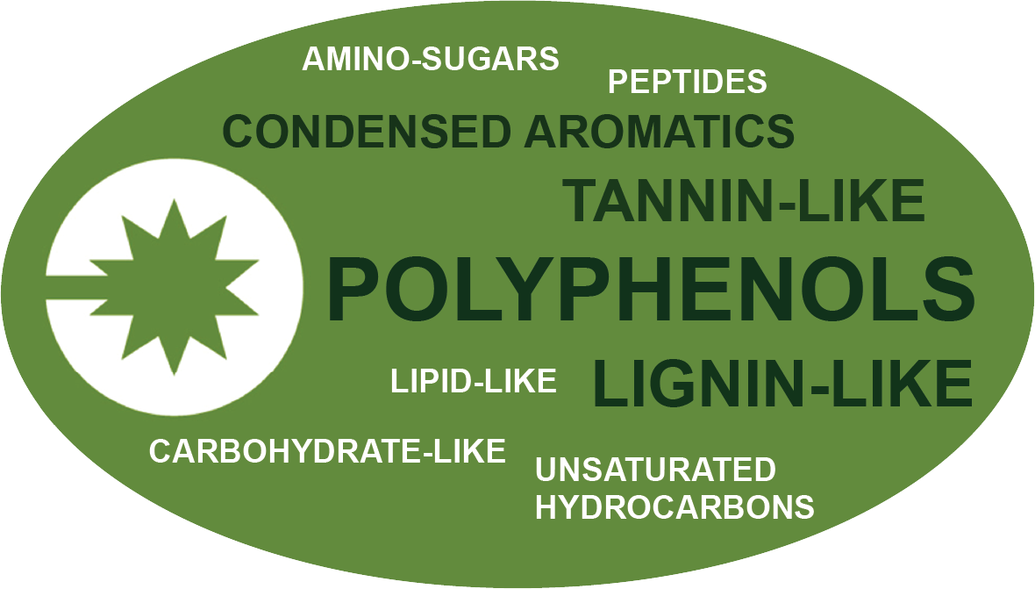
Transit Technology
What is it made of?
Key, diverse functional groups that are biologically active in plants

Slide 11
Transit Biostimulant Mode of Action
Transit technology acts systemically in the plant
Application of Transit at different plant physiological stages influences UP- and DOWN-regulation of various plant pathways. The result is different plant responses and different benefits
Process | Genetic Response | Expressed Response
Gibberellin catabolizing genes e.g. GmGA2ox | DOWN-REGULATION | Increases seed germination Plant growth promotion
Auxin transporter genes e.g. GmLAX (AUX1/LAX) | UP-REGULATION | Root growth stimulation Promotes photosynthetic activity
Cytokinin degrading enzymes e.g. GmCKX3 | DOWN-REGULATION | Promotes cell division Inhibits chlorophyll breakdown
Proteins that bind Ca, Zn, & Fe e.g. Calmodulin, Zinc-finger proteins, Ferritin | DOWN-REGULATION | Increases nutrient availability & mobility within the plant

Slide 12

Transit® Mode of Action
Plant Response to Transit
Benefit | How
Improved Plant Establishment | Down-regulation of catabolizing genes drives increased germination and amplifies root growth for better stand establishment.
Improved Nutrient Mobility | Down-regulation of binding proteins to improve nutrient translocation of non-mobile nutrients.

Slide 13
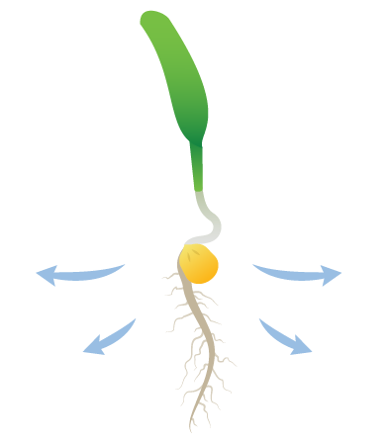
How it Works
Nutrition enhances biostimulant effects
SuperSede Corn maximizes effects by directly supporting growth with key nutrition.
SuperSede Corn supports uniform germination rate for stand uniformity.
SuperSede Corn aids root development for improved nutrient and water access.

Slide 14
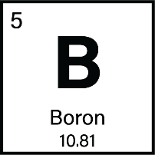


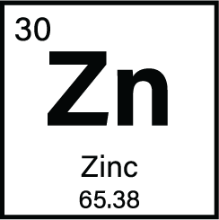
Key Nutrition
Boron supports cell division and cell wall formation during germination.
Manganese enhances enzyme activation and energy production for rapid early growth.
Molybdenum aids nitrogen metabolism for enhanced nutrient use efficiency.
Zinc facilitates auxin signaling to support root growth.

Slide 15
Application Information

Slide 16

General Application Guidelines
Apply using seed treatment application equipment with sufficient liquid to ensure even coverage.
Shake bottle of SuperSede Corn well before use.
DO NOT use treated seed for food, feed, or oil.
Can be utilized with common fungicides and insecticides.
Compatibility: Conduct a standard jar test prior to mixing a slurry.
Recommended mixing order: water, polymers, pesticides, SuperSede Corn, fertilizers, then remaining water.
Effects on the plant last up to 3 weeks.
Does not impact soybean rhizobia.

Slide 17
Application Rates & Timing
Crop Type | Use Rate | Application Timing
Corn | 1.0 fl oz per 50 Lbs of seed | Seed Treatment

Slide 18

Registration Status:
SuperSede Corn
Registered
Not Registered
Registration status is subject to change and may vary by state.

Slide 19
Application, Seed Safety & Stewardship

Slide 20

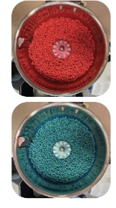
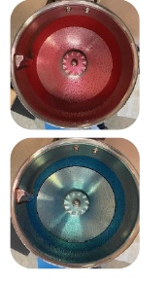
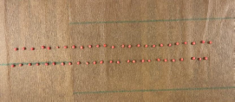
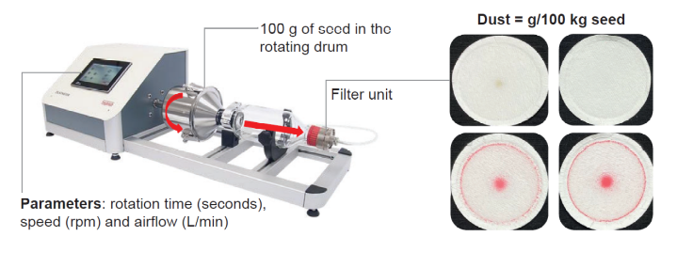
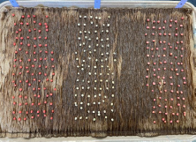
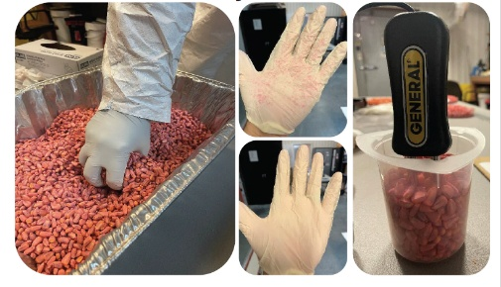

SuperSede Corn
Along with field efficacy data our seed treatment goes through a host of additional tests:
Application
Seed Safety
Stewardship
Consistent & uniform product coverage and adhesion in a wide range of conditions.
Enduring treatments don’t adversely affect seed germination and vigor.
Minimizing potential adverse effects on people and the environment.
Stickiness
Residue
Paper Towel Test
Dust-off
Sand Test
Dry Time
Cold Test

Slide 21
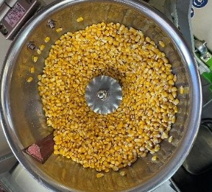
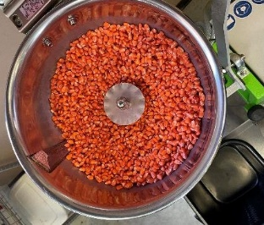
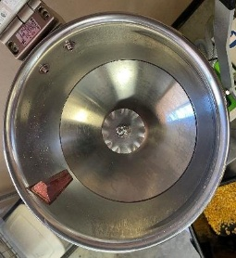
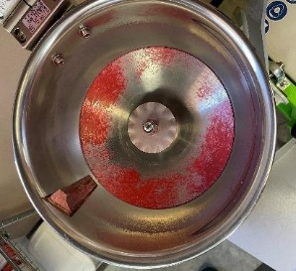
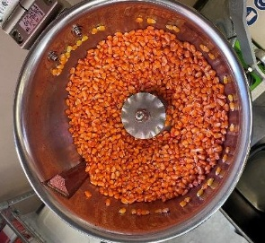
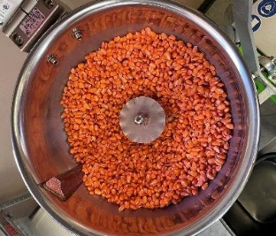
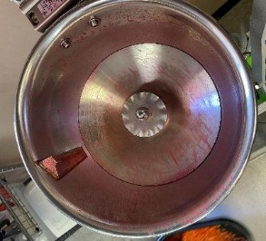
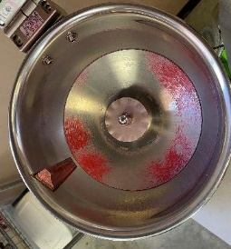
Application
Stickiness & Residue
PROTOCOL | Trt | Product (Label Rates)
 | 1 | Untreated
 | 2 | F&I
 | 3 | SuperSede Corn
 | 4 | SuperSede Corn + F&I
Methodology
Use of commercial seed treatment equipment to evaluate seed clumping and the level of residues that remain in the bowl following application of the various seed treatments.
Goal is consistent and uniform product coverage and adhesion in a wide range of conditions.
Fungicide and insecticide standard (F&I) used as a control.
Stickiness
Residue
UTC (water)
F & I
UTC (water)
F & I
SuperSede Corn
F & I
+ SuperSede Corn
SuperSede Corn
F & I
+ SuperSede Corn
Conclusion: Corn seed did not clump together for any treatments during the stickiness test. Lower residue on the Hege bowl was observed for seed treated with SuperSede Corn.

Slide 22
Application
Dry Time
PROTOCOL | Trt | Product (Label Rates)
 | 1 | Untreated
 | 2 | F&I
 | 3 | SuperSede Corn
 | 4 | SuperSede Corn + F&I
Methodology
Apply seed treatment slurry to seed using commercial equipment.
Evaluate moisture content of the treated seed every two minutes for ten minutes.
Moisture Content
Acceptable Threshold
Conclusion: Moisture content for all treatments was below the acceptable threshold at 4, 6, 8, and 10 min after treating.

Slide 23
Seed Safety
Paper Towel Test
PROTOCOL | Trt | Product (Label Rates)
 | 1 | Untreated
 | 2 | F&I
 | 3 | SuperSede Corn
 | 4 | F&I + SuperSede Corn
Methodology
Soak germination paper towels in water until completely wet.
Plant 50 seeds/sample - 4 replications per treatment.
Cover with another paper towel and carefully roll from one side going to the other.
Place rolled towels in a plastic bag and label each bag.
Place the bags with the towels in a room with temperature set at 25°C.
Evaluate germination by counting the seedling germination, and record any dead, hard, or abnormal seeds/seedlings.
Conclusion: There was no significant reduction of seed germination on the paper towel, tests among all treatments during 12 months of testing. Percent germination ranged between 98 and 99% at the 12-month evaluation.

Slide 24
Seed Safety
Sand Test
PROTOCOL | Trt | Product (Label Rates)
 | 1 | Untreated
 | 2 | F&I
 | 3 | SuperSede Corn
 | 4 | F&I + SuperSede Corn
Methodology
Plant 100 seed per treatment in sand-soil mixture (1:1 ratio) and replicate 4 times.
Place them in the 10ºC growth room for 7 days and then transfer to the 18 ºC growth room for 14 days.
Count emergence of normal seedlings at multiple time points after transferring to 18 ºC growth room.
Conclusion: There was no significant reduction of seed germination on the sand test among all treatments during 12 months of testing. Sand test germination ranged from 98 to 99% at the 12-month evaluation.

Slide 25
Seed Safety
Cold Test
PROTOCOL | Trt | Product (Label Rates)
 | 1 | Untreated
 | 2 | SuperSede Corn
 | 3 | SuperSede Corn + F&I
Methodology
• Plant 100 seed per treatment in sand-soil mixture (1:1 ratio) and replicate 4 times.
• Place them in the 10 °C growth room for 7 days and then transfer to the 18 °C growth room for 14 days.
• Count emergence of normal seedlings at multiple time points (3, 7, 10 and 14 days) after transferring to 18 °C growth room.
Conclusion: There was no significant reduction of seed germination on the cold test among all treatments during 12 months of testing. Percent germination ranged between 98 and 100%.

Slide 26
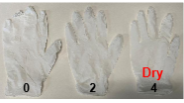


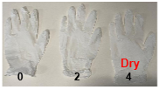
Stewardship
Dust Off
PROTOCOL | Trt | Product (Label Rates)
 | 1 | UTC
 | 2 | F&I
 | 3 | Supersede Corn
 | 4 | F&I + Supersede Corn
Methodology
Utilize known quantity of seed.
Tumbling seeds to generate dust; maintain identical operating parameters of time, rotation speed, and air flow.
Use vacuum system to pull out dust.
Dust was collected on Whatman GF 9 filters from 100 grams of seed.
Average dust values (g/100 kg seed) were measured and recorded from 4 replicates per treatment.
Glove Test
F&I
Dust-off
SuperSede Corn
SuperSede Corn + F&I
Conclusion: All treatments were well below the commercial threshold of 2.7 g/100kg. SuperSede Corn applied alone or in combination with the standard F&I seed treatment had higher dust-off levels compared to the UTC and the standard F&I.

Slide 27
Field Data

Slide 28

SuperSede Corn on Corn
Agri-Tech Consulting | Whitewater, WI | 2022
OVERVIEW
CROP | Corn
DESIGN | Randomized Complete Block
CONCLUSION
SuperSede Corn was applied as a seed treatment in addition to a Grower Standard (GS) program and compared to the GS alone.
The addition of SuperSede Corn resulted in an average 25.3% increase in emergence daily and a 2.5 bu/acre increase in yield when compared to the GS.
LOCAL WEATHER SUMMARY
May – October
Temperature: 64.0°F
Precipitation:
Total Rainfall – 24.98”
Avg Monthly Rainfall – 4.16”
 | TREATMENT | RATE/ACRE | TIMING
 | SuperSede Corn | 1 oz/50 lbs seed | Seed Treatment

Slide 29

SuperSede Corn on Corn
Buckeye Research | Troy, OH | 2022
OVERVIEW
CROP | Corn
DESIGN | Randomized Complete Block
CONCLUSION
SuperSede Corn was applied as a seed treatment in addition to a Grower Standard (GS) program and compared to the GS alone.
The addition of SuperSede Corn improved emergence by 5.1% and resulted in a 2.8 bu/acre increase in yield when compared to the GS.
LOCAL WEATHER SUMMARY
May – October
Temperature: 66.3°F
Precipitation:
Total Rainfall – 23.41”
Avg Monthly Rainfall – 3.90”
 | TREATMENT | RATE/ACRE | TIMING
 | SuperSede Corn | 1 oz/50 lbs seed | Seed Treatment

Slide 30
SuperSede Corn on Corn
S/S Research Services | Richwood, OH | 2012
OVERVIEW
CROP | Corn
DESIGN | Randomized Complete Block
CONCLUSION
SuperSede Corn was applied as a seed treatment in addition to a Grower Standard (GS) program and compared to the GS alone.
The addition of SuperSede Corn resulted in an 18.4 bu/acre increase in yield when compared to the GS.
LOCAL WEATHER SUMMARY
May – October
Temperature: 66.8°F
Precipitation*:
Total Rainfall – 22.48”
Avg Monthly Rainfall – 3.75”
*2012 was a year of generational drought
 | TREATMENT | RATE/ACRE | TIMING
 | SuperSede Corn | 1 oz/50 lbs seed | Seed Treatment

Slide 31

SuperSede Corn on Corn
AllTech R&D | Sparta, IL | 2014
OVERVIEW
CROP | Corn
DESIGN | Randomized Complete Block
CONCLUSION
SuperSede Corn was applied as a seed treatment in addition to a Grower Standard (GS) program and compared to the GS alone.
The addition of SuperSede Corn resulted in a 4.1 bu/acre increase in yield when compared to the GS.
LOCAL WEATHER SUMMARY
May – October
Temperature: 67.7°F
Precipitation:
Total Rainfall – 26.73”
Avg Monthly Rainfall – 4.46”
 | TREATMENT | RATE/ACRE | TIMING
 | SuperSede Corn | 1 oz/50 lbs seed | Seed Treatment

Slide 32
SuperSede Corn on Corn
AllTech R&D | Sparta, IL | 2012
OVERVIEW
CROP | Corn
DESIGN | Randomized Complete Block
CONCLUSION
SuperSede Corn was applied as a seed treatment in addition to a Grower Standard (GS) program and compared to the GS alone.
The addition of SuperSede Corn improved emergence 45% at 7 days after planting and increased the final stand by 5%.
LOCAL WEATHER SUMMARY
May – October
Temperature: 69.8°F
Precipitation:
Total Rainfall – 20.91”
Avg Monthly Rainfall – 3.49”
 | TREATMENT | RATE/ACRE | TIMING
 | SuperSede Corn | 1 oz/50 lbs seed | Seed Treatment

Slide 33

SuperSede Corn on Corn
Midwest Research | York, NE | 2012
OVERVIEW
CROP | Corn
DESIGN | Randomized Complete Block
CONCLUSION
SuperSede Corn was applied as a seed treatment in addition to a Grower Standard (GS) program and compared to the GS alone.
The addition of SuperSede Corn resulted 1.4% better emergence ten days after planting and a 7.7 bu/acre increase in yield when compared to the GS.
LOCAL WEATHER SUMMARY
May – October
Temperature: 70.4°F
Precipitation*:
Total Rainfall – 18.72”
Avg Monthly Rainfall – 3.12”
Irrigated
*2012 was a year of generational drought
 | TREATMENT | RATE/ACRE | TIMING
 | SuperSede Corn | 1 oz/50 lbs seed | Seed Treatment

Slide 34

SuperSede Corn on Corn
Warnke Research | Geneva, MN | 2014
OVERVIEW
CROP | Corn
DESIGN | Randomized Complete Block
CONCLUSION
SuperSede Corn was applied as a seed treatment in addition to a Grower Standard (GS) program and compared to the GS alone.
The addition of SuperSede Corn resulted in a 4.8 bu/acre increase in yield when compared to the GS.
LOCAL WEATHER SUMMARY
May – October
Temperature: 63.7°F
Precipitation:
Total Rainfall – 24.61”
Avg Monthly Rainfall – 4.10”
 | TREATMENT | RATE/ACRE | TIMING
 | SuperSede Corn | 1 oz/50 lbs seed | Seed Treatment

Slide 35
SuperSede Corn on Corn
Warnke Research | Geneva, MN | 2012
OVERVIEW
CROP | Corn
DESIGN | Randomized Complete Block
CONCLUSION
SuperSede Corn was applied as a seed treatment in addition to a Grower Standard (GS) program and compared to the GS alone.
The addition of SuperSede Corn resulted 11% better emergence ten days after planting and a 3.1 bu/acre increase in yield when compared to the GS.
LOCAL WEATHER SUMMARY
May – October
Temperature: 68.2°F
Precipitation:
Total Rainfall – 19.84”
Avg Monthly Rainfall – 3.31”
 | TREATMENT | RATE/ACRE | TIMING
 | SuperSede Corn | 1 oz/50 lbs seed | Seed Treatment

Slide 36

SuperSede Corn on Corn
FFR Cooperative | Otterbein, IN | 2012
OVERVIEW
CROP | Corn
DESIGN | Randomized Complete Block
CONCLUSION
SuperSede Corn was applied as a seed treatment in addition to a Grower Standard (GS) program and compared to the GS alone.
The addition of SuperSede Corn resulted in a 4.9 bu/acre increase in yield when compared to the GS.
LOCAL WEATHER SUMMARY
May – October
Temperature: 68.7°F
Precipitation:
Total Rainfall – 21.46”
Avg Monthly Rainfall – 3.58”
 | TREATMENT | RATE/ACRE | TIMING
 | SuperSede Corn | 1 oz/50 lbs seed | Seed Treatment

Slide 37

SuperSede Corn on Corn
Stewart Agricultural Research Services | Clarence, MO | 2012
OVERVIEW
CROP | Corn
DESIGN | Randomized Complete Block
CONCLUSION
SuperSede Corn was applied as a seed treatment in addition to a Grower Standard (GS) program and compared to the GS alone.
The addition of SuperSede Corn resulted in a 2.7 bu/acre increase in yield when compared to the GS.
LOCAL WEATHER SUMMARY
May – October
Temperature: 69.4°F
Precipitation:
Total Rainfall – 22.83”
Avg Monthly Rainfall – 3.81”
 | TREATMENT | RATE/ACRE | TIMING
 | SuperSede Corn | 1 oz/50 lbs seed | Seed Treatment

Slide 38
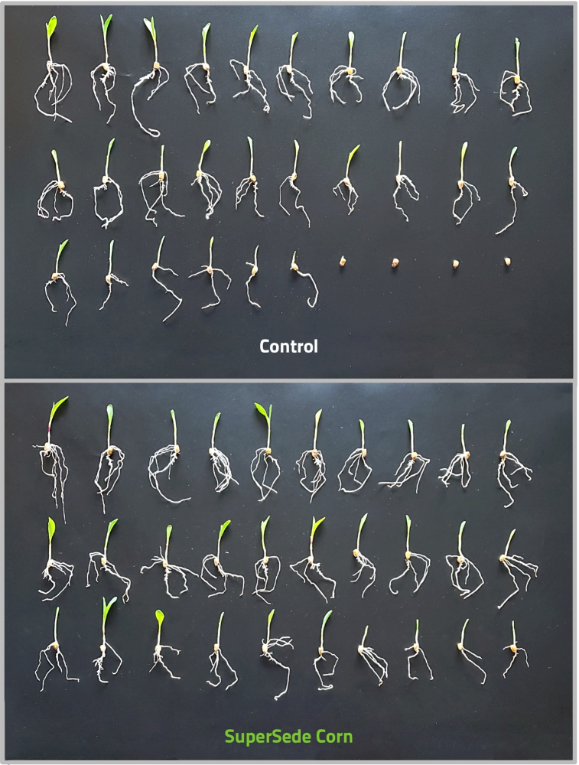
SuperSede Corn on Corn
SuperSede Corn Bioassay | 2021

Slide 39

Contains Transit biostimulant for root development and enhanced nutrient mobility.
Includes key nutrition to enhance Transit biostimulant effects.
Right time, right place application improves:
  Better germination
  Enhanced root growth
  Key nutrition
Better Germination
Enhanced Root Growth
Key Nutrition

