Slide 1
Symvado® WSP
Sales Presentation
Name
Date

Slide 2

Symvado® WSP
Mycorrhizal Inoculant​
Symvado WSP is a mycorrhizal inoculant packaged in a water-soluble pod that can be placed directly in the planting hole for tree and vine establishment. Symvado WSP is powered by MycoApply® Arbuscular Mycorrhizal Fungi (AMF). Symvado WSP extends the root absorption area by up to 50x for season-long access to nutrients and water.

Slide 3
Symvado WSP: Overview
Enhances the root absorption area, resulting in increased nutrient and water uptake and efficiency
Positively impacts the soil environment for improved soil structure and water holding capacity
Packaged for ease of application at planting
Contains MycoApply arbuscular mycorrhizal fungi

Slide 4




Features & Benefits
Symvado WSP Mycorrhizal Inoculant at Planting
Extended Root Area
Nutrient Absorption
Water Holding Capacity
Plant Establishment
Hyphae create a fungal network that extends root absorption area 50x
Hyphae increase access to water and nutrients, reaching micropores inaccessible by root hairs
Glomalin produced by fungal network contribute to increased soil aggregation for better water holding capacity
Enhanced root absorption area and increased nutrient and water uptake improve plant establishment

Slide 5
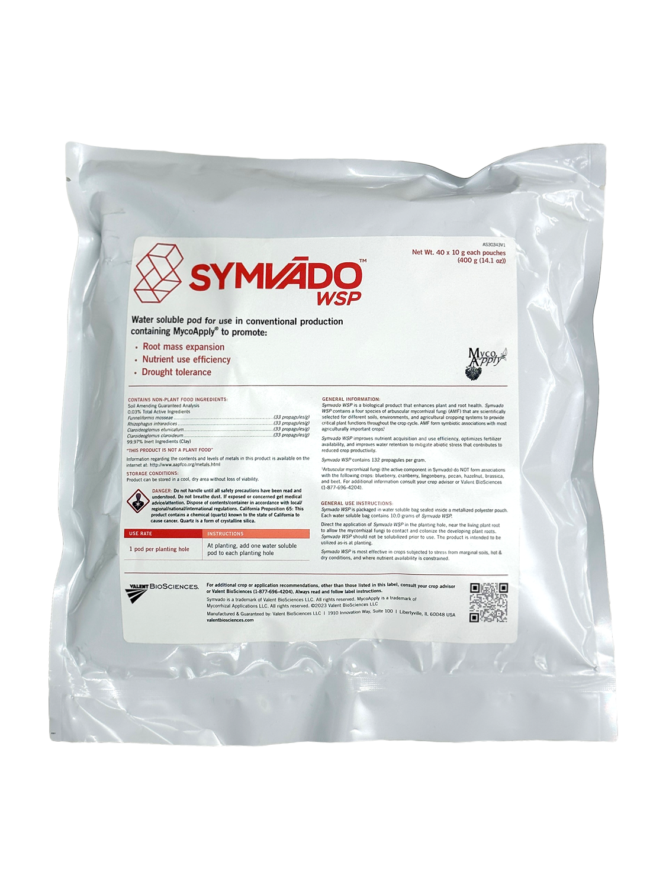

Specifications
Symvado WSP
Funneliformis mosseae .......................... (33 propagules/g) Rhizophagus intraradices ....................... (33 propagules/g) Claroideoglomus etunicatum …............... (33 propagules/g) Claroideoglomus claroideum ................... (33 propagules/g) 99.97% Inert Ingredients (Clay as carrier) CONTAINS NON-PLANT FOOD INGREDIENTS: Soil Amending Guaranteed Analysis 0.03% Total Active Ingredients

Slide 6
Application Rates & Timing
Crop Type | Use Rate | Application Timing
Nut Trees | 1 pod per planting hole | Planting
Citrus | 1 pod per planting hole | Planting
Wine & Table Grapes | 1 pod per planting hole | Planting
Pome Fruit | 1 pod per planting hole | Planting
Stone Fruit | 1 pod per planting hole | Planting

Slide 7
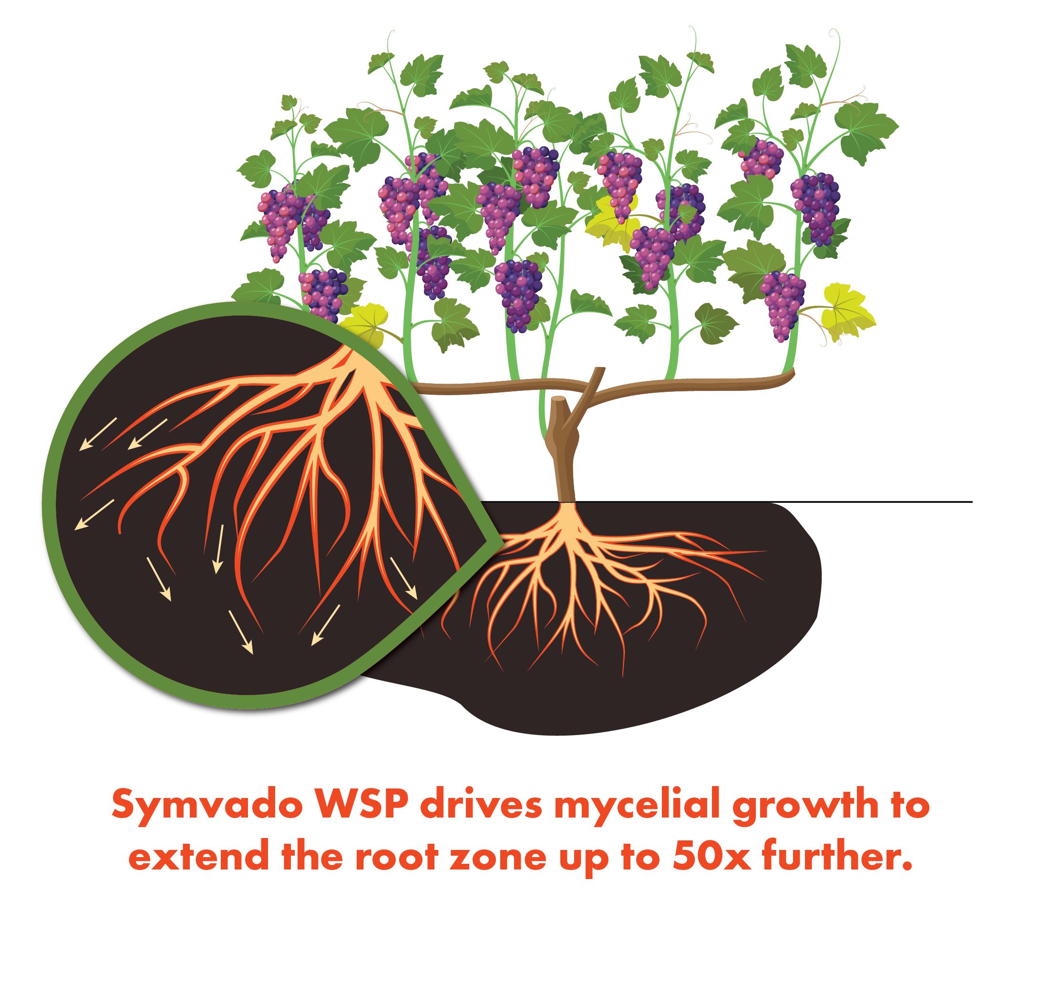
How it works

Slide 8
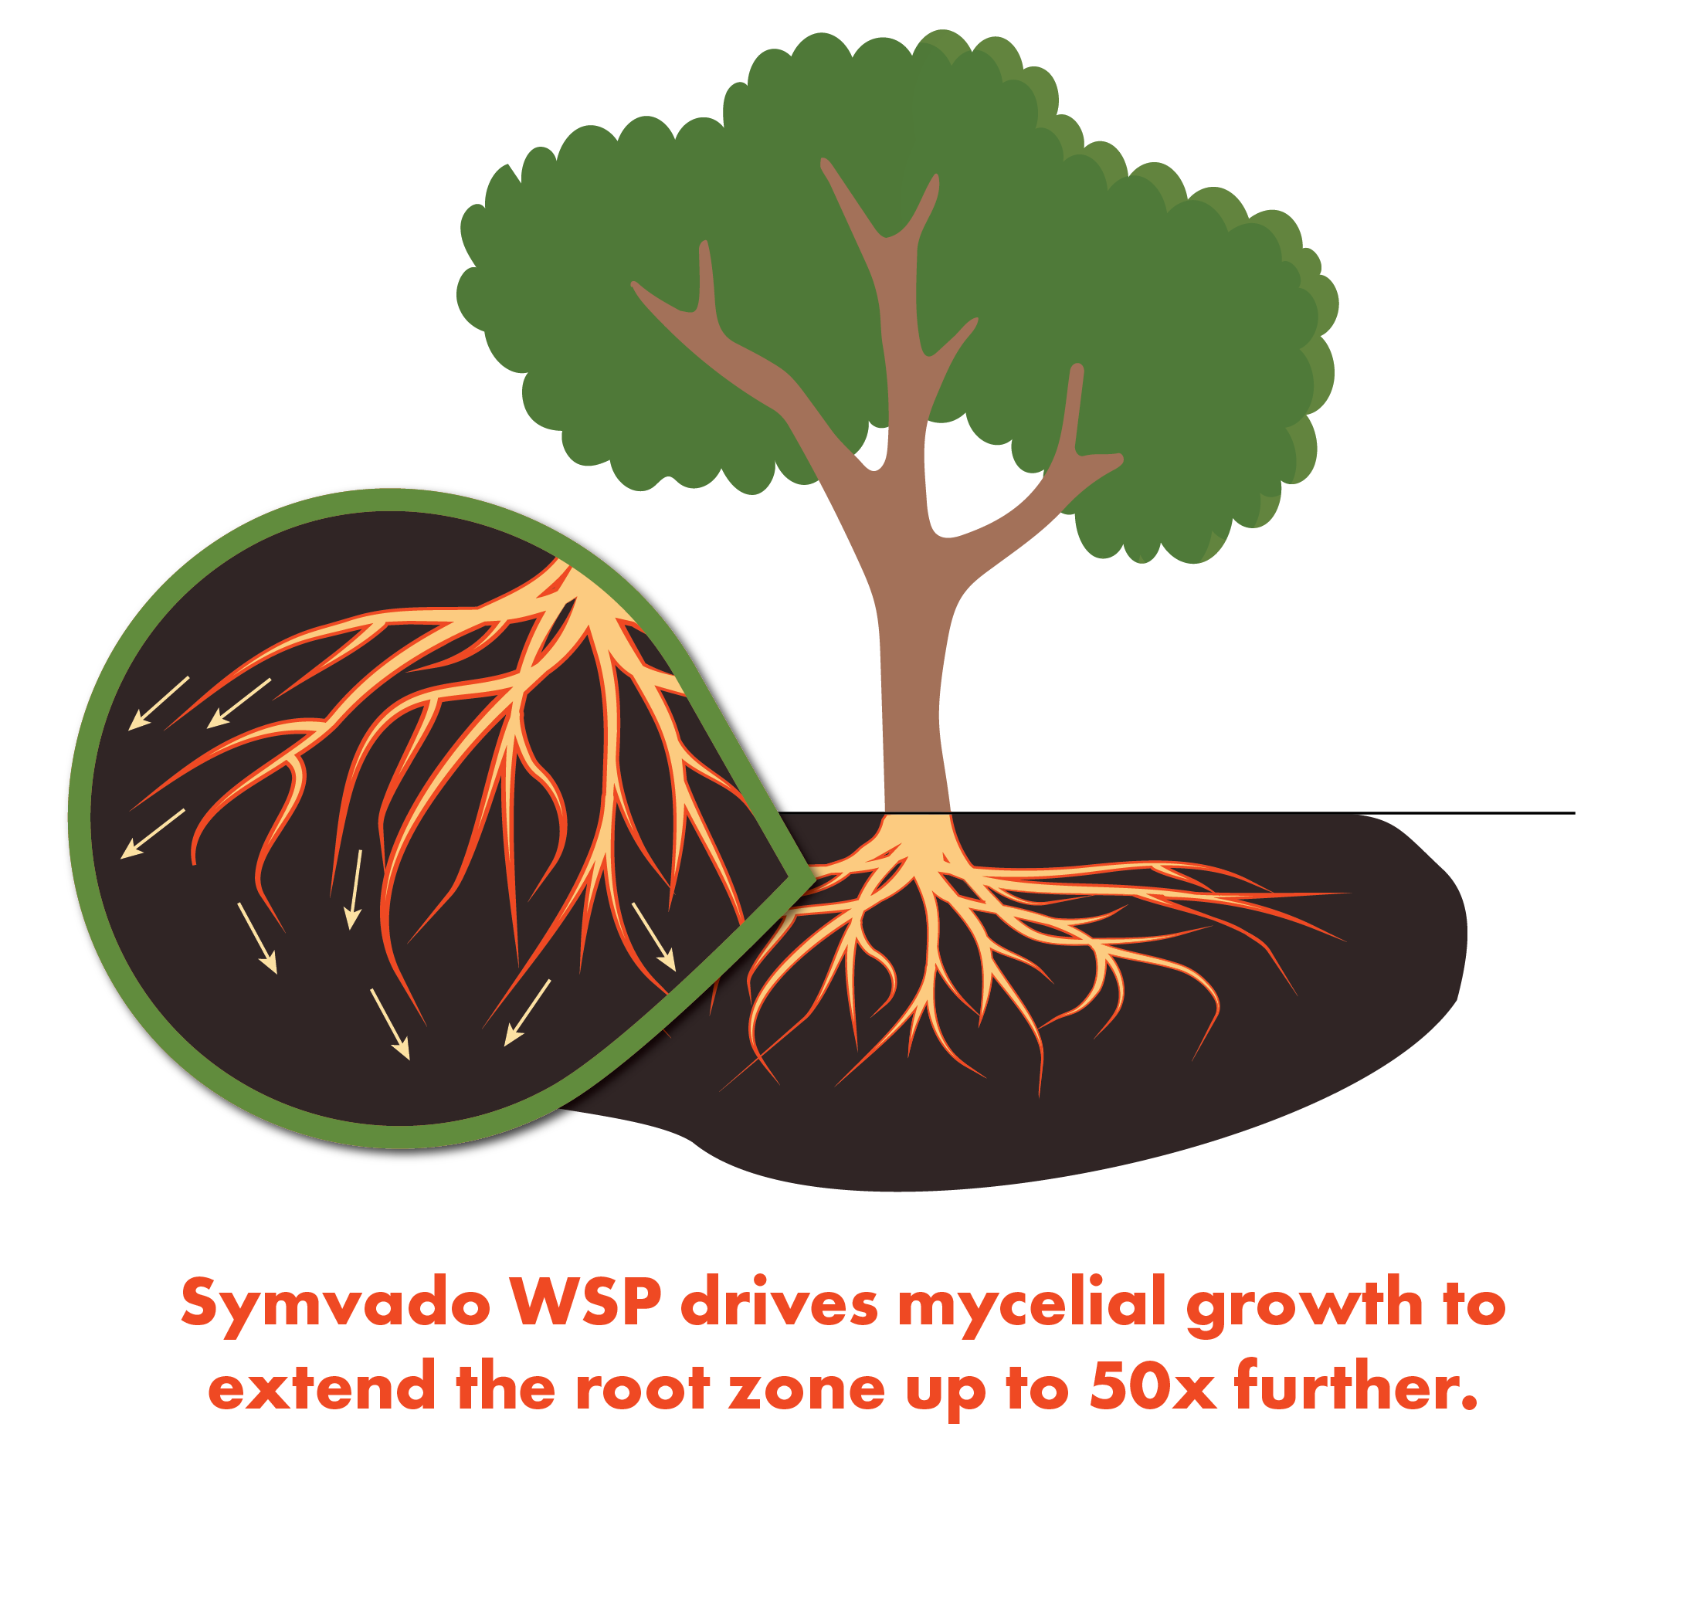
How it works

Slide 9
Symvado WSP Reduced Transplant Tree Loss
Symvado WSP reduced tree loss in transplant trees by 8.7%, resulting in a $536/ac reduction of tree replacement costs
Tree Replacement Costs
$688/ac
$152/ac

Slide 10
Symvado WSP Increased Yield in Table Grapes
Across three varieties, Symvado WSP increased grape yield as much as 19.7% when compared to the UTC
Notes:
Applied at 90,000 ppg/ac

Slide 11
Effects of Symvado® Inoculation on Moisture Stress in Newly Planted Almonds
Under irrigation, trees treated with Symvado had 28% greater root weight than the UTC
Without irrigation, trees treated with Symvado had 52% greater root weight over the UTC
Notes:
Researcher: Mycorrhizal Applications, Inc.; Grants Pass, OR

Slide 12
Evaluations of Symvado® Applications on Newly Planted Almonds
Newly planted trees treated with Symvado had on average a 12% greater trunk diameter than the UTC

Slide 13
Evaluations of Symvado® Applications on Newly Planted Almonds
3-Years after application, trees treated with Symvado showed 15% greater nut set over the UTC
Variety: Independence
Trial Location: Patterson, CA

Slide 14
Yield Effects of Symvado® Applications on 3rd Year Almonds
3-Years after application, trees treated with Symvado showed 12.5% greater nut yield over the UTC
Variety: Independence
Trial Location: Patterson, CA

Slide 15
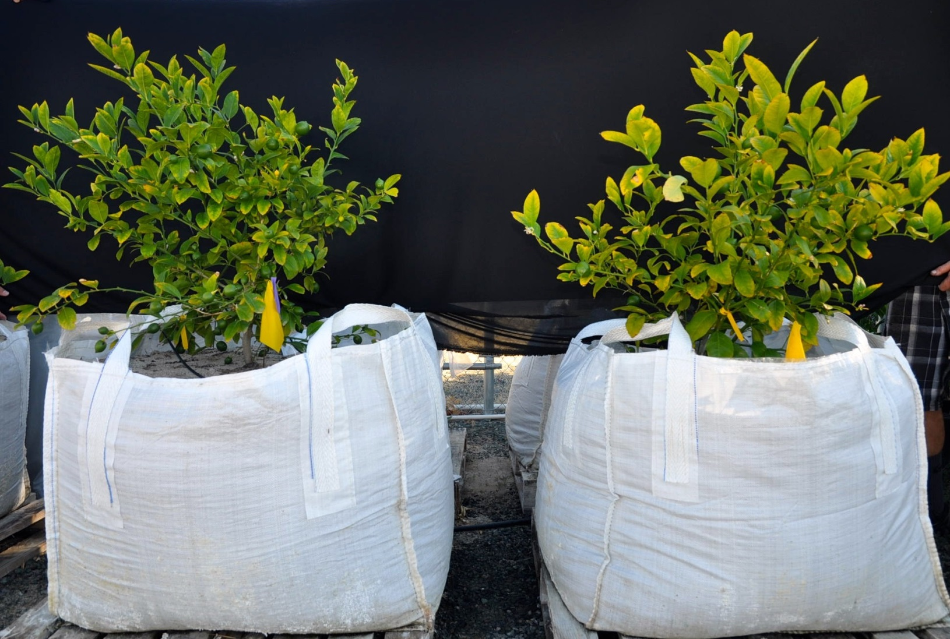
Symvado® Performance in Citrus
A study was conducted to show the performance of Symvado on lemons under salt stressed conditions.
Application of Symvado resulted in a 59% increase in chlorophyll content of lemon leaves compared to the control.
+59%
Trial Location: Grants Pass, OR
Notes:
'Meyer' lemons
Salt was applied weekly starting July 8, 2016 using
100 mMol NaCl (60 g salt per tree in 3 gal water).

Slide 16
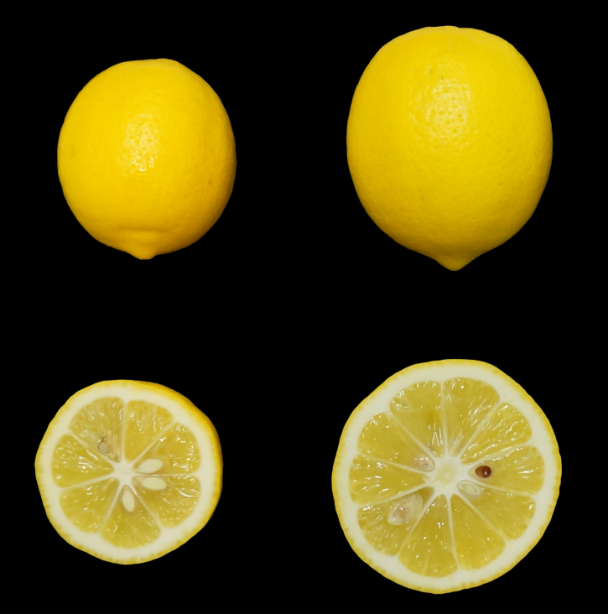
Symvado® Performance in Citrus
A study was conducted to show the performance of Symvado on lemons.
Application of Symvado resulted in 35 more fruit per tree as compared to the untreated control.
+17.4%
Trial Location: Grants Pass, OR
UTC
Symvado
Notes:
'Meyer' lemons

Slide 17






Extended Root Area
Up to 19.7% increase in grape yield when compared to the UTC
Extends the root absorption area by up to 50x for season-long access to nutrients and water.
Nutrient Absorption
Water Holding Capacity
Plant Establishment

Slide 18

Extended Root Area
59% increase in chlorophyll content in lemon tree leaves
Increase of 35 lemons/tree compared to the UTC
8.7% reduction in transplant tree loss, $536/ac reduction of tree replacement costs in apple trees
28% greater root weight in trees under irrigation and 52% greater root weight in trees without irrigation compared to the UTC in almond trees
12% average greater trunk diameter in newly planted trees compared to the UTC in almond trees
Nutrient Absorption
Water Holding Capacity
Plant Establishment

Slide 19

Extended Root Area
8.7% reduction in transplant tree loss, $536/ac reduction of tree replacement costs
28% greater root weight in trees under irrigation and 52% greater root weight in trees without irrigation compared to the UTC
12% average greater trunk diameter in newly planted trees compared to the UTC
15% greater nut set and 12.5% greater nut yield three years after application compared to the UTC
Extends the root absorption area by up to 50x for season-long access to nutrients and water.
Nutrient Absorption
Water Holding Capacity
Plant Establishment

Slide 20
Thank You

Slide 21
Effects of Symvado® Inoculation on Moisture Stress on Newly Planted Almonds
Under irrigation, trees treated with Symvado had 28% greater root weight than the UTC
Without irrigation, trees treated with Symvado had 52% greater root weight over the UTC
David Steinfeld and Tom Lyke; Mycorrhizal Applications, Inc., 2014
Treatments followed by the same letter are not significantly different (P < 0.1) as determined by one-way ANOVA
Notes:
Researcher: Mycorrhizal Applications, Inc.; Grants Pass, OR

Slide 22
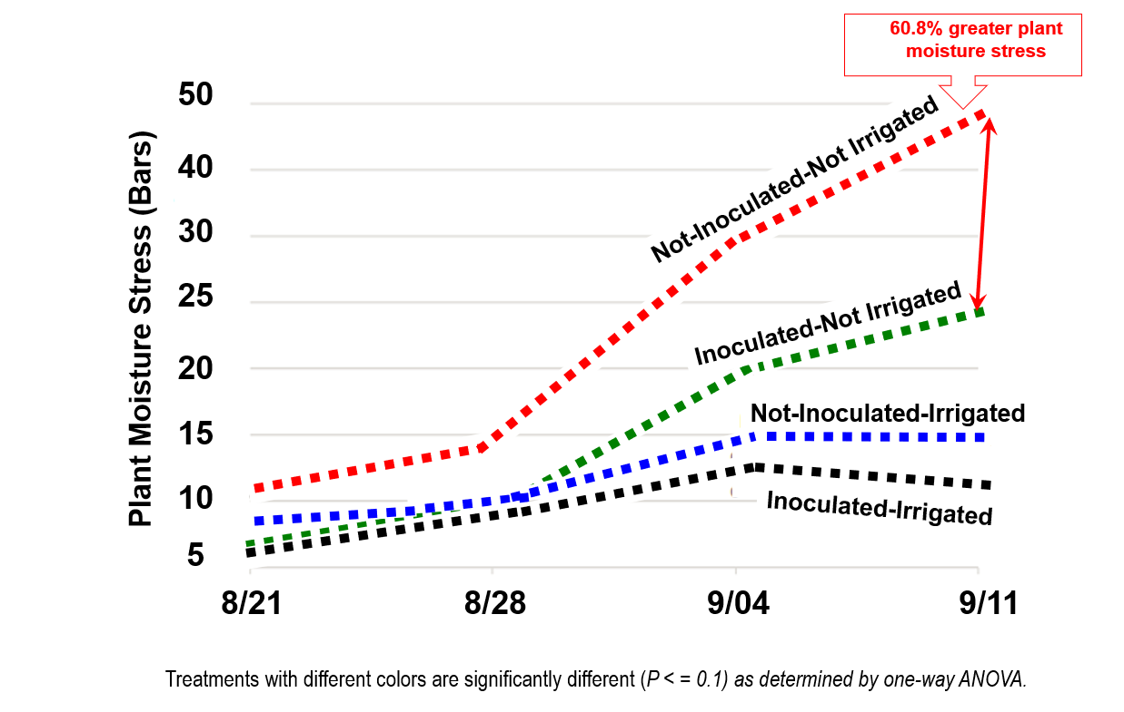
Effects of Symvado® Inoculation on Moisture Stress on Newly Planted Almonds
Notes:
Researcher: Mycorrhizal Applications, Inc.; Grants Pass, OR

Slide 23
Evaluations of Symvado® Applications on Newly Planted Almonds
Newly planted trees treated with Symvado had on average a 12% greater trunk diameter than the UTC
Application Method: At-Plant Soil Drench

Slide 24
Evaluations of Symvado® Applications on Newly Planted Almonds
3-Years after application, trees treated with Symvado showed 15% greater nut set over the UTC
Variety: Independence
Trial Location: Patterson, CA

Slide 25
Yield Effects of Symvado® Applications on 3rd Year Almonds
3-Years after application, trees treated with Symvado showed 12.5% greater nut yield over the UTC
Variety: Independence
Trial Location: Patterson, CA

