Slide 1
GreenSurge®
Training Deck

Slide 2
GreenSurge®
Training Summary
1
Product Overview
2
Mode of Action
3
Application Information
4
Field Data

Slide 3
Product Overview

Slide 4

GreenSurge®
Nutrient
GreenSurge® is a magnesium product built with our Transit® biostimulant. Targeted organic acids enhance nutrient uptake and mobility, helping improve chlorophyll production for greater photosynthetic efficiency.

Slide 5



Features & Benefits
GreenSurge
Improved Chlorophyll Production
Enhanced Photosynthesis
Improved Nutrient Mobility
Improves chlorophyll density, optimizing sunlight capture and carbon dioxide regulation.
Improved photosynthesis enables greater production of carbohydrates and energy storage for plant growth.
Transit biostimulant improves nutrient mobility in the xylem and the phloem. ​

Slide 6
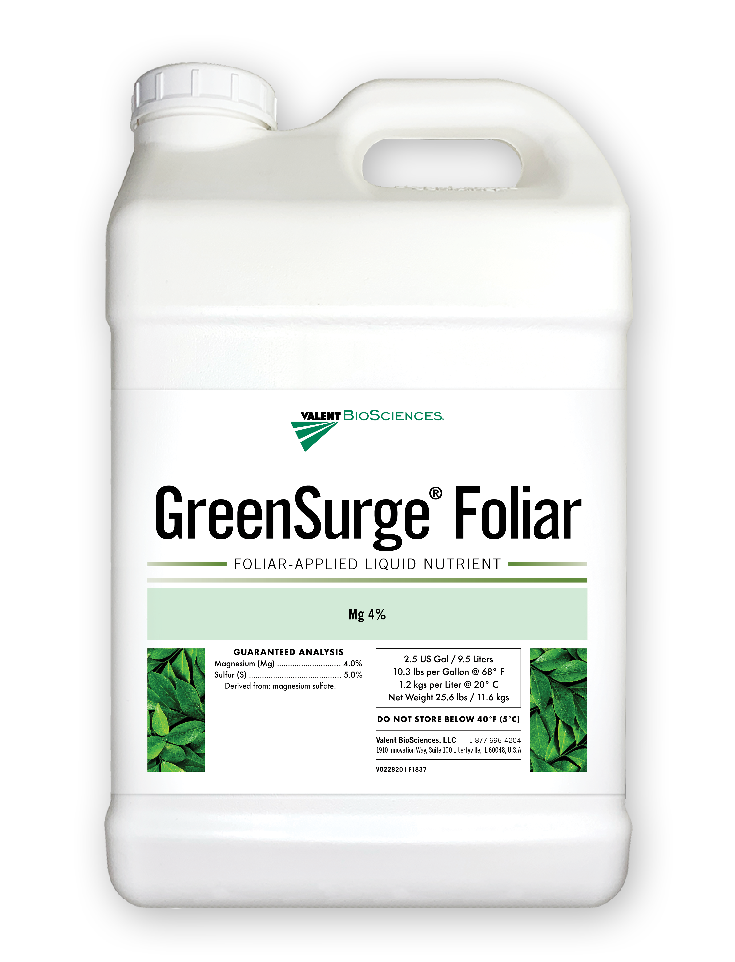

Guaranteed Analysis
GreenSurge Foliar
Guaranteed Analysis: Magnesium (Mg) ................................................... 4.0% Sulfur (S) ............................................................... 5.0%
Derived from: Magnesium sulfate.

Slide 7
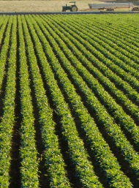
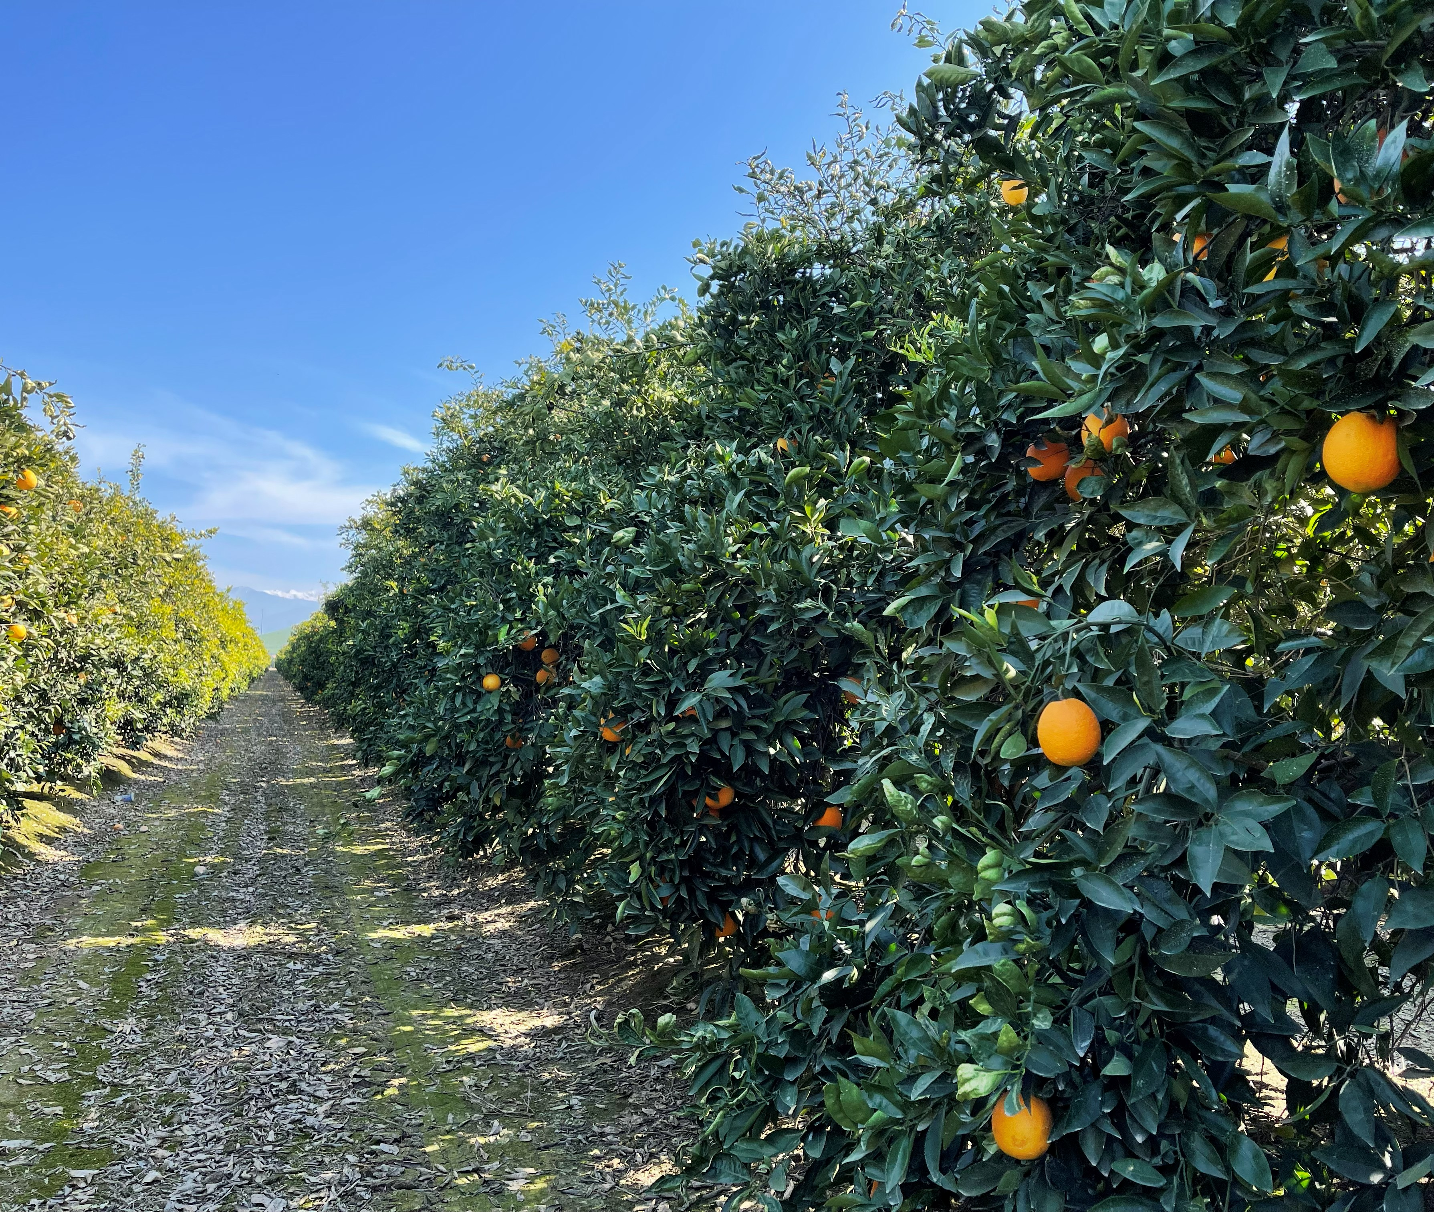
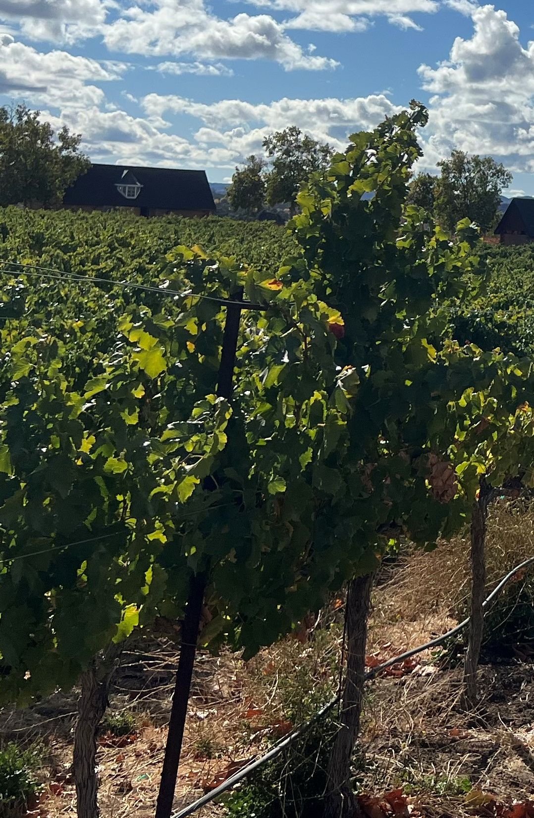
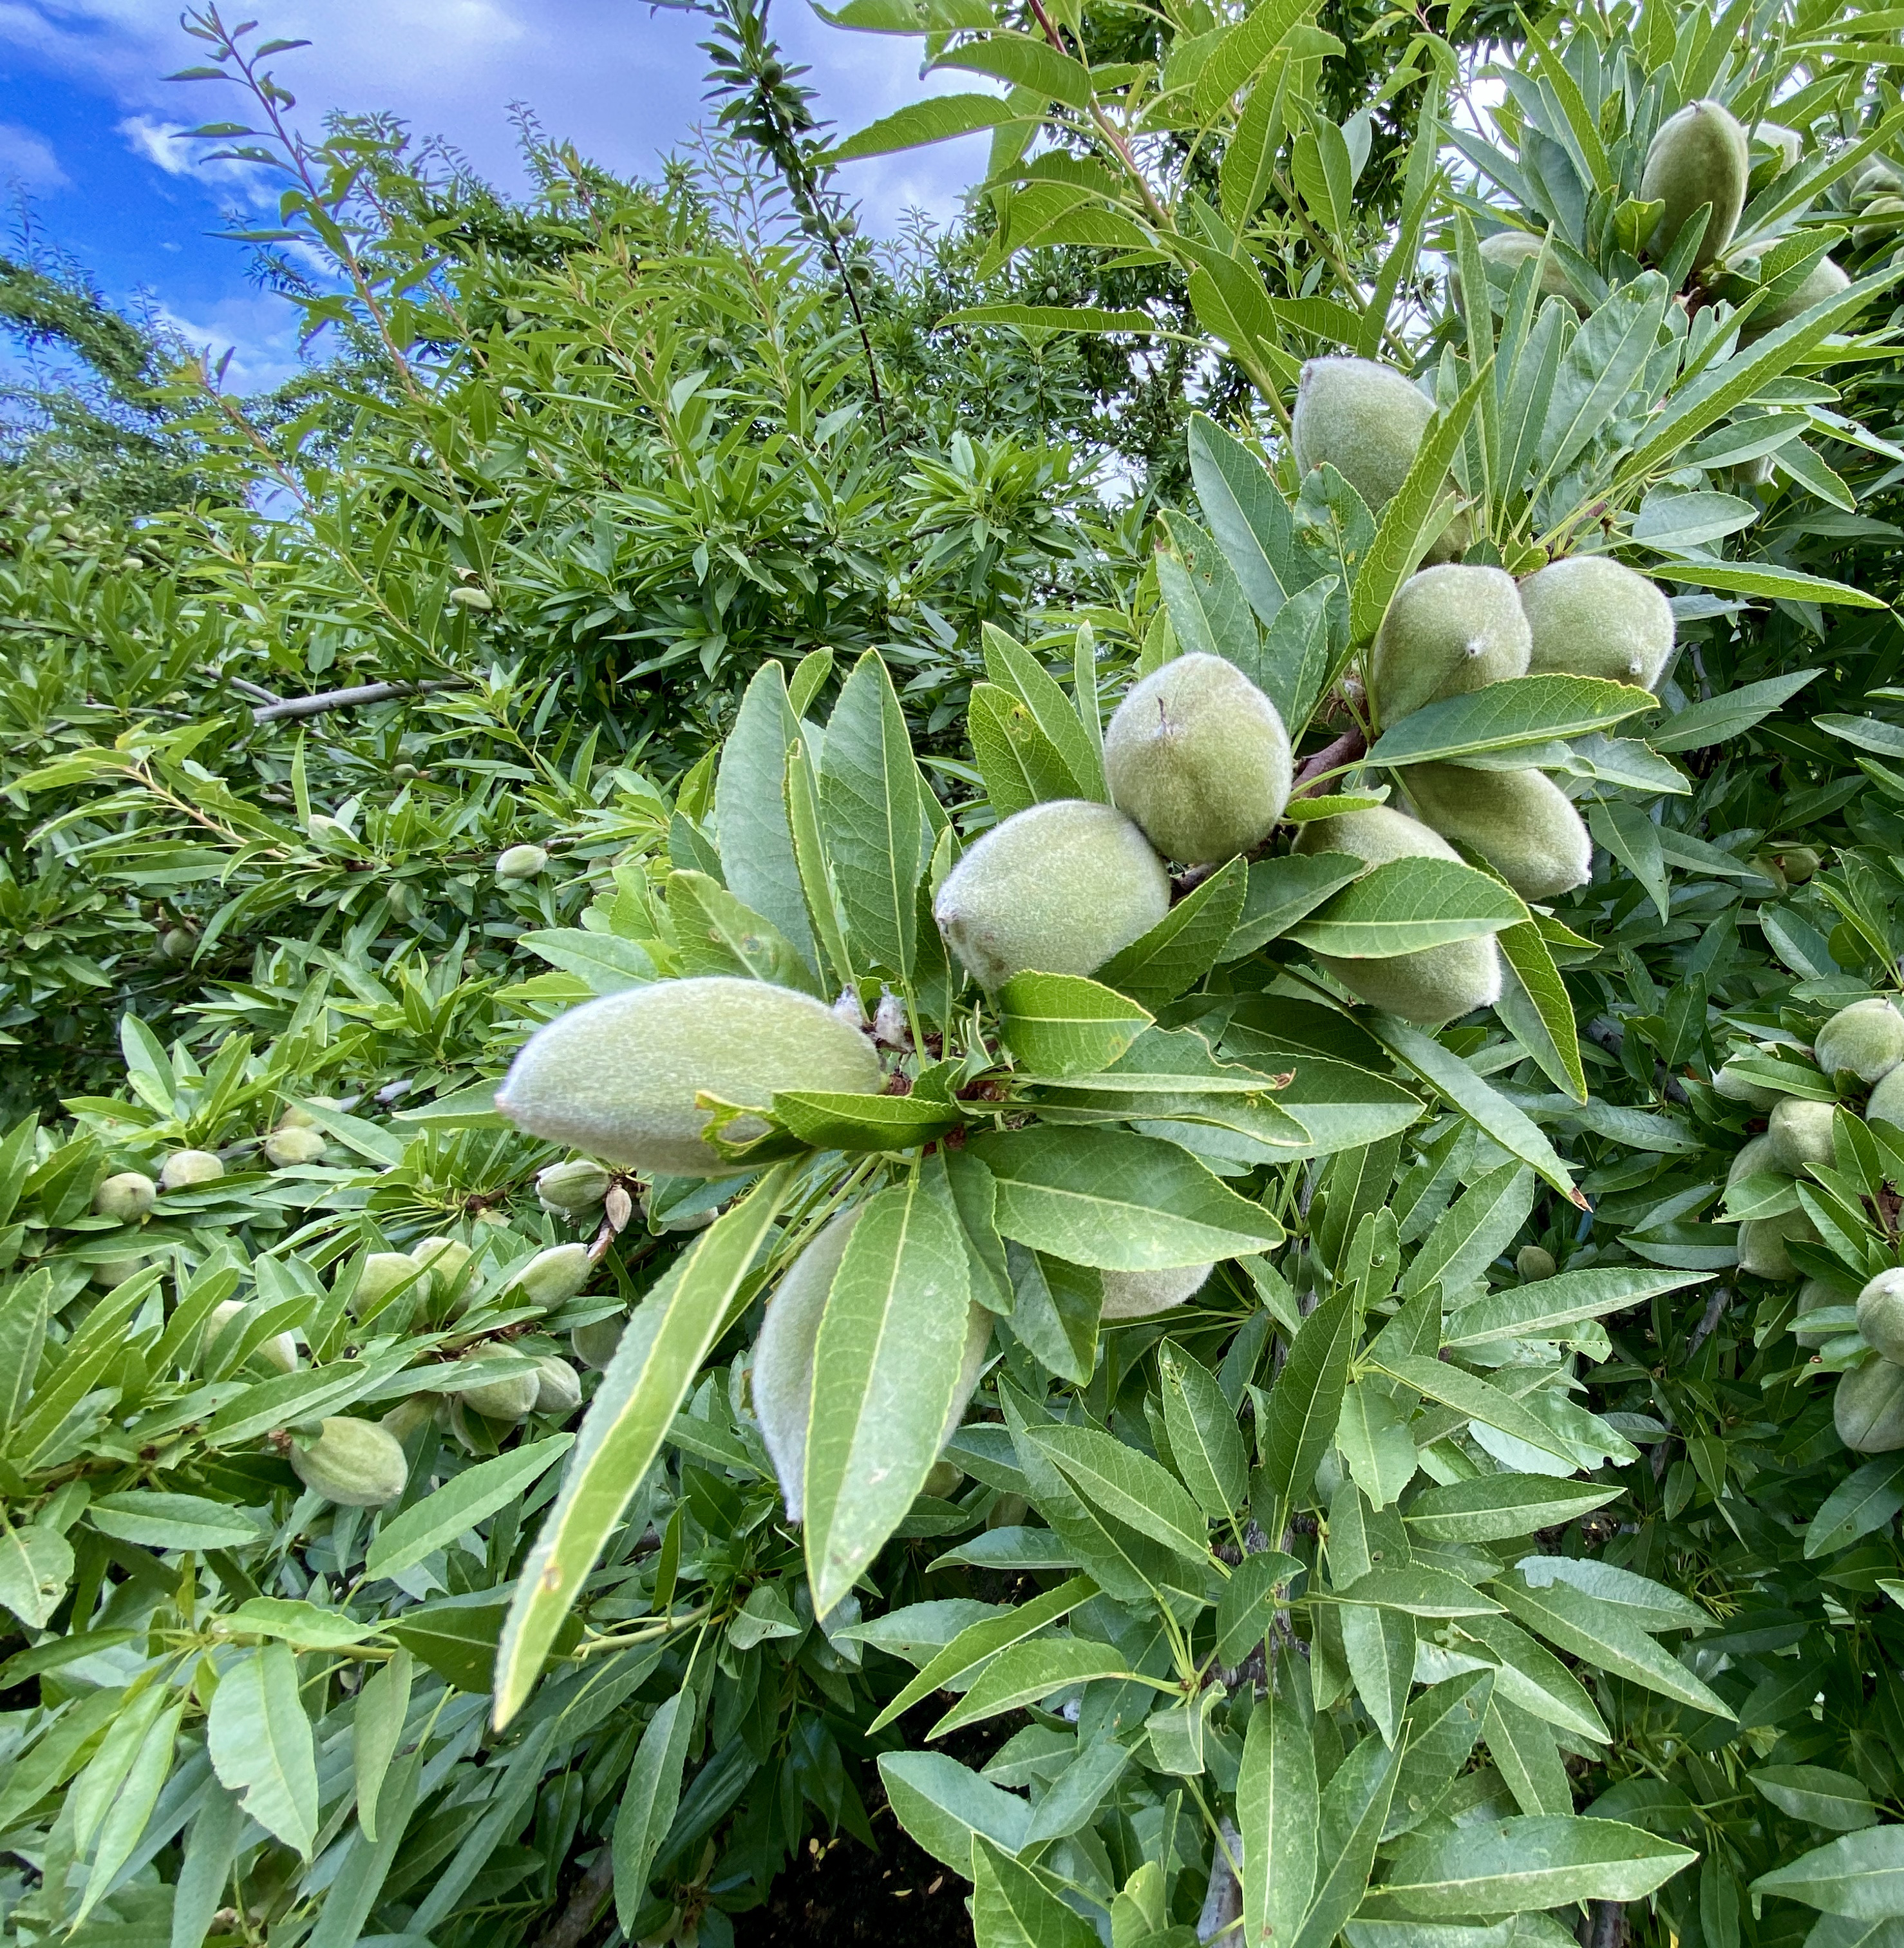
GreenSurge Foliar
Formulation | Soluble Liquid
Package Size | 2.5 Gal, 275 Gal
Application | Foliar
Target Crops | Tree fruit, tree nuts, fruiting vegetables
Application Rates | 1 – 4 qt/ac
Uses | Conventional
Shelf Life | 2 Years

Slide 8
Mode of Action

Slide 9

What is Transit?
Unique highly bioactive compound
Targeted mixture of thousands of bioactive compounds
Transit is the result of a proprietary extraction method that uses early-stage biomass
It contains natural, biologically active, and diverse functional groups
Bioactive compounds in Transit have high oxygen to carbon ratios to enhance biological activity in plants
Humic substances
Humins
B vitamins
Fulvic acids
Acids
Inorganic salts
Proteins
Amino acids
Other organic acids
Mycorrhizae, Trichoderma, other beneficial fungi
Protein hydrolysates
Fatty acids/lipids
Beneficial elements (Si, Na, Co, etc.)
Other
PGPRs
Cytokinins
Microbials
Nitrogenous
compounds
Polyamines
Peptides
Rhizobium
Phosphites
Betaines
Polyphenols
Complex communities/
consortia
Enzymatic extracts
Chitin/ chitosan
Seaweed/kelp
Phytohormones
Extracts
Laminarin, alginates, other polysaccharides
Other organic matters extracts
Botanicals
Allelochemicals

Slide 10
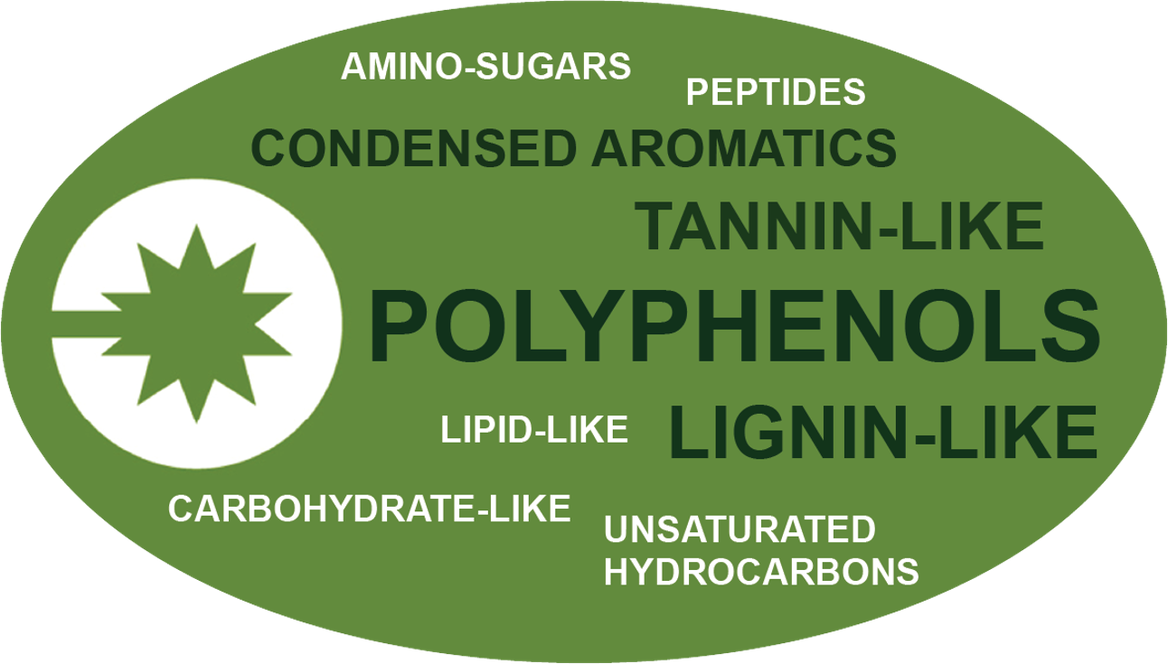
Transit Technology
What is it made of?
Key, diverse functional groups that are biologically active in plants

Slide 11
Transit® Mode of Action
Plant Response to Transit
Benefit | How
Improved Nutrient Mobility | Down-regulation of binding proteins to improve nutrient translocation of non-mobile nutrients.
Increased Photosynthesis | Up-regulation of auxin transporter genes and up-regulation of cytokinin-degrading enzymes increases leaf area and photosynthetic capacity for more nutrient storage.

Slide 12
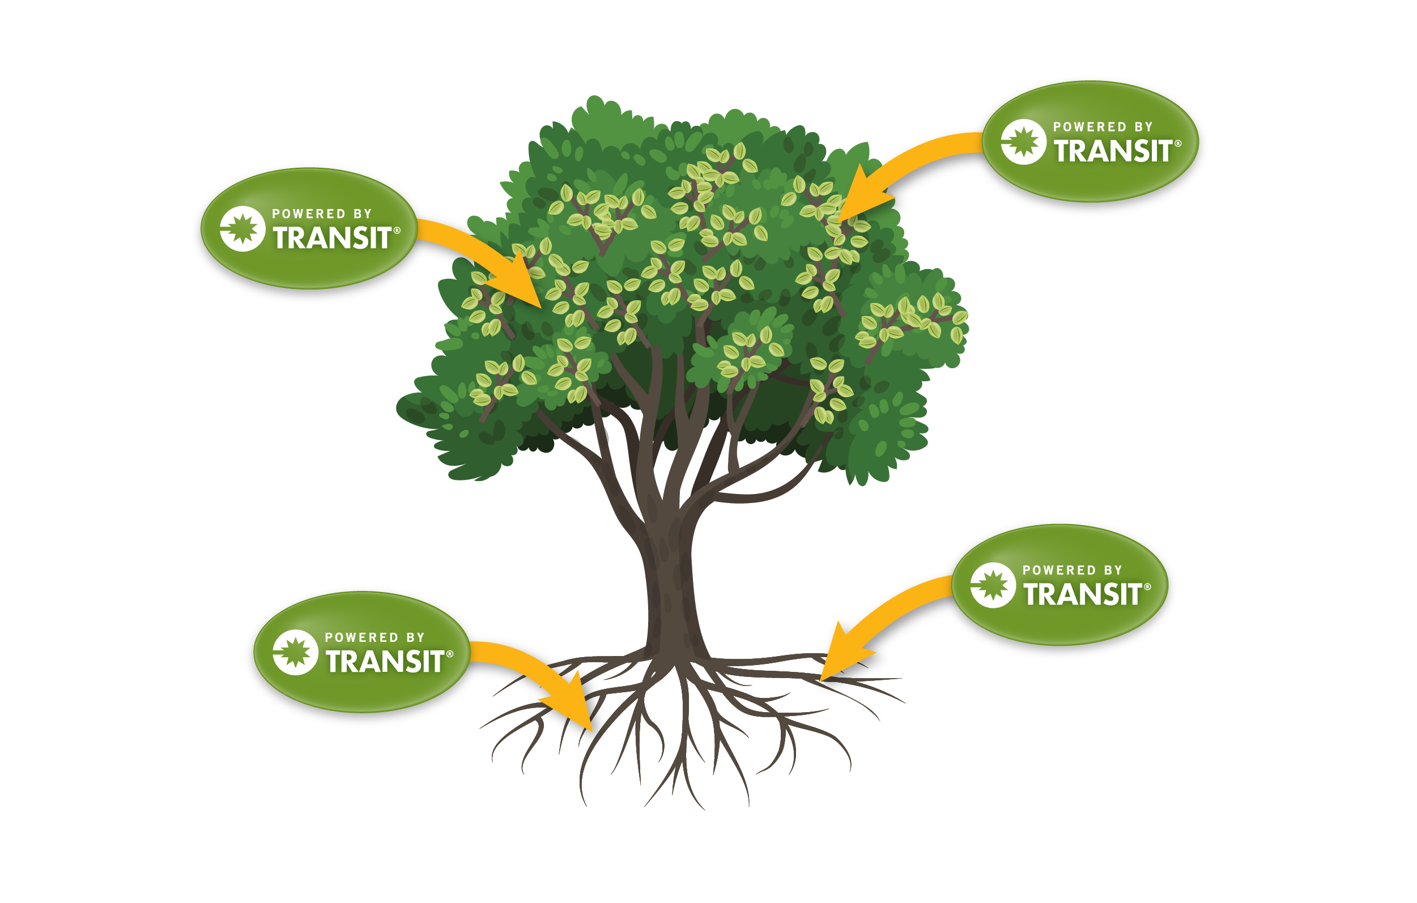
How it Works
Transit Biostimulant enhances nutrition

Slide 13

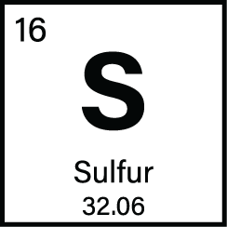
Key Roles of Nutrients on Crop Development
Magnesium supports chlorophyll production.
Sulfur aids enzymatic functions that support chlorophyll formation and photosynthesis.

Slide 14
Application Information

Slide 15

General Application Guidelines
Can be utilized with many common fungicides, insecticides, and fertilizers
  A standard jar test is recommended before tank mixing
  Recommended mixing sequence: water, adjuvants, pesticides, GreenSurge, other fertilizers, balance of water while agitating
If GreenSurge is blended with other products, always mix prior to application
Maintain continuous agitation during application
Use as fine of a spray mist as possible
DO NOT spray in the heat of the day or when the plant is under moisture stress
DO NOT spray to the point of runoff
DO NOT irrigate 3-4 hours after application or apply if rainfall is expected within 3-4 hours

Slide 16
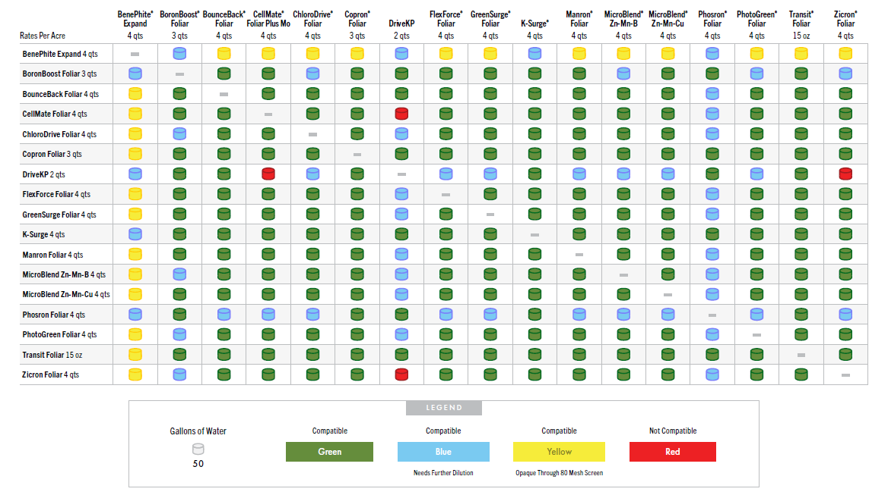
GreenSurge Foliar Compatibility
A standard jar test is recommended before tank mixing. Always read and follow label instructions.

Slide 17
Application Rates & Timing
Crop Type | Use Rate/Acre | Application Timing
All Crops | 1-6 qt/ac | Apply any time during the growing season; repeat as needed.

Slide 18
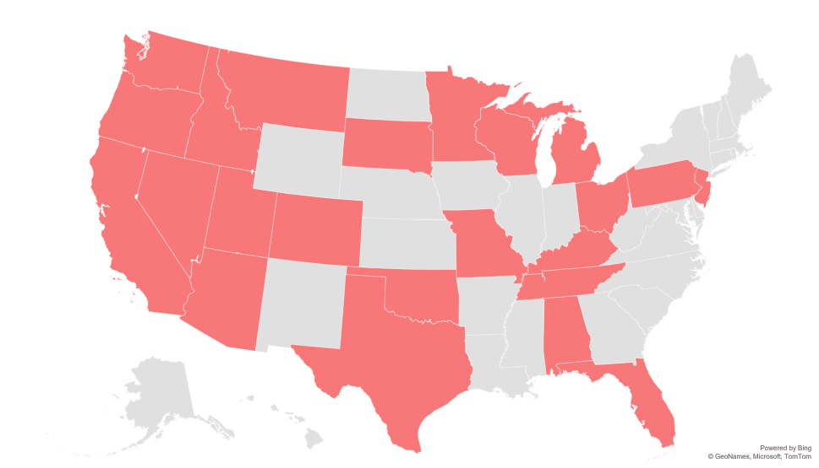
Registration Status:
GreenSurge Foliar
Registered
Not Registered
Registration status is subject to change and may vary by state.

Slide 19
Field Data

Slide 20

GreenSurge Improved Nutrient Uptake
Holden Research & Consulting | Ventura County, CA | 2008
OVERVIEW
CROP​ | Lemon
DESIGN​ | Complete Randomized Block of Four Replicates of Four Trees Each
CONCLUSION
GreenSurge was compared to a grower standard nutrient product (GS) and a premium competitive nutrient product.
Tissue samples were collected at 7, 14, and 21 days after application. An average of the tissue nutrients indicated the GreenSurge application improved Mg and S concentrations more than the premium competitive product and the GS.
LOCAL WEATHER SUMMARY
January – September
Temperature: 60.5°F
Precipitation:
Total Rainfall – 9.41”
Ave Monthly Rainfall – 1.05”
 | TREATMENT | RATE/ACRE | TIMING
 | GreenSurge | 2 qt/ac | Mid – Late January

Slide 21

GreenSurge Increased Watermelon Size
Agri-Technologies | Clinton, NC | 2008
OVERVIEW
CROP​ | Watermelons
DESIGN​ | Complete Randomized Block
CONCLUSION
GreenSurge Foliar was applied in addition to the Grower Standard (GS) program and compared to the GS alone.
The addition of GreenSurge resulted in a 28.7% increase in #6 melons (the largest melons) and an 15.4% decrease in #9 melons (the smallest and least valuable melons). GreenSurge also increased Brix by 4.2% over the GS.
LOCAL WEATHER SUMMARY
May - August
Temperature: 77.0°F
Precipitation:
Total Rainfall – 9.70”
Ave Monthly Rainfall – 2.43”
 | TREATMENT | RATE/ACRE
 | GreenSurge | 2 qt/ac

Slide 22
Contains Transit biostimulant for enhanced nutrient mobility
Right time, right place application results in:
  Chlorophyll production
  Enhanced photosynthesis
Improved Chlorophyll Production
Enhanced Photosynthesis

