Slide 1
Symvado® ST
Training Deck

Slide 2
Symvado® ST
Training Summary
1
Product Overview
2
Mode of Action
3
Application Information
4
Field Data

Slide 3
Product Overview

Slide 4

Symvado®
Mycorrhizal Inoculant
Symvado is a mycorrhizal inoculant powered by MycoApply® Arbuscular Mycorrhizal Fungi (AMF). Symvado extends the root absorption area by up to 50x for season-long access to nutrients and water.

Slide 5



Features & Benefits
Symvado
Increase Root Mass
Enhance Nutrient Uptake
Improve Drought Tolerance
Mycorrhizal fungi increase the total surface area of the root mass, improving establishment and supporting stress mitigation.
Hyphae explore beyond the depletion zone for immobile nutrients, transporting them to the plant.
Mycorrhizae can obtain moisture from areas in the soil that plants cannot access.​

Slide 6

Guaranteed Analysis
Symvado ST
CONTAINS NON-PLANT FOOD INGREDIENTS Soil Amending Guaranteed Analysis 8.73% Total Active Ingredients: Glomus intraradices .............................................. 5,625 ppg/g Glomus mosseae .................................................. 5,625 ppg/g Glomus aggregatum.............................................. 5,625 ppg/g Glomus etunicatum................................................ 5,625 ppg/g
91.27% Total Inert Ingredients (Carrier)

Slide 7

Symvado SC
Formulation | ST
Package Size | 8 x 500 mL case
Application | Seed treatment
Target Crops | Soybeans, rice
Application Rates | Varies by crop
Uses | Conventional
Shelf Life | 2 Years

Slide 8
Mode of Action

Slide 9

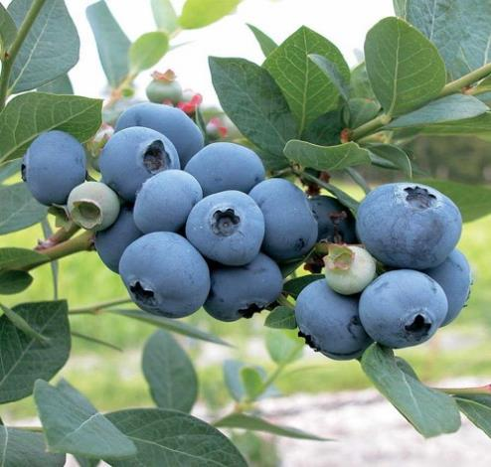

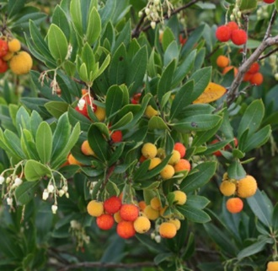
What are Mycorrhizal Fungi?
Soil Microbe with Season-Long Activity
Naturally occurring beneficial fungi that act as a secondary root system for the host crop.​
Form a mutualistic association with ≈95% of land plants. ​
Provide the host crop better access to soil moisture & nutrients in exchange for carbon supplied by the plant.​
Cannot function without living plants.​
Natural populations are often depleted by common agronomic practices i.e., tillage, fumigation, rotations with non-mycorrhizal crops.
There are several different types of mycorrhizal fungi.​
Ericoid Mycorrhizae
Endomycorrhizae
Arbutoid Mycorrhizae
Ectomycorrhizae

Slide 10
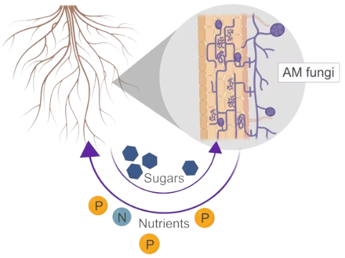
Fungal Root
Mutualistic association between fungi and plant roots
Mycorrhizal fungi co-evolved with plants 400 million years ago
Plants provide mycorrhizal fungi with photosynthetically fixed carbon
Mycorrhizal fungi provide plants with nutrients (phosphorus, nitrogen, etc.)
Because of the many benefits mycorrhizal fungi provide to plants, they are widely used in agriculture
Notes:
- Mutualistic relationship in which plants exchange photosynethetically fixed carbon for essential nutrients such as P and N, which AMF forage from the soil.
- Many mycorrhizal fungi are obligately symbiotic and therefore are unable to survive in nature for extended periods of time without their host.
- The AM fungi contribute up to 90% of plant P to host plants in ecosystems with reduced soil P availability; their contributions of plant nitrogen (N) are less pronounced and often depend on soil type, water content, and pH ^{[3,4]}.

Slide 11
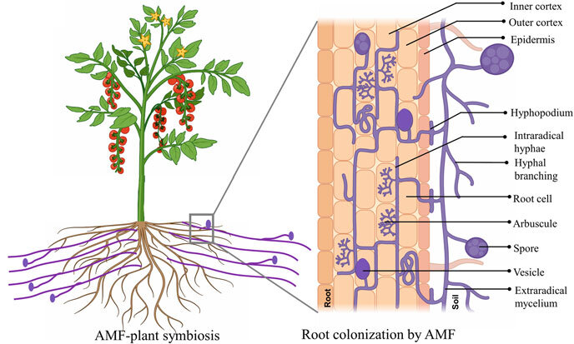
Fungal Root
The mycelium of the fungus grows inside and outside the root zone of the plant
Intraradical mycelium (IRM) develops within root cells, forming arbuscules that facilitate nutrient exchange with the host plant.
Extraradical mycelium(ERM) proliferates into the soil, extending the fungal reach far beyond the root zone to scavenge for nutrients and water.
Ahammed, G.J., Hajiboland, R. (2024). Introduction to Arbuscular Mycorrhizal Fungi and Higher Plant Symbiosis: Characteristic Features, Functions, and Applications. In: Ahammed, G.J., Hajiboland, R. (eds) Arbuscular Mycorrhizal Fungi and Higher Plants. Springer, Singapore
Notes:
AMF predominantly exist in the form of hyphae, which are the thread-like, tubular structures that constitute the basic units of growth of all filamentous fungi.
ERM morphology is plastic, responding dynamically to physicochemical changes. Nutrient concentrations affect the density and architecture of ERM. pH can have direct effects on the ERM, including alterations in hyphal density and enzymatic activity (van Aarle et al., 2002).

Slide 12
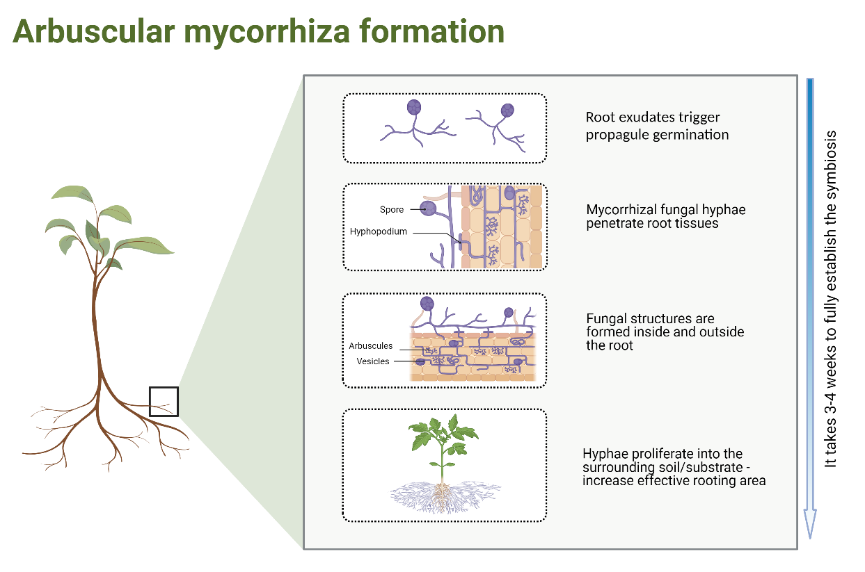
Fungal Root
Arbuscular Mycorrhizal Formation
Proximity to roots – fungi need to come into contact with plant roots
Plants and fungi ‘talk’ to each other via chemical signals – determine friend from foe
Plant drives the formation of the association – based on need
Diagram created with BioRender.com
Notes:
The response of mycorrhiza to fertilization depends highly on the context and the availability of other nutrients – N:P ratio. Therefore been proposed that the relative availability of soil N and P determines whether or not mycorrhizal benefits outweigh their costs
IRM growth and dynamics are strongly influenced by abiotic conditions. High soil phosphorus and low light availability both suppress IRM development by limiting plant– fungal interaction and by reducing the carbon supplied from the host (Kokkoris, 2025)

Slide 13
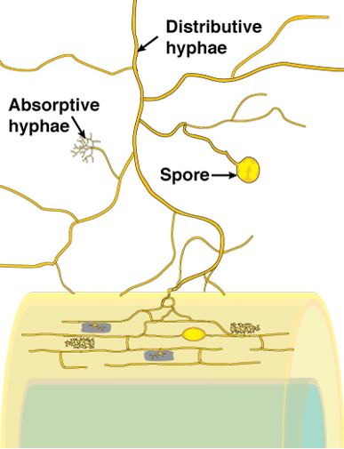
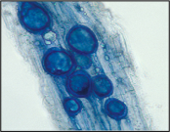

Endomycorrhizae Colonization
Intercellular structures which contain lipids and water to support plant growth.
Arbuscules
Intercellular structures which serve
as the site of nutrient and carbon
transfer between the fungus and the
host plants.
host plant root

Slide 14
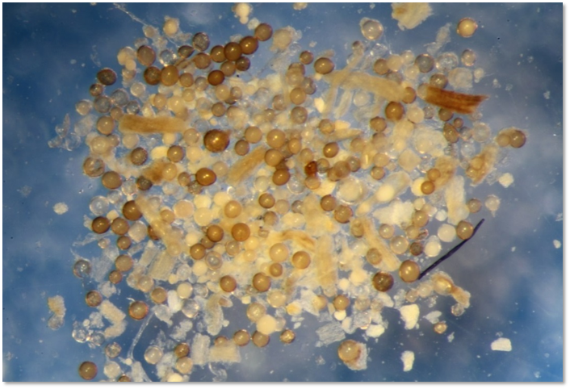
Endomycorrhizae Colonization
Colonized root fragments: Fungal structures within root tissues. Provide a fast hyphal re-growth and quick colonization of plants. Size range: 50-250 micron.
The establishment of the symbiotic interaction starts with the germination of the propagules (spores & root fragments).​
Root exudates trigger propagule germination.​
Mycorrhizal fungal hyphae penetrates into plant root tissues, transferring soil moisture and nutrients to the plant.​
Fungal organs i.e., hyphae, arbuscules, vesicles are formed inside and outside the root.​
Hyphae proliferate into the surrounding substrate increasing the plants effective rooting area.​
It can take up to 3-weeks for the plant to fully establish a symbiotic relationship with the fungus.​
Spores are normally dormant and germinate slower than root fragments. Very resilient structures.​ Size range: 35-120 micron.​

Slide 15
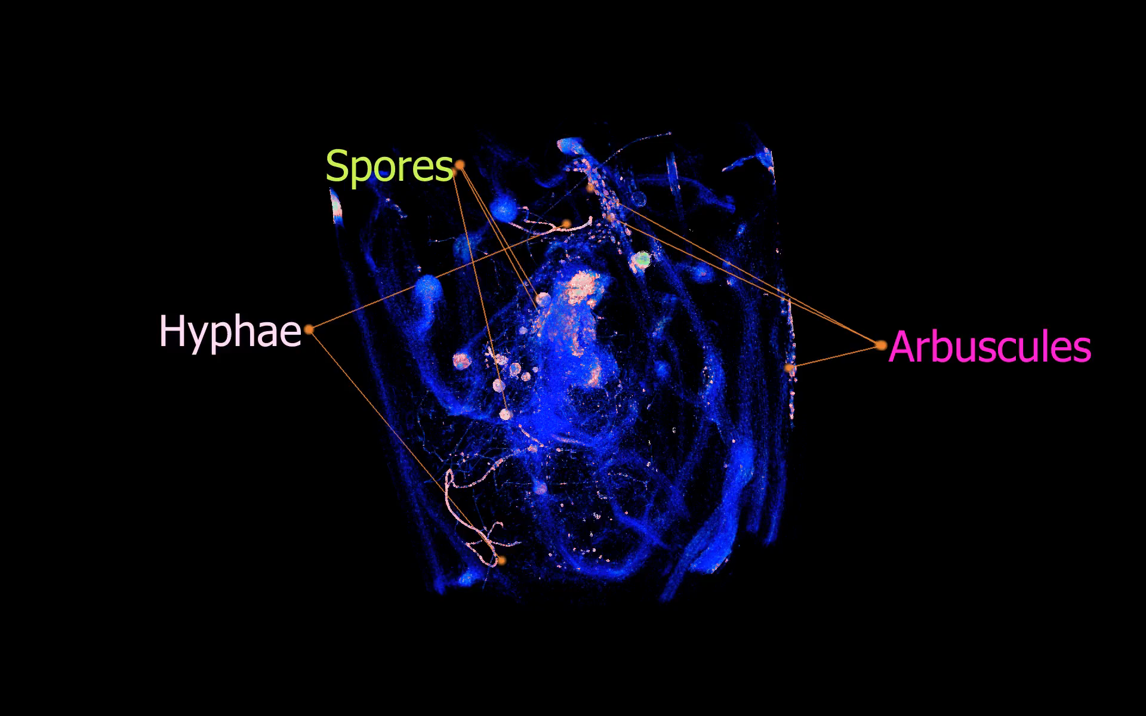

Slide 16
AMF Mode of Action
Plant Response & Soil Response to AMF
Benefit | How
Increased Root Area | Hyphae create a fungal network that extends root absorption area up to 50x.
Nutrient & Water Absorption | Hyphae increase access to water and nutrients, reaching micropores inaccessible by root hairs.
Water Holding Capacity | Glomalin produced by fungal network contribute to increased soil aggregation for better water holding capacity.

Slide 17

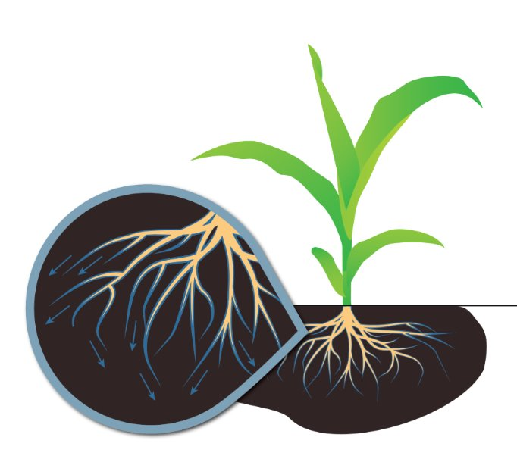
How it Works
Mycorrhizae provide season-long support
Mycorrhizae obtain moisture from areas in the soil that plants cannot access.​
.
Hyphae explore beyond the depletion zone for immobile nutrients, transporting them to the plant.
Mycorrhizal fungi increase the total surface area of the root mass, serving as a more efficient extension of the plant root system within the soil.​​

Slide 18
Application Information

Slide 19

General Application Guidelines
Results of AMF treatments largely depend on the success of application.​
Direct contact with the roots is essential – Propagules need root exudate to germinate.​
The earlier the application the greater the benefits (best timing is at planting).​
It takes 3-4 weeks for the symbiosis to establish. ​
High levels of fertility in the soil can temporarily inhibit mycorrhizal activity.​
Certain fungicides can negatively affect mycorrhizal activity (propiconzole, prothioconazole, captan, benomyl, folpet, triadimefon).​

Slide 20
Symvado Compatibility
A standard jar test is recommended before tank mixing. Always read and follow label instructions.
FRAC/IRAC | Chemical Class(es) | Active Ingredient(s) | Commercial Product | Compatibility Recommendation
4 | Phenylsmide | Metalaxyl | Allegiance® FL | Compatible
4A | Neonicotinoid | Imidacloprid | Gaucho® 600FS | Compatible
4A/22/3/4 | Neonicotinoid Thiazole-carboxamide Triazole Phenylamide | Clothianidin Ethaboxam Ipconazole Metalaxyl | Intego® Suite | Compatible

Slide 21
Application Rates & Timing
Crop Type | Use Rate | Application Timing
Soybeans | 0.26 fl oz per 100 lbs of seed | Seed treatment
Cotton | 0.32 fl oz per 100,000 seeds | Seed treatment
Rice (hybrid) | 0.65 fl oz per 100 lbs of seed | Seed treatment
Rice (conventional) | 0.19 fl oz per 100 lbs of seed | Seed treatment
Wheat | 0.19 fl oz per 100 lbs of seed | Seed treatment
Sunflower | 0.72 fl oz per 100 lbs of seed | Seed treatment
Corn | 0.35 fl oz per 80,000 seeds | Seed treatment
Sorghum | 0.35 fl oz per 100,000 seeds | Seed treatment

Slide 22

Registration Status:
Symvado ST
Registered
Not Registered
Registration status is subject to change and may vary by state.

Slide 23
Field Data

Slide 24
Soybeans

Slide 25
Symvado on Soybeans
SUMMARY
Across 20 trials in the Midwest, Symvado increased soybean yield by an average of 1.7 Bu/Ac
Symvado ST performed particularly well in TN and AR, with an average increase of 4.7 Bu/Ac
Symvado ST has been shown to significantly improve plant health and yield, especially under conditions prone to stress
Notes:
2021DDODG505

Slide 26

Symvado on Soybeans
Midwest Agricultural Research Center | Seymour, IL | 2021
OVERVIEW
CROP | Soybeans
DESIGN | Randomized Complete Block
CONCLUSION
Symvado was applied at planting in addition to a Grower Standard (GS) program and compared to the GS alone.
The addition of Symvado ST resulted in 2.9 bu/ac more yield than the GS.
GS + Symvado
LOCAL WEATHER SUMMARY
April - September
Temperature: 67.3°F
Precipitation:
Total Rainfall – 24.50”
Avg Monthly Rainfall – 4.08”
 | TREATMENT | RATE/ACRE | TIMING
 | Symvado ST | 0.26 fl oz/100 lbs seed | Seed Treatment
Notes:
2021DDODG505

Slide 27
Symvado on Soybeans
Midwest Agricultural Research Center | Seymour, IL | 2021
OVERVIEW
CROP | Soybeans
DESIGN | Randomized Complete Block
CONCLUSION
Symvado was applied at planting in addition to a Grower Standard (GS) program and compared to the GS alone.
The addition of Symvado ST resulted in 7.3 bu/ac more yield than the GS.
GS + Symvado
LOCAL WEATHER SUMMARY
April - September
Temperature: 67.3°F
Precipitation:
Total Rainfall – 24.50”
Avg Monthly Rainfall – 4.08”
 | TREATMENT | RATE/ACRE | TIMING
 | Symvado ST | 0.26 fl oz/100 lbs seed | Seed Treatment
Notes:
2021DDODG522

Slide 28

Symvado on Soybeans
Tech Services, Inc | Brookings, SD | 2022
OVERVIEW
CROP | Soybeans
DESIGN | Randomized Complete Block
CONCLUSION
Symvado was applied at planting in addition to a Grower Standard (GS) program and compared to the GS alone.
The addition of Symvado ST resulted in 2.4 bu/ac more yield than the GS.
GS + Symvado
LOCAL WEATHER SUMMARY
April - September
Temperature: 64.8°F
Precipitation:
Total Rainfall – 13.24”
Avg Monthly Rainfall – 2.21”
 | TREATMENT | RATE/ACRE | TIMING
 | Symvado ST | 0.26 fl oz/100 lbs seed | Seed Treatment
Notes:
2022DMCDU004

Slide 29

Symvado on Soybeans
Tech Services, Inc. | Marion, IN | 2022
OVERVIEW
CROP | Soybeans
DESIGN | Randomized Complete Block
CONCLUSION
Symvado was applied at planting in addition to a Grower Standard (GS) program and compared to the GS alone.
The addition of Symvado ST resulted in 5.2 bu/ac more yield than the GS.
GS + Symvado
LOCAL WEATHER SUMMARY
April - September
Temperature: 65.0°F
Precipitation:
Total Rainfall – 18.71”
Avg Monthly Rainfall – 3.12”
 | TREATMENT | RATE/ACRE | TIMING
 | Symvado ST | 0.26 fl oz/100 lbs seed | Seed Treatment
Notes:
2022DMCDU010

Slide 30

Symvado on Soybeans
Tech Services, Inc. | Janesville, WI | 2022
OVERVIEW
CROP | Soybeans
DESIGN | Randomized Complete Block
CONCLUSION
Symvado was applied at planting in addition to a Grower Standard (GS) program and compared to the GS alone.
The addition of Symvado ST resulted in 4.9 bu/ac more yield than the GS.
GS + Symvado
LOCAL WEATHER SUMMARY
April - September
Temperature: 63.2°F
Precipitation:
Total Rainfall – 20.56”
Avg Monthly Rainfall – 3.43”
 | TREATMENT | RATE/ACRE | TIMING
 | Symvado ST | 0.26 oz/100 lbs seed | Seed Treatment
Notes:
2022DMCDU012

Slide 31
Symvado on Soybeans
Tech Services, Inc. | Kirkwood, IL | 2022
OVERVIEW
CROP | Soybeans
DESIGN | Randomized Complete Block
CONCLUSION
Symvado was applied at planting in addition to a Grower Standard (GS) program and compared to the GS alone.
The addition of Symvado ST resulted in a 4.4 bu/ac increase in yield compared to the GS.
GS + Symvado
LOCAL WEATHER SUMMARY
April - September
Temperature: 72.4°F
Precipitation:
Total Rainfall – 13.3”
Avg Monthly Rainfall – 2.7”
 | TREATMENT | RATE/ACRE | TIMING
 | Symvado ST | 0.26 fl oz/100 lbs seed | Seed Treatment
Notes:
2022DMCDU013

Slide 32

Symvado on Soybeans
Tech Services, Inc. | Malta Bend, MO | 2022
OVERVIEW
CROP | Soybeans
DESIGN | Randomized Complete Block
CONCLUSION
Symvado was applied at planting in addition to a Grower Standard (GS) program and compared to the GS alone.
The addition of Symvado ST resulted in 1.9 bu/ac more yield than the GS.
GS + Symvado
LOCAL WEATHER SUMMARY
April - September
Temperature: 72.4°F
Precipitation:
Total Rainfall – 23.0”
Avg Monthly Rainfall – 4.6”
 | TREATMENT | RATE/ACRE | TIMING
 | Symvado ST | 0.26 fl oz/100 lbs seed | Seed Treatment
Notes:
2022DMCDU062

Slide 33
Rice

Slide 34

Symvado on Rice
Delta Crop Care & Research | Indianola, MS | 2018
OVERVIEW
CROP | Rice
DESIGN | Randomized Complete Block
CONCLUSION
Symvado was applied at planting in addition to a Grower Standard (GS) program and compared to the GS alone.
The addition of Symvado ST resulted in 146 lbs/ac more yield than the GS.
GS + Symvado ST
LOCAL WEATHER SUMMARY
April - September
Temperature: 78.2°F
Precipitation:
Total Rainfall – 20.0”
Avg Monthly Rainfall – 4.0”
 | TREATMENT | RATE/ACRE | TIMING
 | Symvado ST | 0.65 fl oz/100 lbs seed | Seed Treatment
Notes:
2018FCARE014

Slide 35
Symvado on Rice
Mississippi State University | Stoneville, MS | 2018
OVERVIEW
CROP | Rice
DESIGN | Randomized Complete Block
CONCLUSION
Symvado was applied at planting in addition to a Grower Standard (GS) program and compared to the GS alone. Treatments were evaluated under varying rates of triple super phosphate fertilizer.
Regardless of the rate of phosphate applied, rice treated with Symvado ST resulted in higher yields than the GS.
LOCAL WEATHER SUMMARY
April - September
Temperature: 79.0°F
Precipitation:
Total Rainfall – 27.1”
Avg Monthly Rainfall – 4.5”
 | TREATMENT | RATE/ACRE | TIMING
 | Symvado ST | 0.65 fl oz/100 lbs seed | Seed Treatment
Notes:
2018FCARE019

Slide 36
Corn

Slide 37

Symvado on Corn
KMR | Carroll, IA | 2015
OVERVIEW
CROP | Corn
DESIGN | Randomized Complete Block
CONCLUSION
Symvado was applied as a seed treatment in addition to a Grower Standard (GS) seed treatment program and compared to the GS alone.
Corn treated with Symvado ST + the Grower Standard had 13% greater yield than the GS.
LOCAL WEATHER SUMMARY
April - September
Temperature: 66.7°F
Precipitation:
Total Rainfall – 23.9”
Avg Monthly Rainfall – 4.0”
 | TREATMENT | RATE/ACRE | TIMING
 | Symvado ST | 0.35 fl oz per 80,000 seeds | Planting

Slide 38

Symvado on Corn
Real Farm Research | Aurora, NE | 2019
OVERVIEW
CROP | Corn
DESIGN | Randomized Complete Block
CONCLUSION
Symvado was applied as a seed treatment in addition to a Grower Standard (GS) seed treatment program and compared to the GS alone.
The addition of Symvado ST resulted in corn with a 17% greater yield than the GS.
LOCAL WEATHER SUMMARY
April - September
Temperature: 68.5°F
Precipitation:
Total Rainfall – 15.0”
Avg Monthly Rainfall – 2.5”
 | TREATMENT | RATE/ACRE | TIMING
 | Symvado ST | 0.35 fl oz per 80,000 seeds | Planting

Slide 39
Symvado on Corn
ABG Ag Service | Toronto, SD | 2016
OVERVIEW
CROP | Corn
DESIGN | Randomized Complete Block
CONCLUSION
Symvado was applied as a seed treatment in addition to a Grower Standard (GS) seed treatment program and compared to the GS alone.
Corn treated with Symvado ST + the Grower Standard had 9% greater yield than the GS.
LOCAL WEATHER SUMMARY
April - September
Temperature: 60.8°F
Precipitation:
Total Rainfall – 18.91”
Avg Monthly Rainfall – 3.15”
 | TREATMENT | RATE/ACRE | TIMING
 | Symvado ST | 0.35 fl oz per 80,000 seeds | Planting

Slide 40

Symvado on Corn
University of Georgia | Tifton, GA | 2017
OVERVIEW
CROP | Corn
DESIGN | Randomized Complete Block
CONCLUSION
Symvado was applied as a seed treatment in addition to a Grower Standard (GS) seed treatment program and compared to the GS alone.
Corn treated with Symvado ST + the Grower Standard had 29% greater yield than the GS.
LOCAL WEATHER SUMMARY
April - September
Temperature: 77.0°F
Precipitation:
Total Rainfall – 24.62”
Avg Monthly Rainfall – 4.10”
 | TREATMENT | RATE/ACRE | TIMING
 | Symvado ST | 0.35 fl oz per 80,000 seeds | Planting

Slide 41

Symvado on Corn
KMR | Carroll, MN | 2015
OVERVIEW
CROP | Corn
DESIGN | Randomized Complete Block
CONCLUSION
Symvado was applied as a seed treatment in addition to a Grower Standard (GS) seed treatment program and compared to the GS alone.
Corn treated with Symvado ST + the Grower Standard had 9% greater yield than the GS.
LOCAL WEATHER SUMMARY
April - September
Temperature: 64.3°F
Precipitation:
Total Rainfall – 18.0”
Avg Monthly Rainfall – 3.0”
 | TREATMENT | RATE/ACRE | TIMING
 | Symvado ST | 0.35 fl oz per 80,000 seeds | Planting

Slide 42
Symvado on Corn
Easton Ag | Cooper, IA | 2016
OVERVIEW
CROP | Corn
DESIGN | Randomized Complete Block
CONCLUSION
Symvado was applied as a seed treatment in addition to a Grower Standard (GS) seed treatment program and compared to the GS alone.
Corn treated with Symvado ST + the Grower Standard had 9% greater yield than the GS.
LOCAL WEATHER SUMMARY
April - September
Temperature: 67.8°F
Precipitation:
Total Rainfall – 25.4”
Avg Monthly Rainfall – 4.2”
 | TREATMENT | RATE/ACRE | TIMING
 | Symvado ST | 0.35 fl oz per 80,000 seeds | Planting

Slide 43

Symvado on Corn
Auburn University | Auburn, AL | 2017
OVERVIEW
CROP | Corn
DESIGN | Randomized Complete Block
CONCLUSION
Symvado was applied as a seed treatment in addition to a Grower Standard (GS) seed treatment program and compared to the GS alone.
Corn treated with Symvado ST + the Grower Standard had 11% greater yield than the GS.
LOCAL WEATHER SUMMARY
April - September
Temperature: 75.3°F
Precipitation:
Total Rainfall – 32.7”
Avg Monthly Rainfall – 5.45”
 | TREATMENT | RATE/ACRE | TIMING
 | Symvado ST | 0.35 fl oz per 80,000 seeds | Planting

Slide 44

Symvado on Corn
SGS | Troy, KS | 2016
OVERVIEW
CROP | Corn
DESIGN | Randomized Complete Block
CONCLUSION
Symvado was applied as a seed treatment in addition to a Grower Standard (GS) seed treatment program and compared to the GS alone.
Corn treated with Symvado ST + the Grower Standard had 9% greater yield than the GS.
LOCAL WEATHER SUMMARY
October – July
Temperature: 72.26°F
Precipitation:
Total Rainfall – 30.75”
Avg Monthly Rainfall – 6.15”
 | TREATMENT | RATE/ACRE | TIMING
 | Symvado ST | 0.35 fl oz per 80,000 seeds | Planting

Slide 45
Symvado on Corn
Southwest Seed | Hutchinson, KS | 2015
OVERVIEW
CROP | Corn
DESIGN | Randomized Complete Block
CONCLUSION
Symvado was applied as a seed treatment in addition to a Grower Standard (GS) seed treatment program and compared to the GS alone.
Corn treated with Symvado ST + the Grower Standard had 5% greater yield than the GS.
LOCAL WEATHER SUMMARY
April - September
Temperature: 72.8°F
Precipitation:
Total Rainfall – 27.56”
Avg Monthly Rainfall – 4.59”
 | TREATMENT | RATE/ACRE | TIMING
 | Symvado ST | 0.35 fl oz per 80,000 seeds | Planting

Slide 46
Symvado on Corn
University of Nebraska | Lincoln, NE | 2016
OVERVIEW
CROP | Corn
DESIGN | Randomized Complete Block
CONCLUSION
At two locations, Symvado was applied as a seed treatment in addition to a Grower Standard (GS) seed treatment program and compared to the GS alone.
Corn treated with Symvado ST + the Grower Standard had an average 0.8% greater yield over the GS.
LOCAL WEATHER SUMMARY
April - September
Temperature: 70.0°F
Precipitation:
Total Rainfall – 22.25”
Avg Monthly Rainfall – 3.71”
 | TREATMENT | RATE/ACRE | TIMING
 | Symvado ST | 0.35 fl oz per 80,000 seeds | Planting

Slide 47
Symvado on Corn
University of Nebraska | Scottsbluff, NE | 2016
OVERVIEW
CROP | Corn
DESIGN | Randomized Complete Block
CONCLUSION
Symvado was applied as a seed treatment in addition to a Grower Standard (GS) seed treatment program and compared to the GS alone.
Corn treated with Symvado ST + the Grower Standard had 4% greater yield than the GS.
LOCAL WEATHER SUMMARY
April - September
Temperature: 64.2°F
Precipitation:
Total Rainfall – 8.39”
Avg Monthly Rainfall – 1.40”
 | TREATMENT | RATE/ACRE | TIMING
 | Symvado ST | 0.35 fl oz per 80,000 seeds | Planting

Slide 48
Symvado on Corn
Precision Ag Research | Grimes, IA | 2015
OVERVIEW
CROP | Corn
DESIGN | Randomized Complete Block
CONCLUSION
Symvado was applied as a seed treatment in addition to a Grower Standard (GS) seed treatment program and compared to the GS alone.
Corn treated with Symvado ST + the Grower Standard had 3% greater yield than the GS.
LOCAL WEATHER SUMMARY
October – July
Temperature: 68.9°F
Precipitation:
Total Rainfall – 31.91”*
Avg Monthly Rainfall – 5.32”
*June and July contributed 15.57” of the total rainfall
 | TREATMENT | RATE/ACRE | TIMING
 | Symvado ST | 0.35 fl oz per 80,000 seeds | Planting

Slide 49
Symvado on Corn
University of Nebraska | Scottsbluff, NE | 2015
OVERVIEW
CROP | Corn
DESIGN | Randomized Complete Block
CONCLUSION
Symvado was applied as a seed treatment in addition to a Grower Standard (GS) seed treatment program and compared to the GS alone.
Corn treated with Symvado ST + the Grower Standard had 6% greater yield than the GS.
LOCAL WEATHER SUMMARY
May - October
Temperature: 64.9°F
Precipitation:
Total Rainfall – 17.82”
Avg Monthly Rainfall – 2.97”
 | TREATMENT | RATE/ACRE | TIMING
 | Symvado ST | 0.35 fl oz per 80,000 seeds | Planting

Slide 50
Symvado on Corn
MidSouth Research and Extension | Leland, MS | 2019
OVERVIEW
CROP | Corn
DESIGN | Randomized Complete Block
CONCLUSION
Symvado was applied as a seed treatment in addition to a Grower Standard (GS) seed treatment program and compared to the GS alone.
Corn treated with Symvado ST + the Grower Standard had 2% greater yield than the GS.
LOCAL WEATHER SUMMARY
May - October
Temperature: 78.0°F
Precipitation:
Total Rainfall – 32.0”*
Avg Monthly Rainfall – 5.3”
*2019 was an exceptionally wet year, with 81.9” of total rainfall compared to a yearly avg of 55.4”
 | TREATMENT | RATE/ACRE | TIMING
 | Symvado ST | 0.35 fl oz per 80,000 seeds | Planting

Slide 51
Symvado on Corn
ABG Ag Service | Sheridan, IN | 2019
OVERVIEW
CROP | Corn
DESIGN | Randomized Complete Block
CONCLUSION
Symvado was applied as a seed treatment in addition to a Grower Standard (GS) seed treatment program and compared to the GS alone.
Corn treated with Symvado ST + the Grower Standard had 1% greater yield than the GS.
LOCAL WEATHER SUMMARY
May - October
Temperature: 69.9°F
Precipitation:
Total Rainfall – 25.0”
Avg Monthly Rainfall – 4.2”
 | TREATMENT | RATE/ACRE | TIMING
 | Symvado ST | 0.35 fl oz per 80,000 seeds | Planting

Slide 52
Contains MycoApply arbuscular mycorrhizal fungi for season long plant benefits.
Right time, right place application improves:
  Increased root mass
  Enhance nutrient uptake
  Drought stress tolerance
Increase Root Mass
Enhance Nutrient Uptake
Improve Drought Tolerance

