Slide 1
K-Surge®
Training Deck

Slide 2
K-Surge®
Training Summary
1
Product Overview
2
Mode of Action
3
Application Information
4
Field Data

Slide 3
Product Overview

Slide 4

K-Surge®
Nutrient
K-Surge® is a potassium acetate product built with our Transit® biostimulant, designed for high nutrient mobility and uptake within the plant. Using targeted organic acids to improve nutrient uptake and mobility, K-Surge supports superior sugar and water transport in plants for fruit development and quality.

Slide 5


Features & Benefits
K-Surge
Improved Water Uptake
Increased Brix
Contributes to enhanced potassium mobility to support plant water regulation and berry firmness.
Increases sugar translocation to the grape for superior berry Brix.

Slide 6
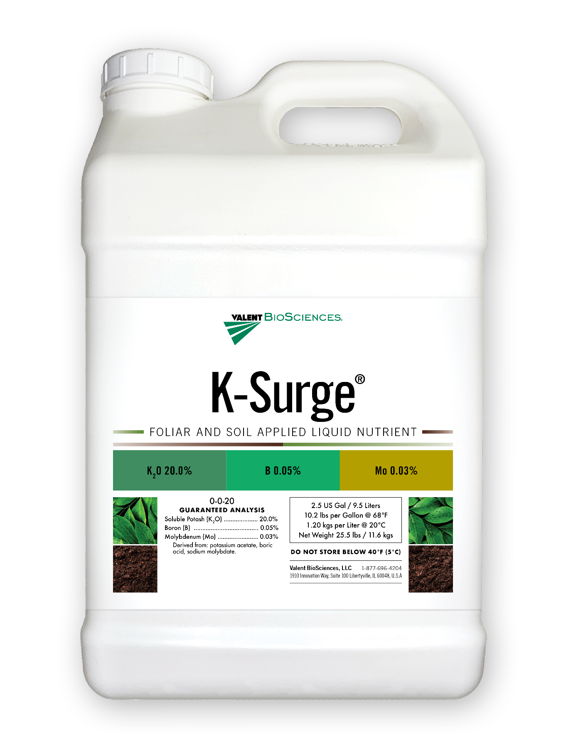

Guaranteed Analysis
K-Surge
Guaranteed Analysis: Soluble Potash (K₂O) ............................................ 20.0% Boron (B) ............................................................... 0.05% Molybdenum (Mo) .................................................. 0.03%
Derived from: Potassium acetate, boric acid, and sodium molybdate

Slide 7
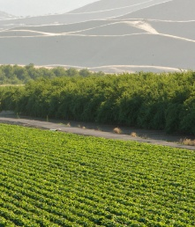
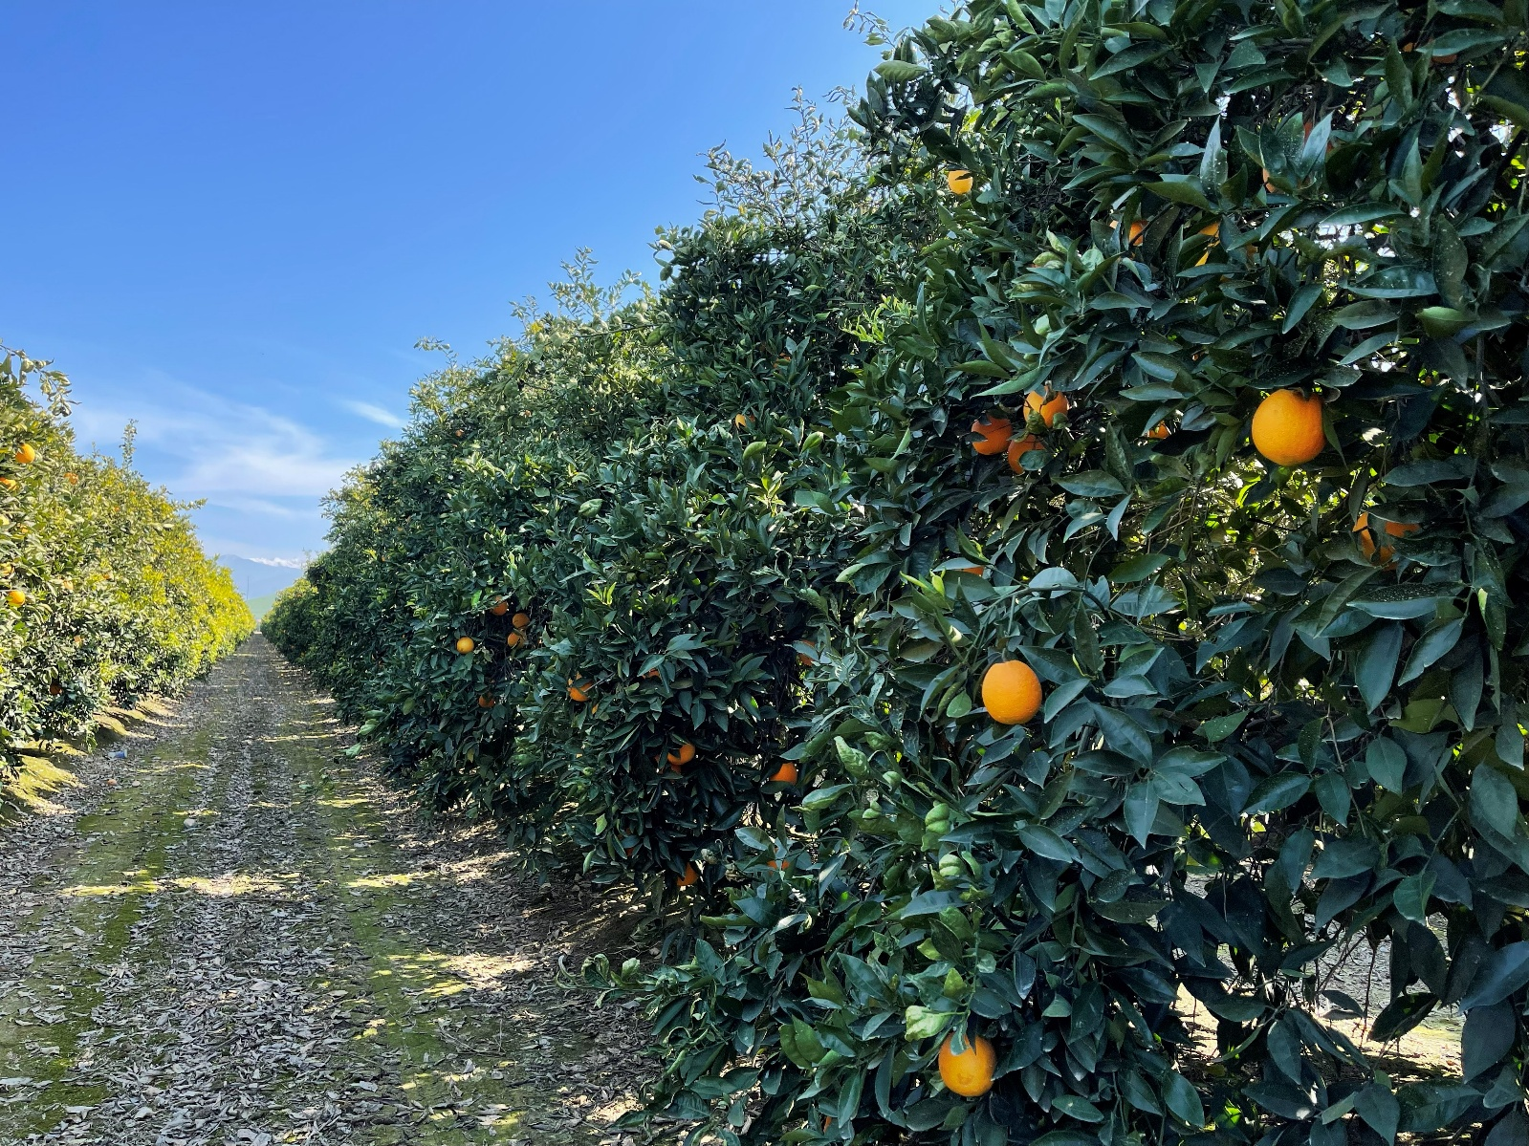
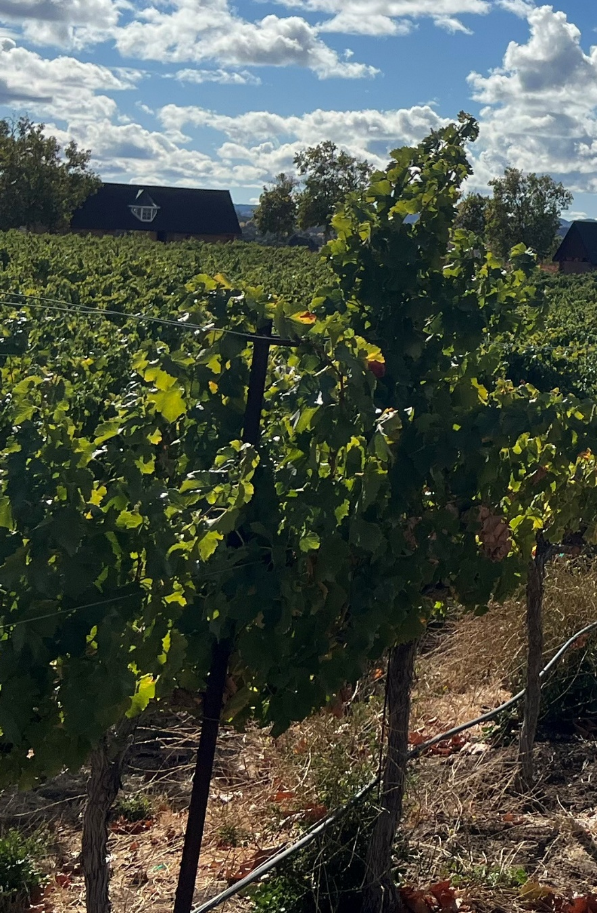
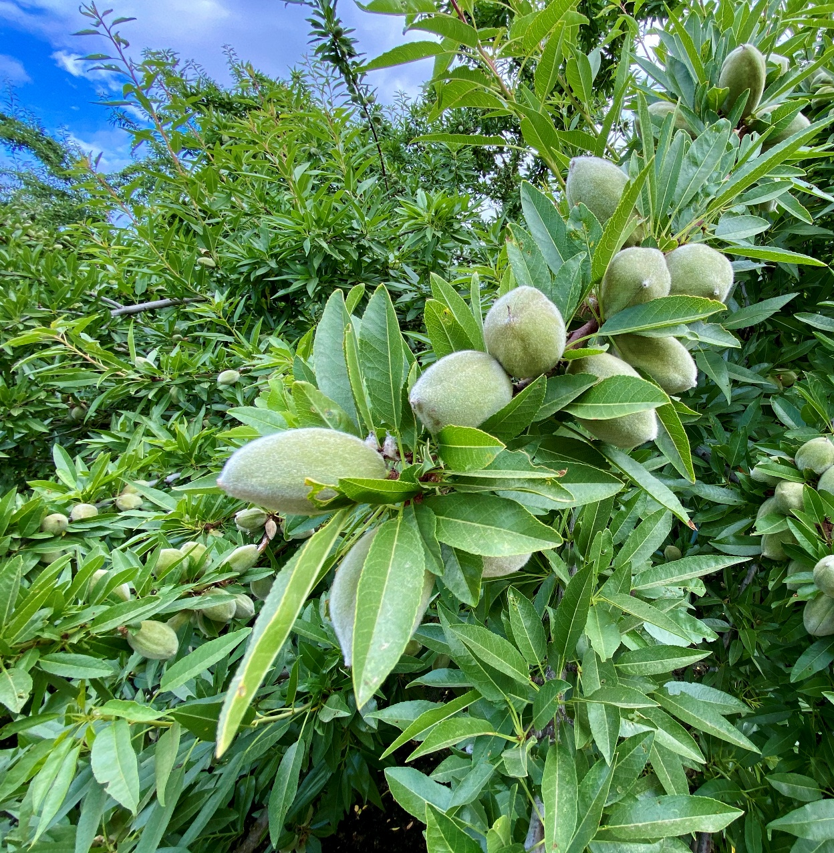
K-Surge
Formulation | Soluble Liquid
Package Size | 2.5 Gal, 275 Gal
Application | Foliar, Soil
Target Crops | Tree fruit, tree nuts, fruiting vegetables
Application Rates | Foliar: 1 – 6 qt/ac
 | Soil: 1 – 5 gal/ac
Uses | Conventional
Shelf Life | 2 Years

Slide 8
Mode of Action

Slide 9

What is Transit?
Unique highly bioactive compound
Targeted mixture of thousands of bioactive compounds
Transit is the result of a proprietary extraction method that uses early-stage biomass
It contains natural, biologically active, and diverse functional groups
Bioactive compounds in Transit have high oxygen to carbon ratios to enhance biological activity in plants
Humic substances
Humins
B vitamins
Fulvic acids
Acids
Inorganic salts
Proteins
Amino acids
Other organic acids
Mycorrhizae, Trichoderma, other beneficial fungi
Protein hydrolysates
Fatty acids/lipids
Beneficial elements (Si, Na, Co, etc.)
Other
PGPRs
Cytokinins
Microbials
Nitrogenous
compounds
Polyamines
Peptides
Rhizobium
Phosphites
Betaines
Polyphenols
Complex communities/
consortia
Enzymatic extracts
Chitin/ chitosan
Seaweed/kelp
Phytohormones
Extracts
Laminarin, alginates, other polysaccharides
Other organic matters extracts
Botanicals
Allelochemicals

Slide 10
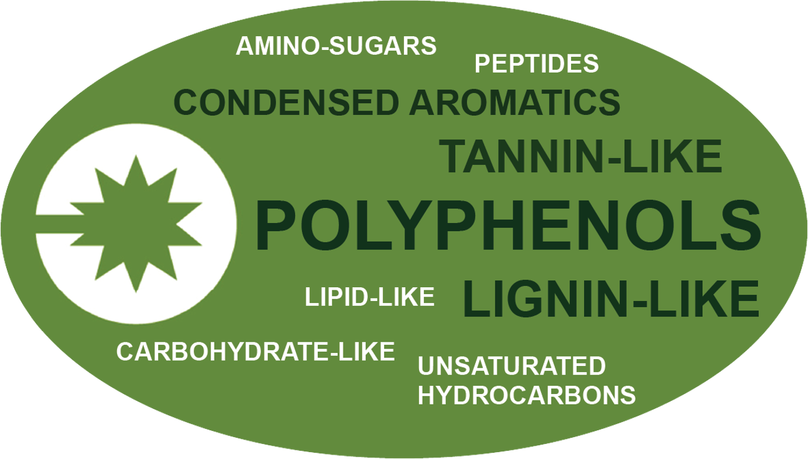
Transit Technology
What is it made of?
Key, diverse functional groups that are biologically active in plants

Slide 11

Transit® Mode of Action
Plant Response to Transit
Benefit | How
Improved Nutrient Mobility | Down regulation of binding proteins to improve nutrient translocation of non-mobile nutrients.

Slide 12
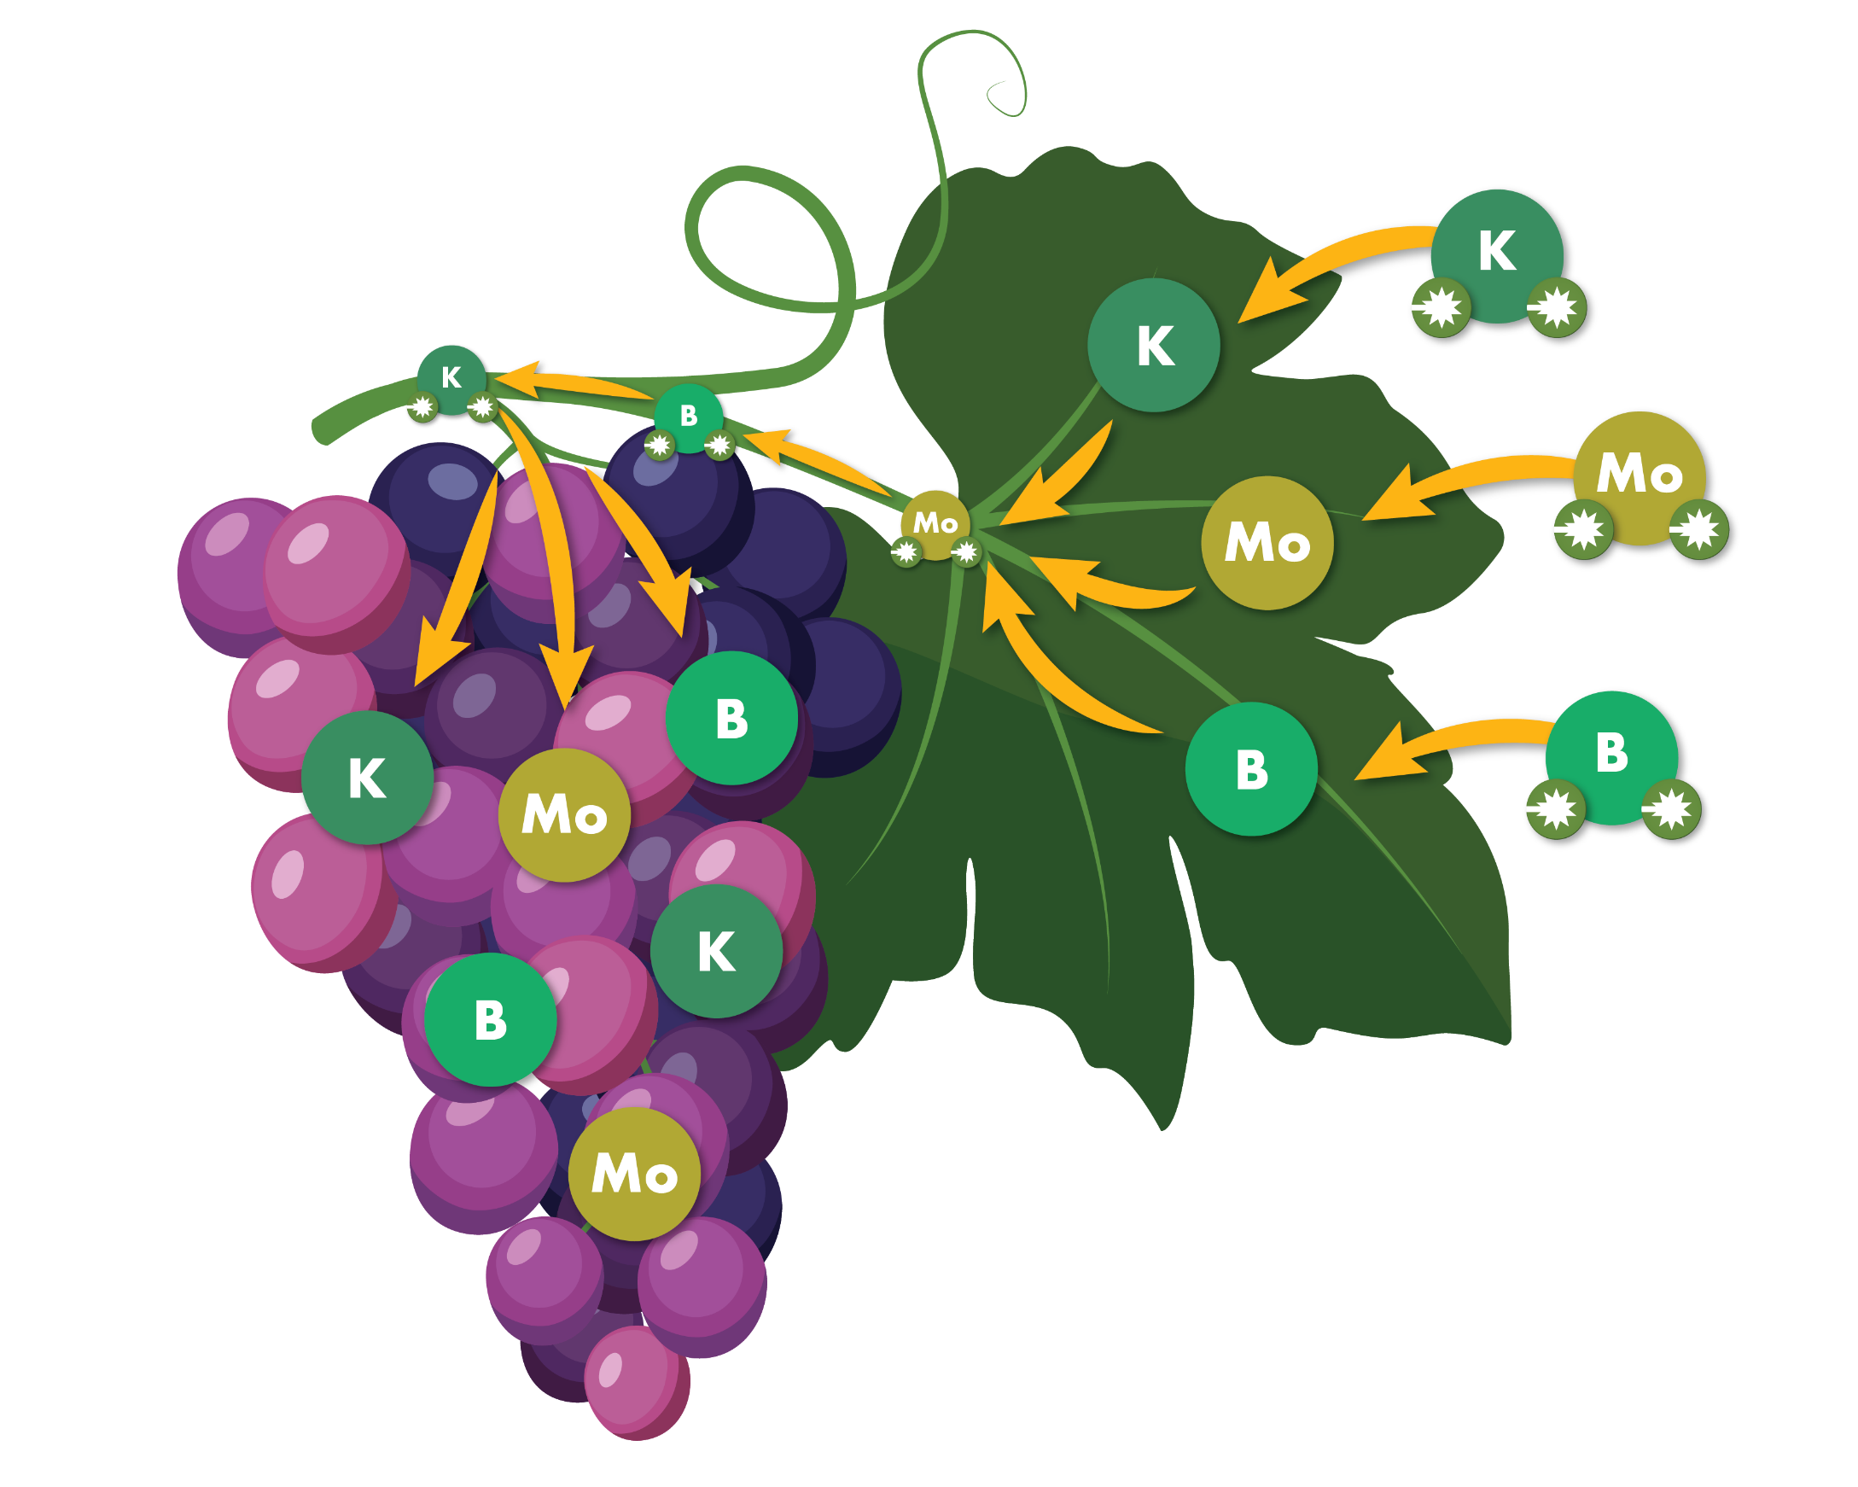
How it Works
Transit Biostimulant enhances nutrition

Slide 13

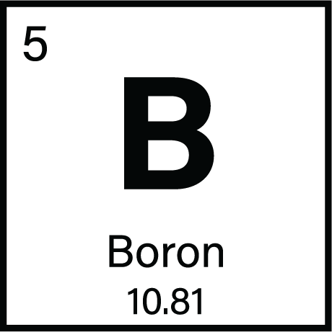
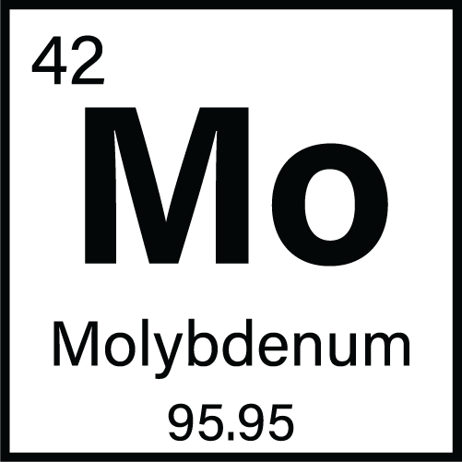
Key Roles of Nutrients on Crop Development
Potassium supports sugar metabolism and translocation of sugars from leaves to fruiting bodies. It also supports osmotic regulation, aiding fruit firmness.
Boron increases the rate of sugar transport in the plant to facilitate enhanced sugar concentration in the fruit.
Molybdenum aids nitrogen fixation and utilization thereby enabling efficient use of potassium in the plant.

Slide 14
Application Information

Slide 15

General Application Guidelines
Can be utilized with many common fungicides, insecticides, and fertilizers
  A standard jar test is recommended before tank mixing
  Recommended mixing sequence: water, adjuvants, pesticides, K-Surge, other fertilizers, balance of water while agitating
If K-Surge is blended with other products, always mix prior to application
Maintain continuous agitation during application
Use as fine of a spray mist as possible
DO NOT spray in the heat of the day or when the plant is under moisture stress
DO NOT spray to the point of runoff
DO NOT irrigate 3-4 hours after application or apply if rainfall is expected within 3-4 hours

Slide 16
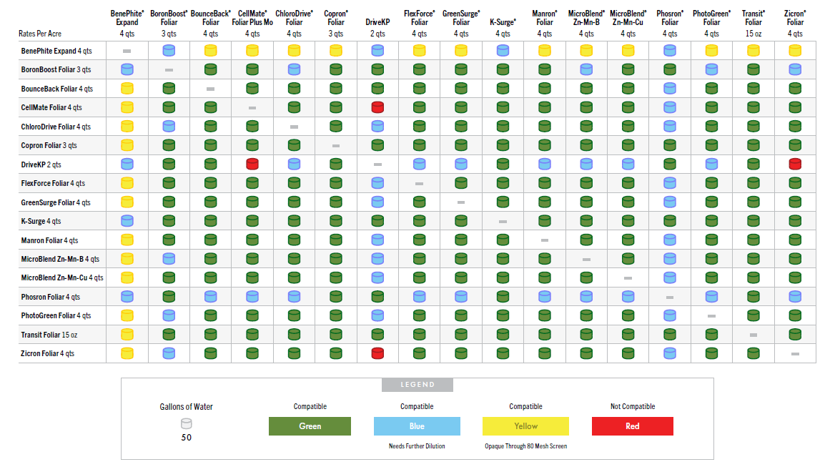
K-Surge Compatibility
A standard jar test is recommended before tank mixing. Always read and follow label instructions.

Slide 17
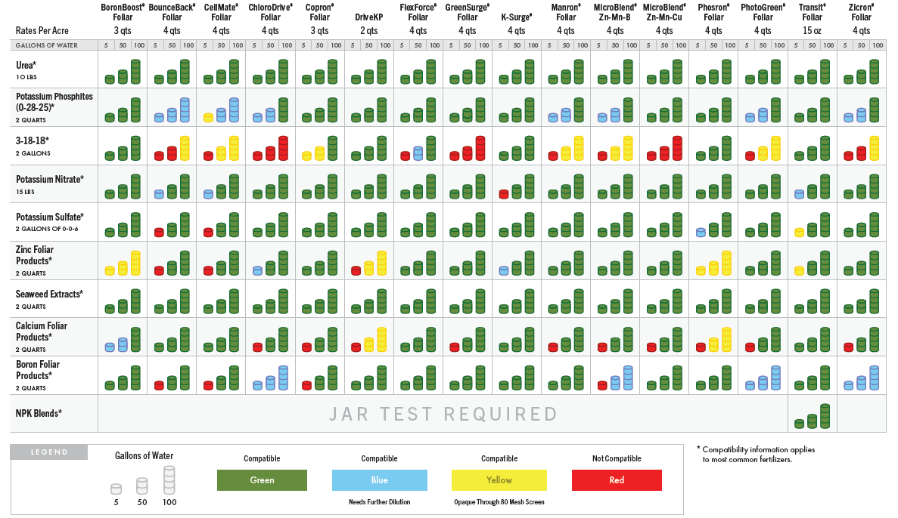
K-Surge Compatibility
A standard jar test is recommended before tank mixing. Always read and follow label instructions.

Slide 18
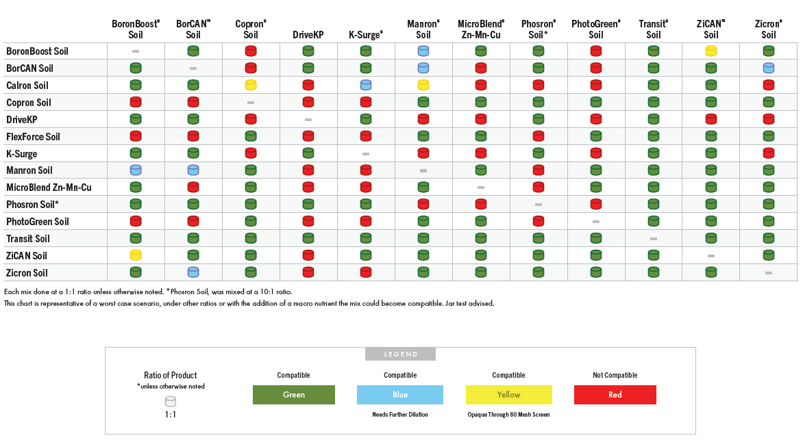
K-Surge Compatibility
A standard jar test is recommended before tank mixing. Always read and follow label instructions.

Slide 19
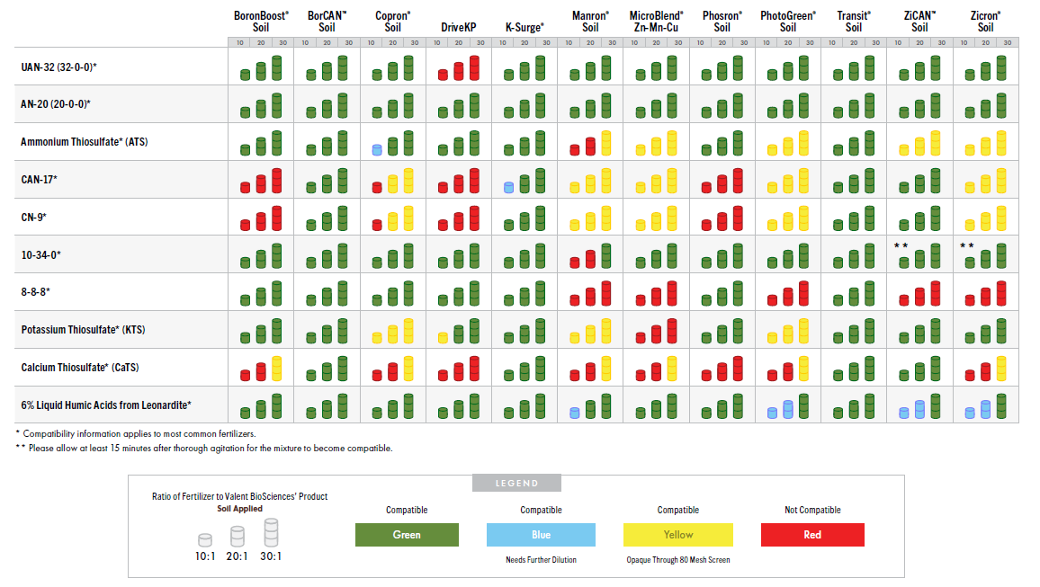
K-Surge Compatibility
A standard jar test is recommended before tank mixing. Always read and follow label instructions.

Slide 20
Application Rates & Timing
Crop/Application Type | Use Rate/Acre | Application Timing
Vines | 1-2 qt/ac | Every 14-21 days after veraison
Foliar | 1-6 qt/ac | Apply any time during the growing season; repeat as needed.
Soil | 1-5 gal/ac | Apply any time during the growing season; repeat as needed.

Slide 21
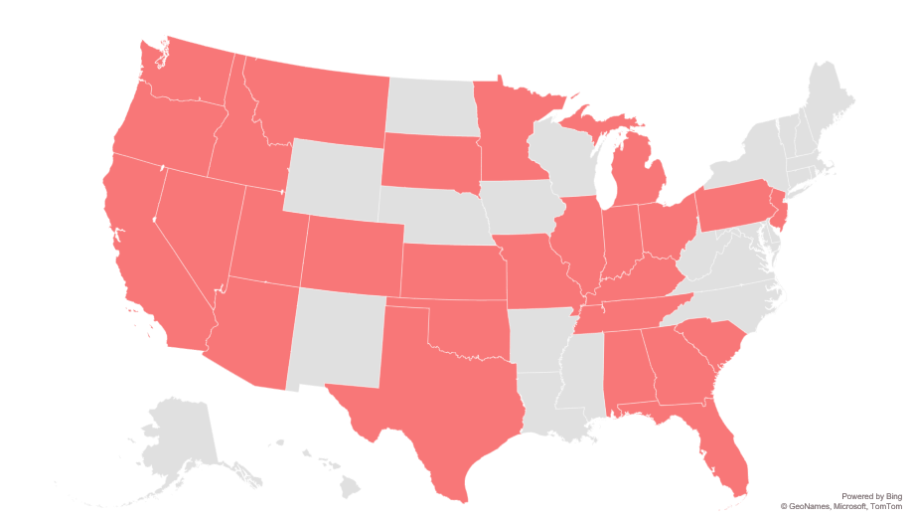
Registration Status:
K-Surge
Registered
Not Registered
Registration status is subject to change and may vary by state.

Slide 22
Field Data

Slide 23

K-Surge Increased Yield in Processing Tomatoes
Grower | Lodi, CA | 2022
OVERVIEW
CROP | Processing Tomatoes
DESIGN | Commercial Split Field
CONCLUSION
K-Surge was applied in addition to a Grower Standard (GS) program and compared to the GS alone.
The addition of K-Surge resulted in an additional 3.7 tons/ac more yield as compared to the GS alone.
LOCAL WEATHER SUMMARY
April - September
Temperature: 73.7°F
Precipitation:
Total Rainfall – 0.87”
Ave Monthly Rainfall – 0.14”
 | TREATMENT | RATE/ACRE | TIMING
 | K-Surge | 2 qt/ac | May, June

Slide 24

K-Surge Increased Yield in Hazelnuts
Retailer | Hubbard, OR | 2021
OVERVIEW
CROP | Hazelnuts
VARIETY | Barcelona and Enis
DESIGN | Commercial Split Field
CONCLUSION
K-Surge was applied in addition to a Grower Standard (GS) program and compared to the GS alone.
The addition of K-Surge resulted in an additional 156 lbs/ac more marketable hazelnut yield as compared to the GS alone.
LOCAL WEATHER SUMMARY
April - October
Temperature: 63.4°F
Precipitation:
Total Rainfall – 9.57”
Ave Monthly Rainfall – 1.37”
 | TREATMENT | RATE/ACRE | TIMING
 | K-Surge | 2 qt/ac | May, June

Slide 25
Contains Transit biostimulant for enhanced nutrient mobility
Right time, right place application improves:
  Improved Water Uptake
  Increased Brix
Improved Water Uptake
Increased Brix

