Slide 1
Symvado® Granular
Sales Presentation
Name
Date

Slide 2

Symvado® Granular
Mycorrhizal Inoculant​
Symvado Granular is a mycorrhizal inoculant that is pelletized so that it can be placed directly in the hopper box for planting. Symvado Granular is powered by MycoApply® Arbuscular Mycorrhizal Fungi (AMF). Symvado Granular extends the root absorption area by up to 50x for season-long access to nutrients and water.

Slide 3
Symvado Granular: Overview
Enhances the root absorption area, resulting in increased nutrient and water uptake and efficiency
Positively impacts the soil environment for improved soil structure and water holding capacity
Packaged for ease of application at planting
Contains MycoApply arbuscular mycorrhizal fungi

Slide 4




Features & Benefits
Symvado Granular Mycorrhizal Inoculant at Planting
Extended Root Area
Nutrient Absorption
Water Holding Capacity
Plant Establishment
Hyphae create a fungal network that extends root absorption area up to 50x
Hyphae increase access to water and nutrients, reaching micropores inaccessible by root hairs
Glomalin produced by fungal network contribute to increased soil aggregation for better water holding capacity
Enhanced root absorption area and increased nutrient and water uptake improve plant establishment

Slide 5
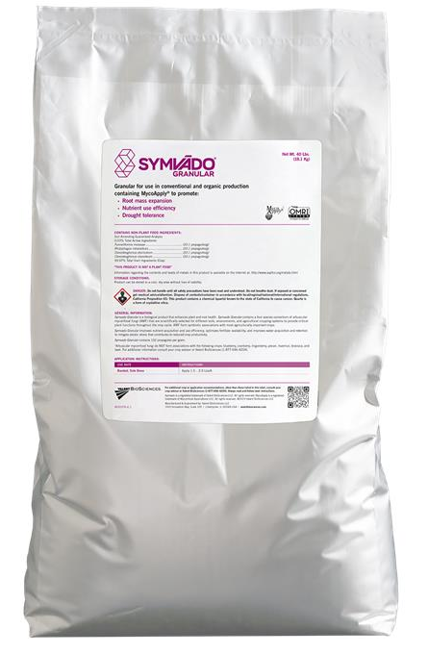


Specifications
Symvado Granular
0.03% Total Active Ingredients Funneliformis mosseae ............................... (33.1 propagules/g) Rhizophagus intraradices............................ (33.1 propagules/g) Claroideoglomus etunicatum ....................... (33.1 propagules/g) Claroideoglomus claroideum ....................... (33.1 propagules/g) 99.97% Total Inert Ingredients (Clay as carrier)

Slide 6
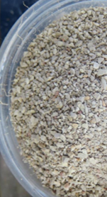
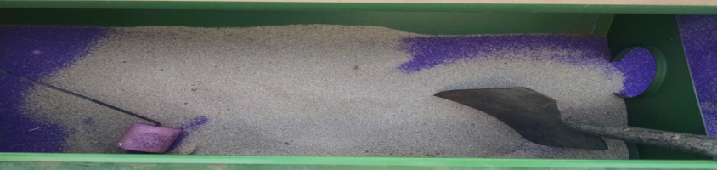
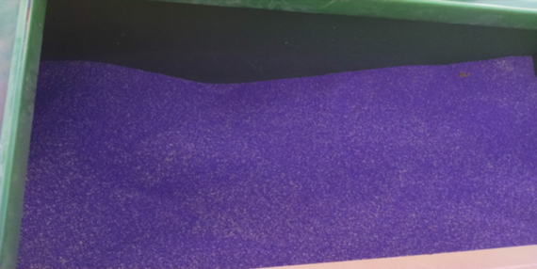
Application Rates & Timing
Crop Type | Use Rate/Acre | Application Timing
Alfalfa | 2 lbs per acre | Thoroughly mix with alfalfa seed; adjust planting rate to maintain desired seeding population.
Hopper Box – Blending Symvado Granular with seed

Slide 7
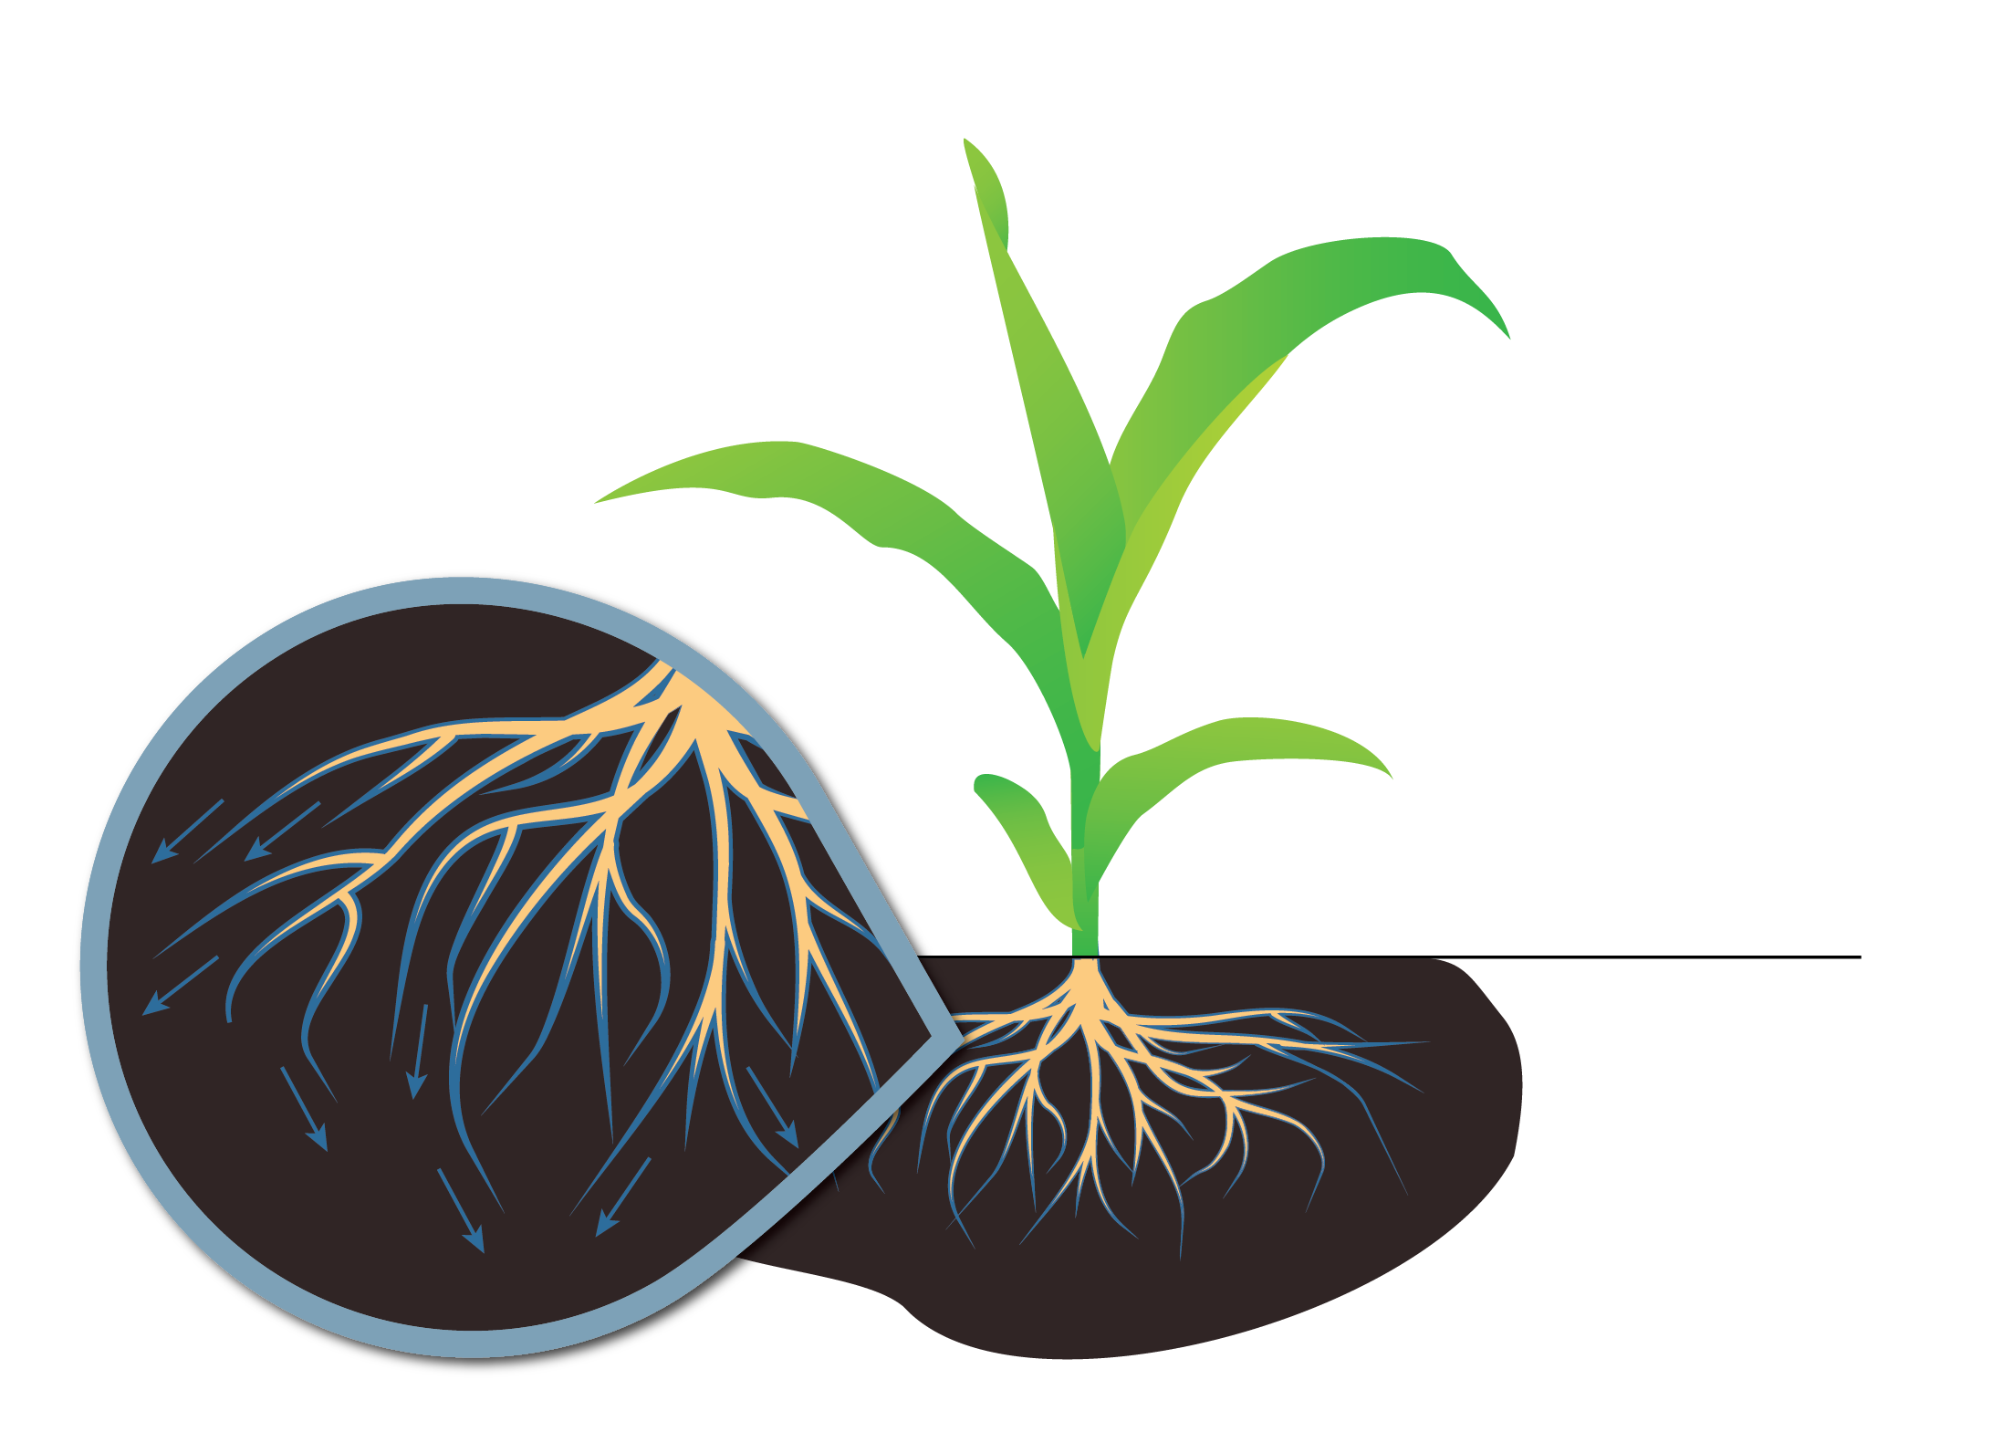
How it works
Symvado Granular drives mycelial growth to extend the root zone up to 50x further.

Slide 8
Symvado® Granular - Alfalfa Yield Summary
Across twenty-three site locations, 78% of applications of Symvado Granular resulted in a positive yield response
Symvado Granular increased yield on average 247 lbs/cutting compared to the UTC

Slide 9
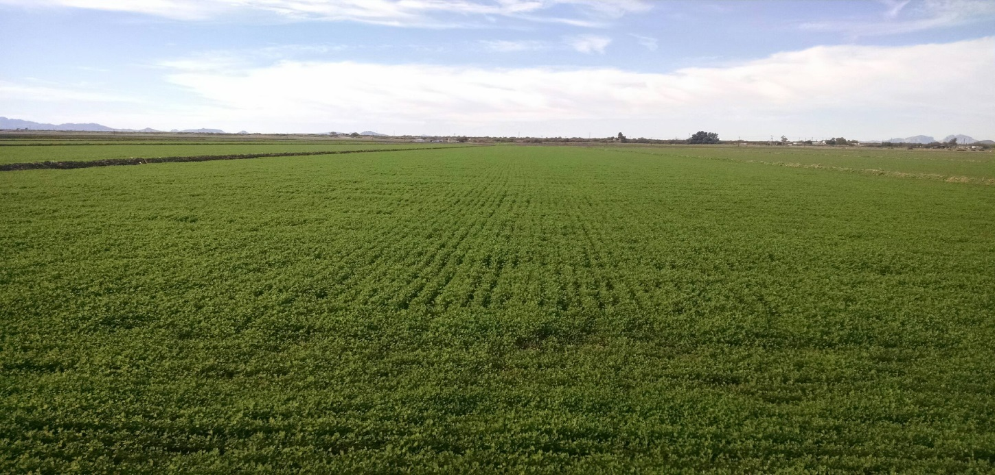
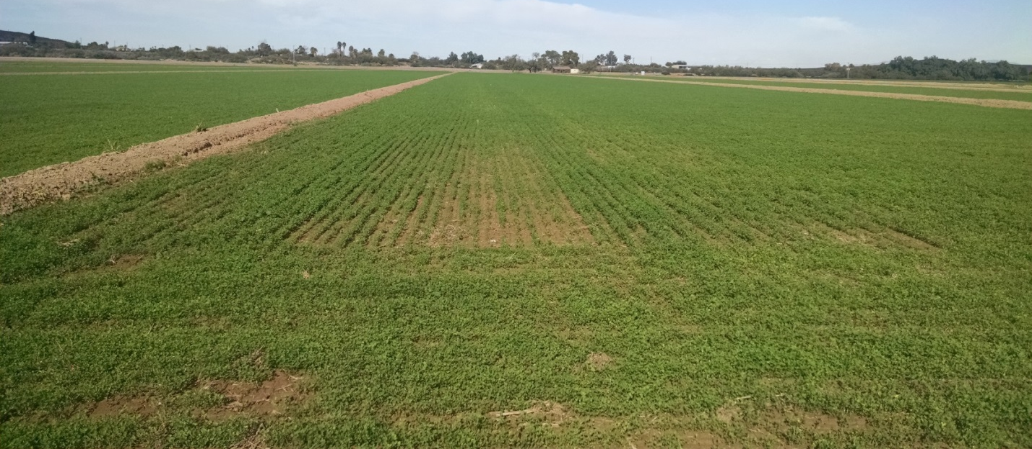
Alfalfa Trial – 30 DAP
Alfalfa planted Oct. 6th; Photo from Nov. 9th
Location: Buckeye, AZ
Symvado Granular
Untreated

Slide 10
Alfalfa Yield Summary
Symvado Granular applied at 1.5 lbs/A at planting
Harvest Dates: 5/20/16, 6/15/16
Location: Yuma, AZ

Slide 11
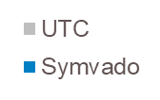
Alfalfa Yield Summary
Symvado Granular applied at 1.5 lbs/A at planting on Oct. 30th
Location: Buckeye, AZ
7 Cuttings resulted in 1,516 lb/acre increase in Symvado treated area vs UTC (12% yield increase)

Slide 12
Alfalfa Feed Analysis
Across three different trial sites (Miranda, Buckeye, Yuma) the average changes to feed quality were minimal

Slide 13



Extended Root Area
247 lb increase in alfalfa yield when compared to the UTC
Consistent results across cuttings
Maintains feed quality
Extends the root absorption area by up to 50x for season-long access to nutrients and water
Nutrient Absorption
Water Holding Capacity
Plant Establishment

Slide 14
Thank You

