Slide 1
BenePhite® Expand
Sales Presentation
Name
Date

Slide 2

BenePhite Expand
P₂O₅ 19.0%, Co 0.05%, Fe 0.75%, Mn 1.75%, Mo 0.10%, Zn 4.0%
BenePhite Expand is a phosphorus product built with Transit® biostimulant. By pairing phosphite, a highly plant-available form of phosphorus, with organic acids and key complementary nutrition, BenePhite Expand delivers a readily available nutritive boost to enhance photosynthetic activity for improved canopy development and fruit quality.
Increased canopy development
Improved fruit quality
Reduced risk of phytotoxicity

Slide 3
BenePhite Expand: Overview
Contains Transit organic acids and complementary nutrition
Superior foliar formulation for leaf penetration
Increases canopy development
Improves fruit quality
Reduced risk of phytotoxicity

Slide 4




Features & Benefits
BenePhite Expand
Improved fruit quality
Enhanced Canopy Development
Optimized Formulation
Enhances phosphate mobility for increased cell wall strength to support fruit firmness.
Supports new leaf growth for robust canopy development.
Formulated to reduce the risk of phytotoxicity.
Notes:
Mg, Zn are non-mobile in plants

Slide 5
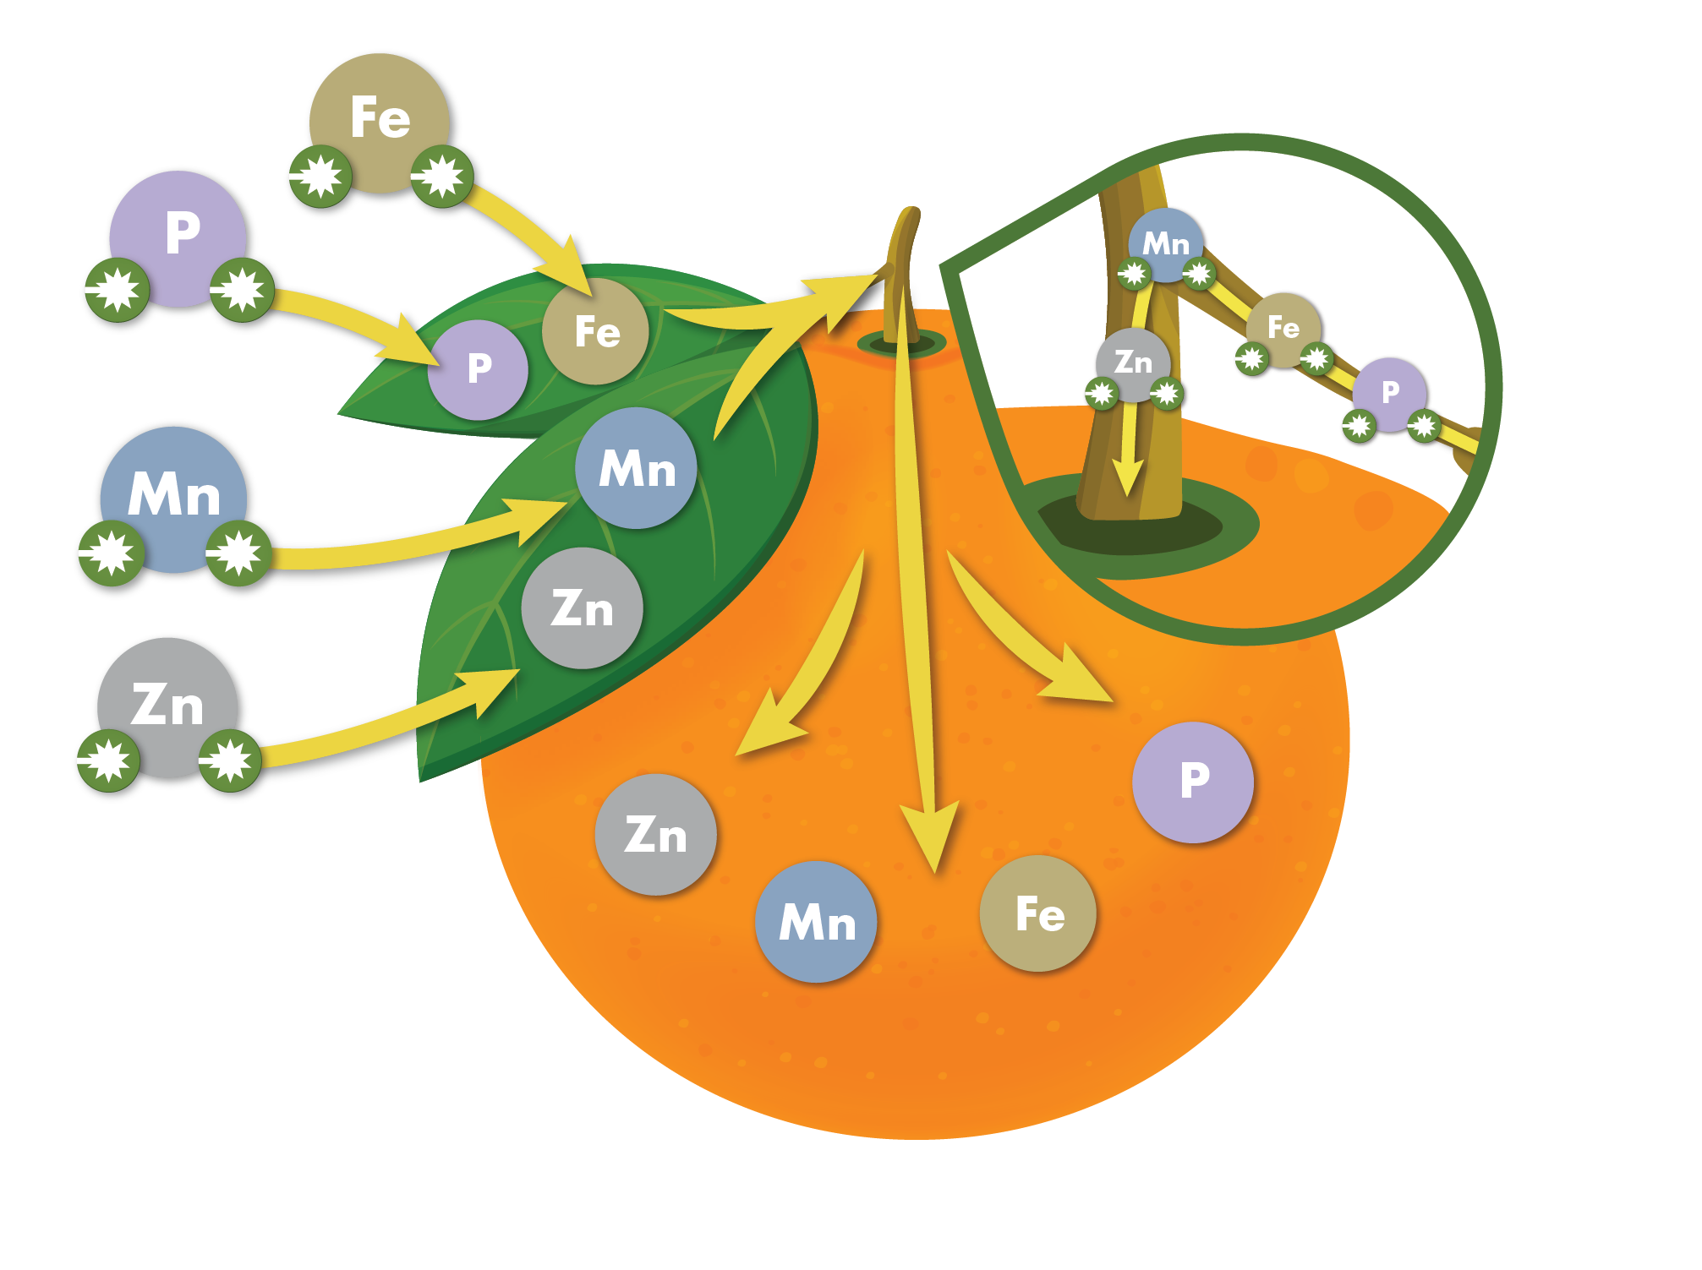
How it Works

Slide 6
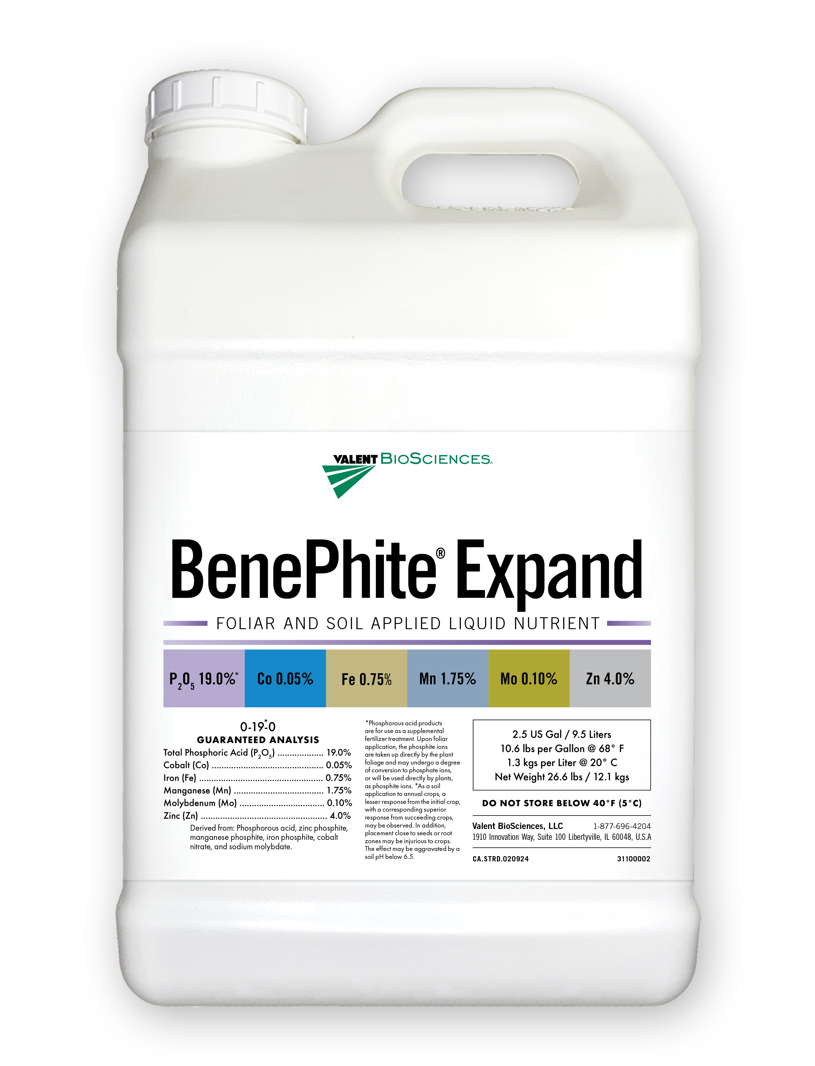

Specifications
Benephite Expand
Guaranteed Analysis: Total Phosphoric Acid (P₂O₅)…............................ 19.0% Cobalt (Co) …….................................................... 0.05% Iron (Fe) ……........................................................ 0.75% Manganese (Mn) ……........................................... 1.75% Molybdenum (Mo) ……......................................... 0.10% Zinc (Zn) ……......................................................... 4.0%
Derived from: Phosphorous acid, zinc phosphite, manganese phosphite, iron phosphite, cobalt nitrate, and sodium molybdate.

Slide 7
Application Rates & Timing
Crop Type | Use Rate/Acre | Application Timing
BenePhite Expand Foliar | 0.5 – 4.0 qt/ac | Repeat every 2-3 weeks
BenePhite Expand Soil | 2 – 6 qt/ac | Repeat every 2-3 weeks

Slide 8
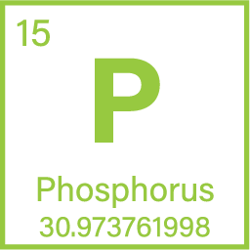
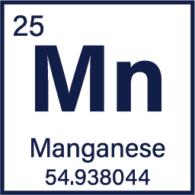
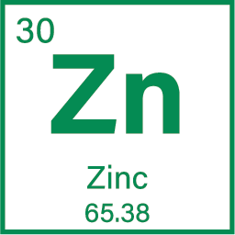
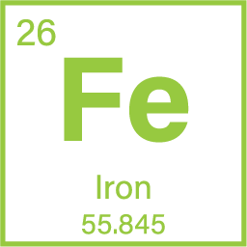
BenePhite Expand: Key Nutrition
Phosphorous contributes to the production of strong tissues and structural integrity, supporting the weight of developing fruit and ensuring fruit is healthy and matures properly.
Manganese supports energy utilization, photosynthetic electron transfer, and nitrogen and auxin metabolism to enhance photosynthesis and canopy development
Zinc improves photosynthetic efficiency. It is needed for the formation of chlorophyll, enzyme activation for photosynthetic pathways, and stomatal regulation.
Iron supports chlorophyll formation and photosynthesis to support vigorous canopy development.

Slide 9




19.0% P, 0.05% Co, 0.75% Fe, 1.75% Mn, 0.10% Mo, 4.0% Zn
Improved Fruit Quality
Delivers a readily available nutritive boost to enhance photosynthetic activity for improved canopy development and fruit quality, with reduced risk of phytotoxicity
Enhanced Canopy Development
Optimized Formulation

Slide 10
Thank You

